Slide 1



SUPER BRUTE
Group C: Sponsor:
Andrew Melvin Herbert gingold
Hesham Zidan RV intelligence
Lucy Golebiewski
Nader Abd El rasol

Slide 2

SUPER BRUTE
The newest version Husky Brute by Husky Towing
Updated and streamlined to reduce reliance on mechanical components by using electrical alternatives
Cost of production decreased
New features for the latest model include external LEDs and floodlight ports for simple plug and play use

Slide 3

Project goals
The Ability to retract and extend the Jack through the Android/IOS app.
Physical controls on the Jack itself.
The Ability to control RGB lights through the app.
Safety features to protect the user and the device. (motion sensing, direction of rotation sensing, connection timeout shut-off, mechanical brake)

Slide 4
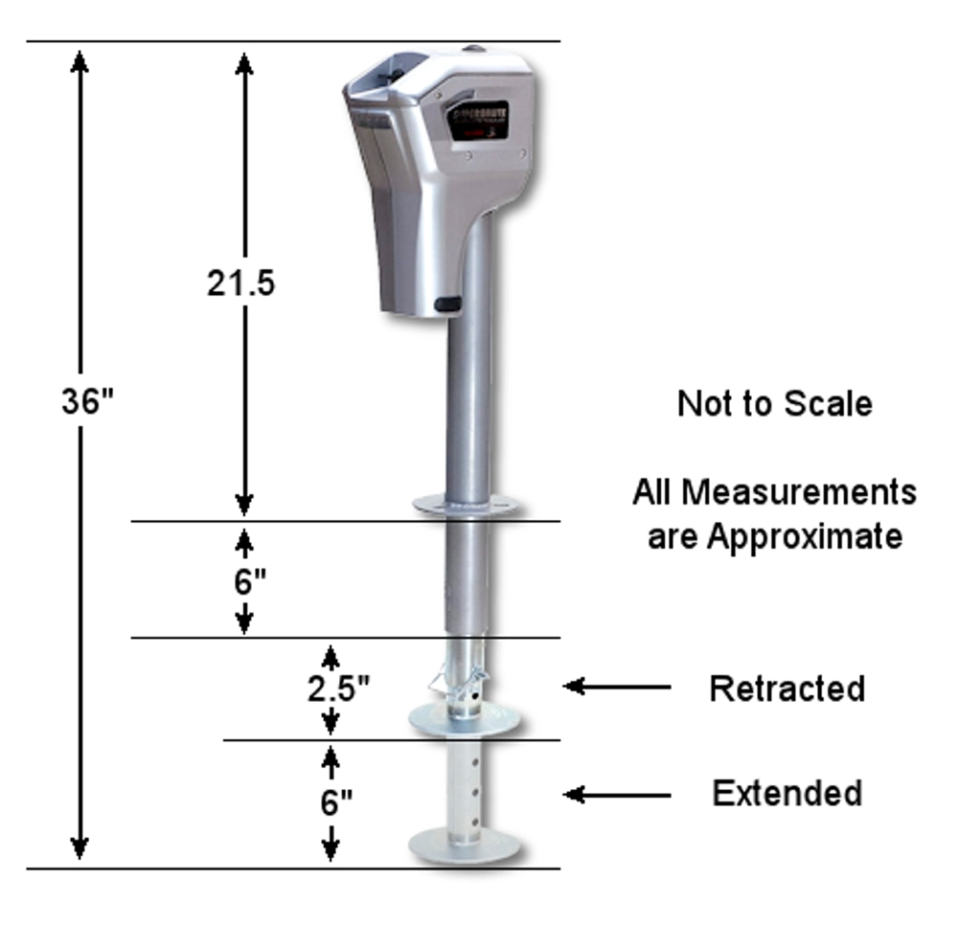
Specifications
Brushed DC motor
12v operating voltage.
20A – 30A operating current
60A destruction current
Lifting capacity 5000lbs
Bluetooth Low Energy 50ft radius
Trailer wiring connector
4 pin mate and lock connector

Slide 5
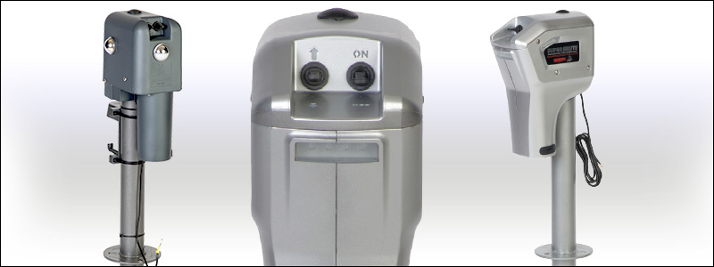

Design Approach
Influenced by
Sponsor, RV Intelligence
Customer, Husky Towing
Functions needed:
Motor control
Bluetooth
Leveling
PCB must fit inside pre-existing Husky RV Jacks.

Slide 6
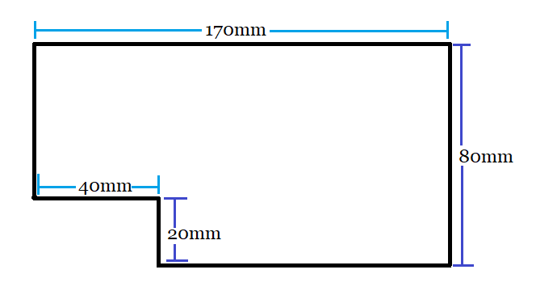




Design Approach
Motor Control
Multi MOSFET Driver IC - TLE92108
Hall Effect Latch with Hall Sensor (HES) - AH3774
Brushed DC Motor provided by Husky Towing
Bluetooth
Bluetooth Low Energy wireless module - CYBLE-212006-01
Leveling
Accelerometer – BMA456
The entire system must fit within these dimensions

Slide 7
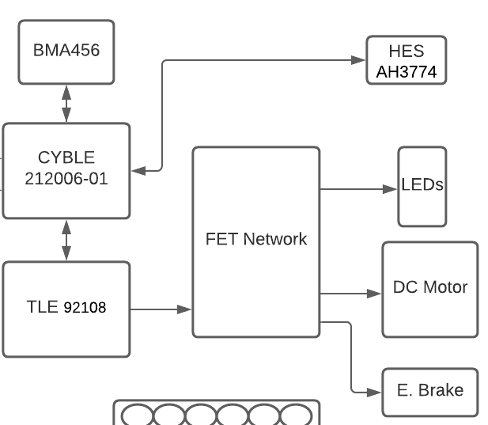

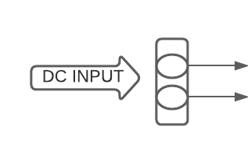








Implementation
The Cypress CYBLE will be the main controller for this system
Mobile application will send signals to the CYBLE through Bluetooth Low Energy
CYBLE programmed to control the TLE, BMA, and HES
The Infineon TLE driver will drive the MOSFET network comprised of 8 Half Bridges to supply power to:
Brushed DC Motor
Emergency Brake
LEDs

Slide 8
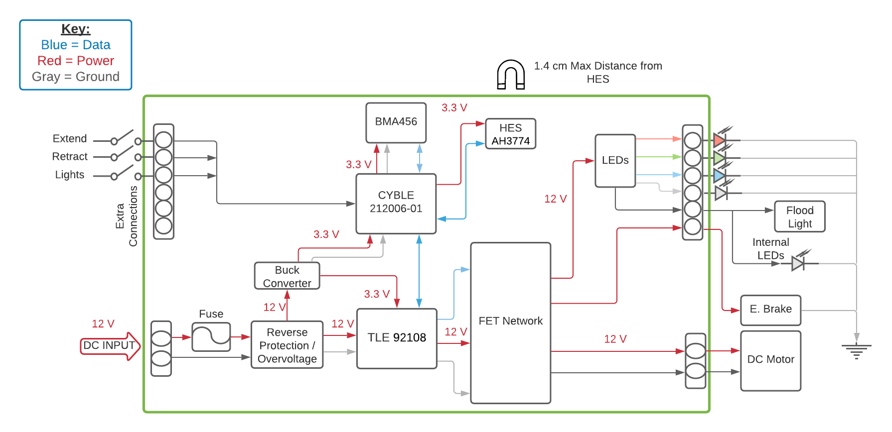
Block Diagram

Slide 9
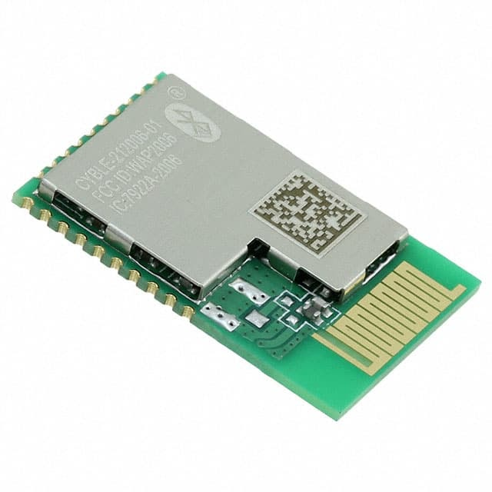
CYBLE Microcontroller
Two serial communication blocks (SCBs) supporting I2C (master/slave), SPI (master/slave), or UART
Four dedicated 16-bit timer, counter, or PWM blocks (TCPWMs)
Programmable low voltage detect (LVD) from 1.8 V to 3.6 V
remappable pins
BLE protocol stack supporting generic access profile
Drivers take up 40% of the memory

Slide 10
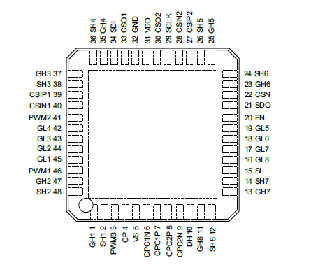
TLE92108-232QX - MOSFET Driver
Adaptive multi-stage MOSFET gate control
Integrated dual-stage pump for reverse battery protection
2 x flexible current sense amplifiers (low-side, high-side capable and bidirectional) with configurable gain
24-bit Serial Peripheral Interface
Drain-source monitoring for hard short circuit detection
Current sense monitoring for soft short circuit detection
Over temperature warning and shutdown
Timeout watchdog
Detailed off-state diagnostic (open load, short circuit to battery or to GND) via SPI
3 x PWM inputs (up to 25kHz)

Slide 11
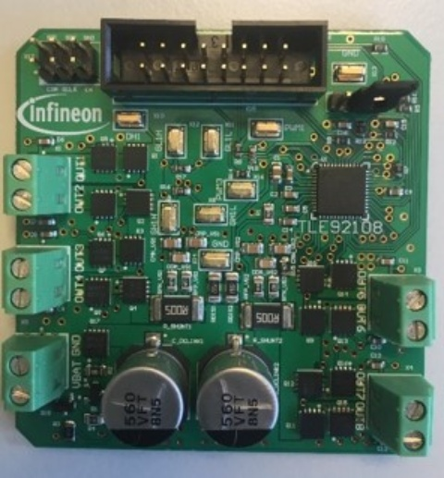
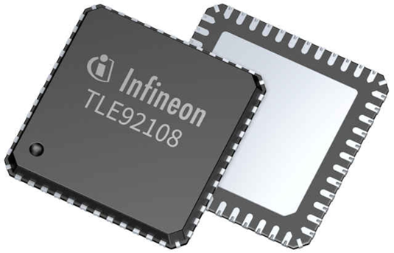
TLE92108-232QX - MOSFET Driver
Infineon‘s TLE92108-23QX APPKIT offers an easy method for connecting to the microcontroller for debugging the TLE
The 24-bit Serial Peripheral Interface (SPI) enables the communication between the microcontroller and the TLE92108-232QX.
The MOSFET driver IC acts as a SPI-slave while the microcontroller acts as a SPI-master.

Slide 12
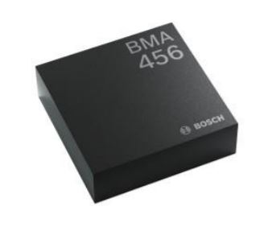
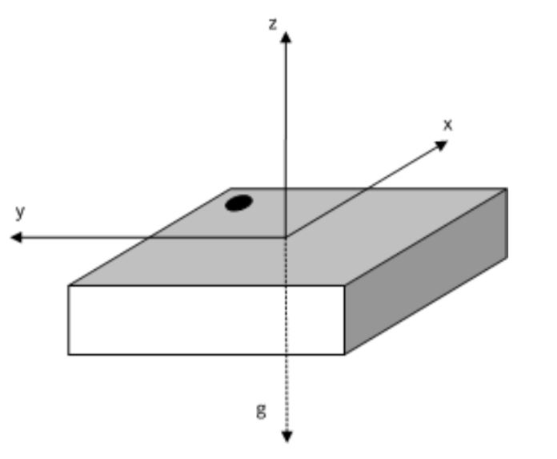
BMA 456 - Accelerometer
Triaxial acceleration sensor
Gathers the coordinate data
Digital interface using SPI
Programmable functionality
Low current consumption
Features 2 interrupt pins
On-chip motion triggered interrupt
New data interrupt
API available for users to implement

Slide 13
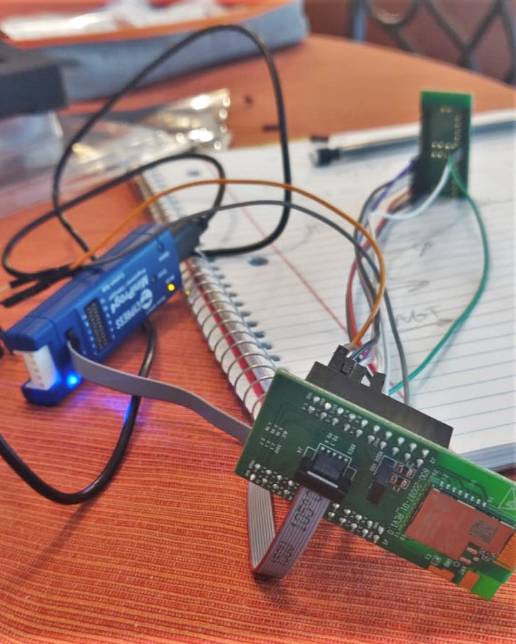
BMA 456 - Accelerometer
To program the Accelerometer, we used the BMA456 shuttle board.
The shuttle board allows us to easily connect the accelerometer to the CYBLE for debugging.

Slide 14
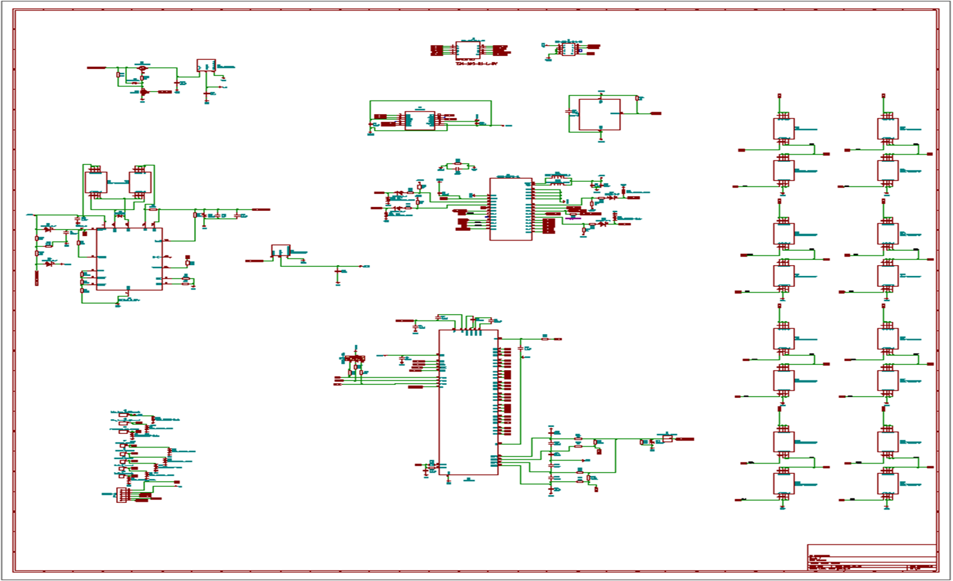

Schematic

Slide 15
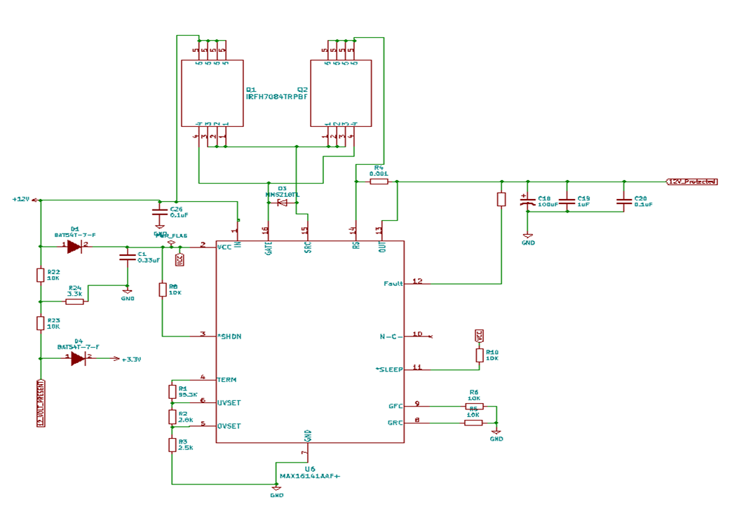
Schematic

Slide 16
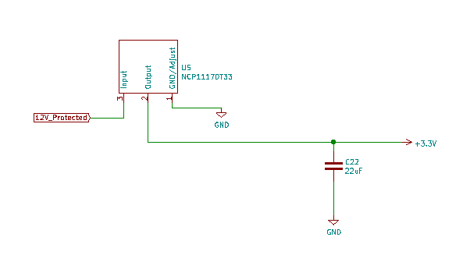
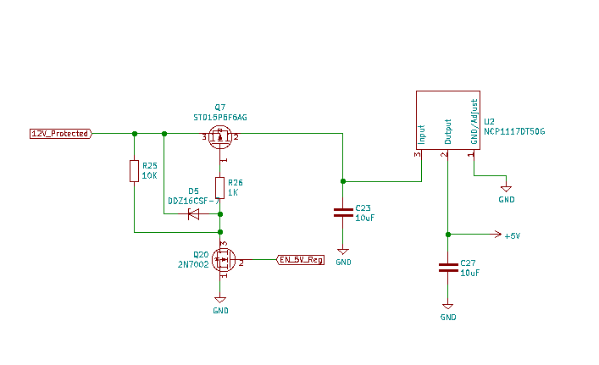
Schematic

Slide 17
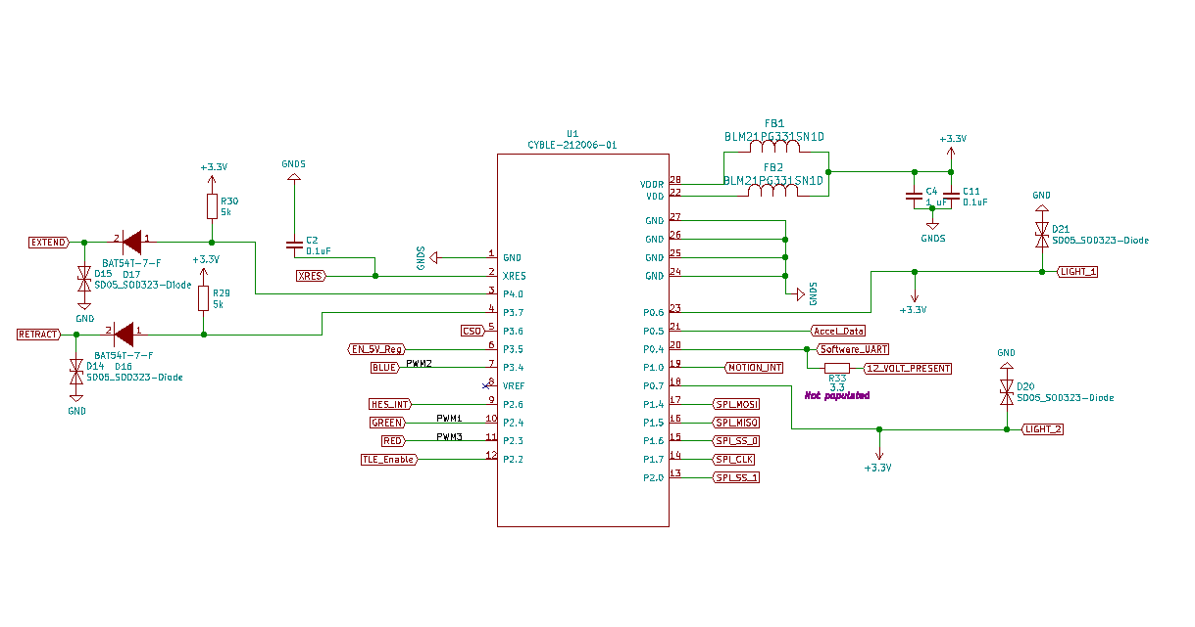
Schematic

Slide 18
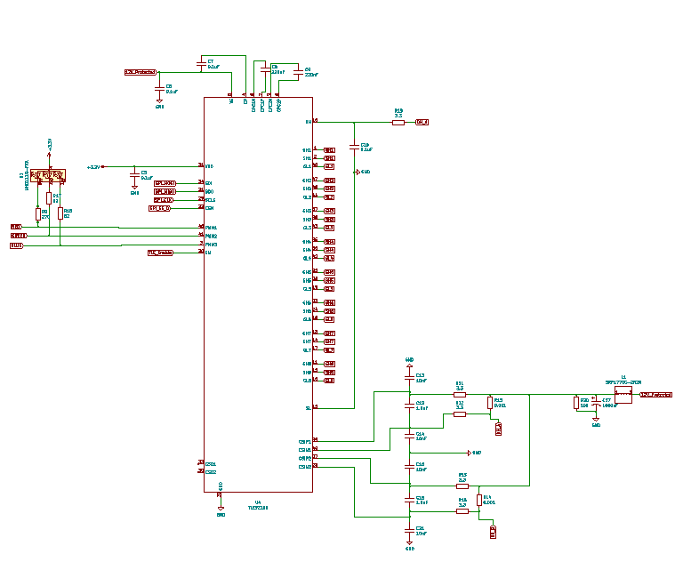
Schematic

Slide 19
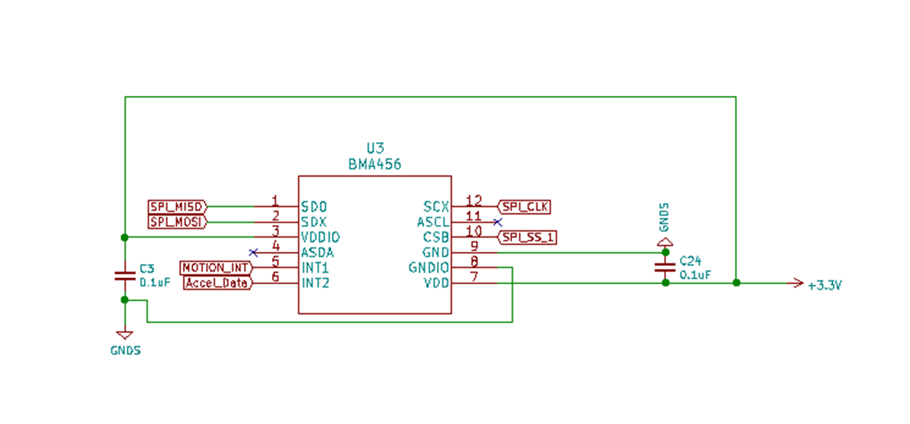
Schematic

Slide 20
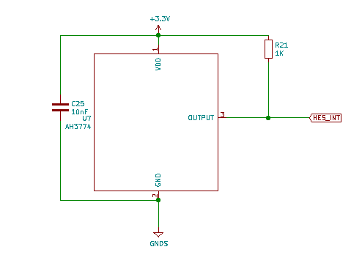
Schematic

Slide 21
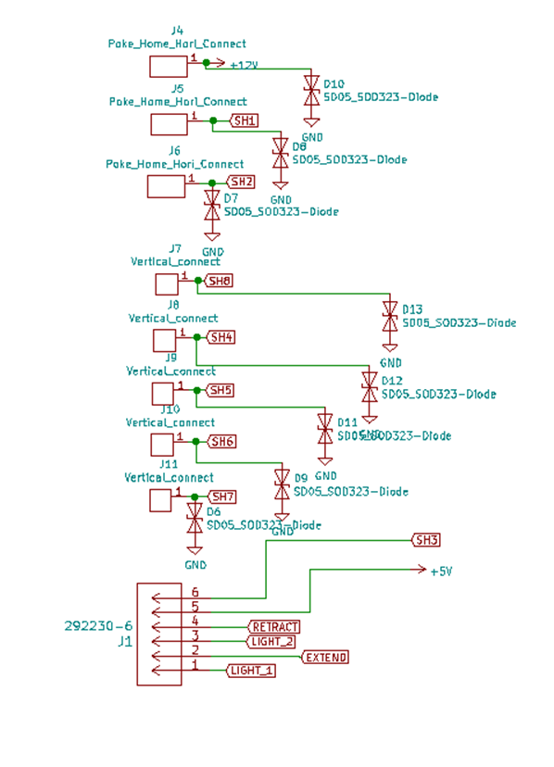
Schematic

Slide 22
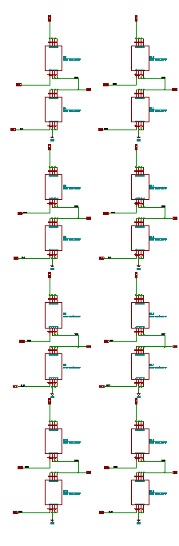
Schematic

Slide 23
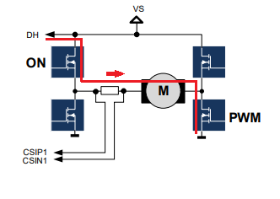
Motor Driver
The TLE driver can drive up to eight half-bridges comprised of two N-channel FETs
Half bridges one and two are used to control the motor through extend and retract signals
Half bridge 3 is used for the brake signal.
Half bridges 4-8 are used for controlling the external LEDs.
The driver has three PWM inputs. The three PWM signals are designated for the LEDs. PWM1 for green, PWM2 for blue, and PWM3 for red.

Slide 24
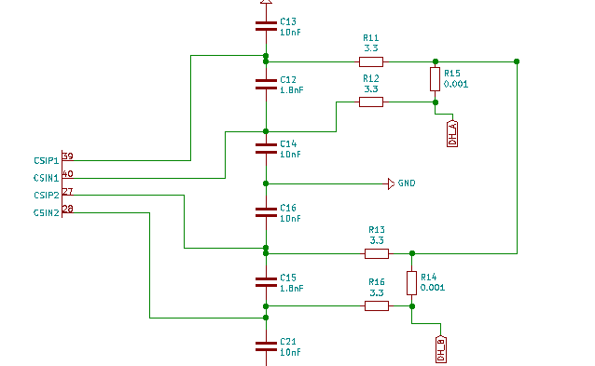
Motor Driver
CSIPX and CSINX are current sense inputs to the TLE that are internally connected to an instrumental amplifier A shunt circuit is added between the sense resistor and CSIPX and CSINX to protect the TLE from any high voltage or current.
The current measurement is then given to the microcontroller through a RC low-pass filter. Since the microcontroller sampling rate is around 1000 Hz, we picked R to be 1.5kΩ and C to be 0.1µF.

Slide 25
Protection Circuit
Our supply voltage range is between 9 V to 20 V.
Our typical supply voltage is 12V.
The MAX16141A part is a diode controller that functions as reverse-voltage protection circuit, over-voltage protection circuit and under-voltage protection circuit
The circuit shuts down based on the threshold that we decided, which are 9V minimum and 20V maximum
The part has a window-detection threshold comparators
By using a voltage divider circuit, we can set the values of the resistors, so that when the voltage changes beyond the desired thresholds, the N-Channel FETs will turn off

Slide 26





Protection Circuit
Using the following equations, we set the values of the resistors of the voltage-divider circuit:

Slide 27
Protection Circuit
SLEEP mode is active high.
We connected SLEEP to a 10kΩ pull-down resistor to ground.
pins RS and OUT are connected to a comparator inside the module.
A sense resistor is connected between RS and OUT which is which compares the current and detects any overcurrent.
If any overcurrent is detected, then the module shuts off. The current threshold is calculated using a simple Ohm’s law equation.
V_{RS-OUT} is the voltage of the overcurrent threshold
R_{SENSE} is the sense resistor between pins RS and OUT.
I_{OS} = 27.5 A, V_{RS-OUT} is 27.5 mV (which is the maximum V_{RS-OUT} that the module can handle), and the R_{SENSE} = 1 mΩ.
The motor is rated at around 240 W (12V*20A), then 27.5A is an appropriate overcurrent threshold

Slide 28
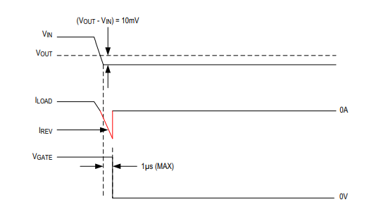
Protection Circuit
For reverse-voltage/reverse-current protection:
The module measures the different between V_{IN} and V_{OUT} across the external FETs. If V_{OUT} – V_{IN} = 10mV
the module activates a fault that turns the gate voltage to zero as well as load current.

Slide 29
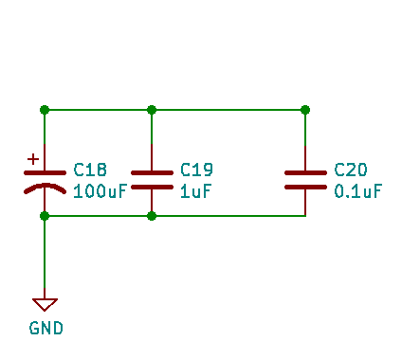
Protection Circuit
Connected to the protection circuit is a hold-up circuit which is a circuit of three capacitors in parallel
Two capacitor are ceramic, and one is a 100µF electrolytic capacitor that functions as a reservoir.
The hold-up circuit is then connected to a 12V-3.3V and a 12V-5V linear voltage regulators. The small signal ICs have a nominal voltage of 3.3V, and the 5V regulator is for the external LEDs

Slide 30
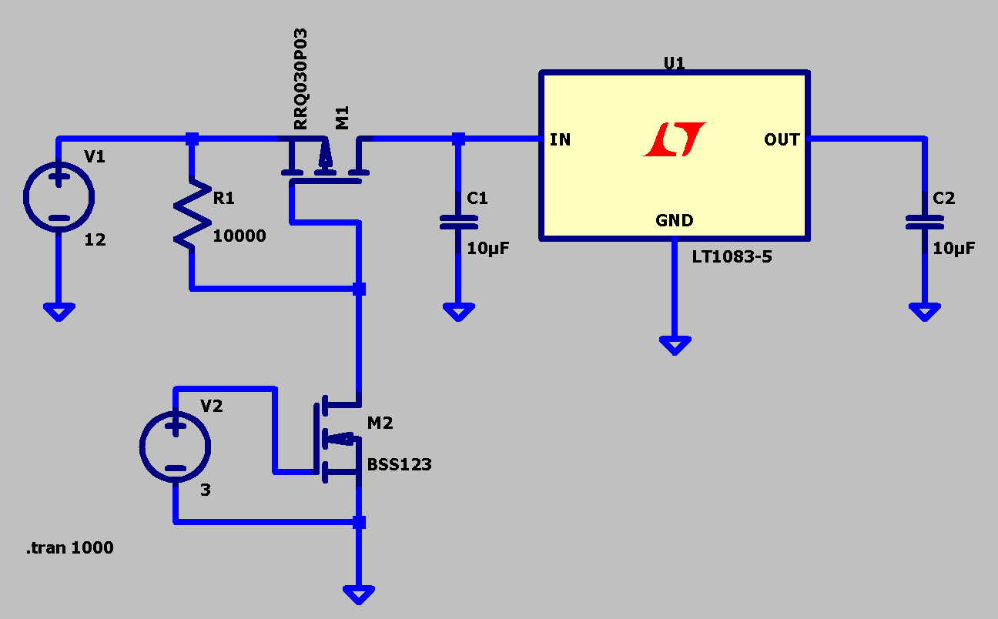
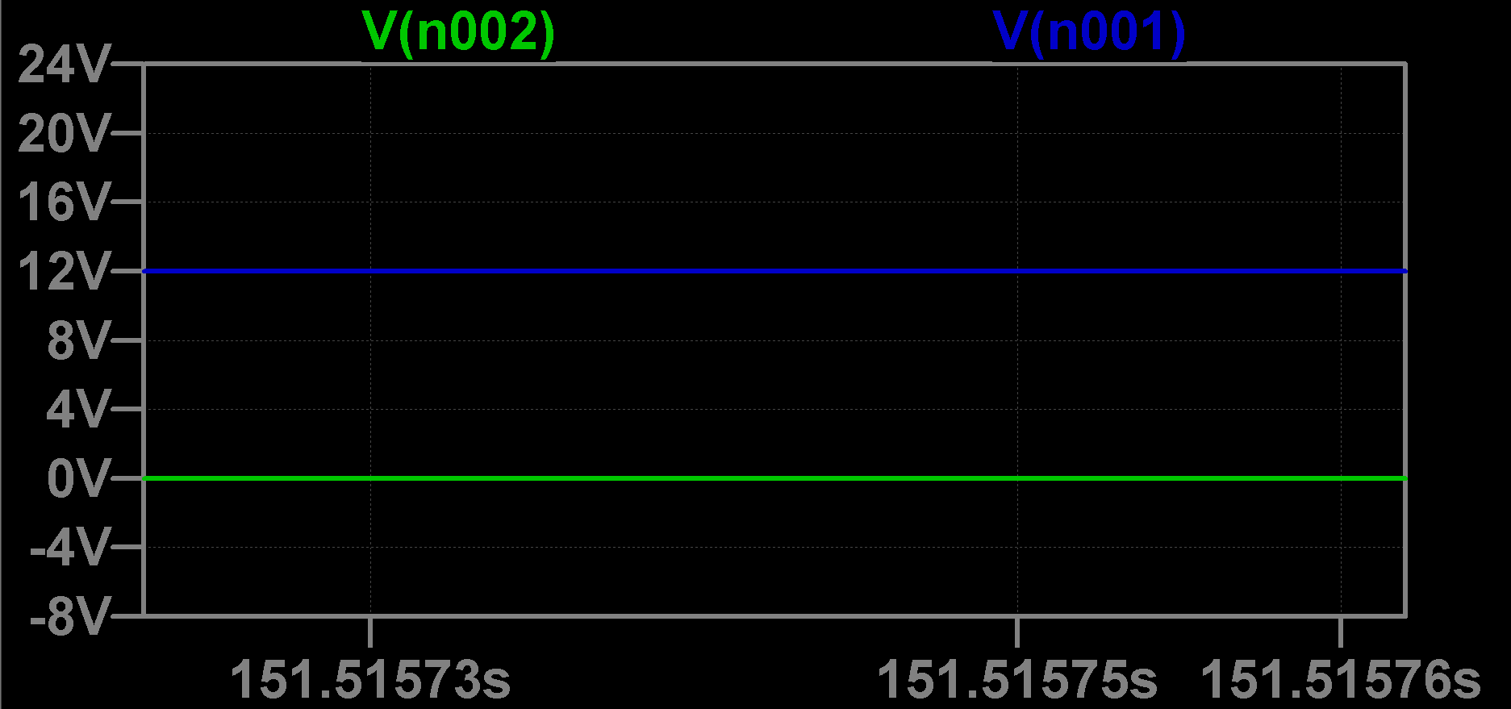
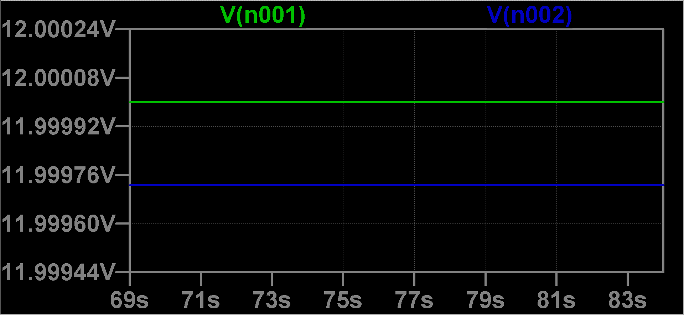
Voltage Regulators
The 5V linear regulator is enabled by the microcontroller through an enable circuit that we designed.
The circuit is mainly consisted of a P-channel MOSFET and a N-channel MOSFET which has its source connected to ground.

Slide 31
Connectors
we have a 6-position connector for the switches: LIGHT_1, LIGHT_2, EXTEND, RETRACT, and BRAKE. LIGHT_1 and LIGHT_2 are for the LEDs.
We decided to use five signal vertical connectors for external LEDs to be connected: RED, GREEN, BLUE, WHITE, and Work LIGHT. External LEDs are controlled by the MOSFET driver which gets its signal from the microcontroller
we decided to use single horizontal connectors. To each connector for the power supply and the motor, we connected a transient voltage suppressor to prevent any spikes in voltages.

Slide 32
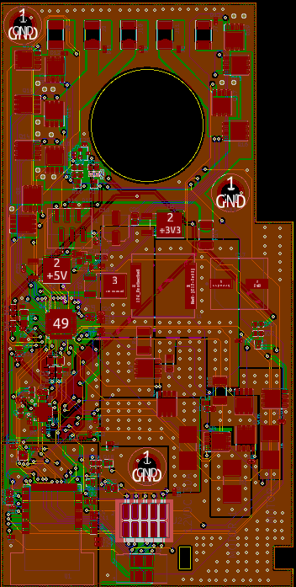
PCB Design
A 4-layer board
The top and bottom layers are for power traces
Second and third layers are for signal traces
The top and bottom layers are filled with ground
The bottom left area of the top layer is designated to be signal ground
Three 5-mm screw holes
The power supply is connected to the bottom right of the board
There is a drill hole at the bottom right and an edge cut for the zip tie to hold tight the three high supply current wires: Motor_1 (source current of the first half-bridge), Motor_2 (source current of the second half bridge), and 12V supply.

Slide 33
PCB Design
We created different zones for the different high-power components such as the 12V voltage supply, SH_1, and DH_1
Each zone on the front copper has its identical sister on the back copper and they are connected through stitching vias
TLE is placed as close to the middle of the board as possible
We placed the radio in the very bottom as far from the high current and the motor as possible to avoid radio interference
The MAX part is placed between the TLE and the radio
The six-position connector is connected above the TLE
The LEDs connectors are placed at the top of the board close enough to the FETs that are assigned to control the LEDs
We have the debug connectors placed at the bottom of the board close enough to the radio.

Slide 34
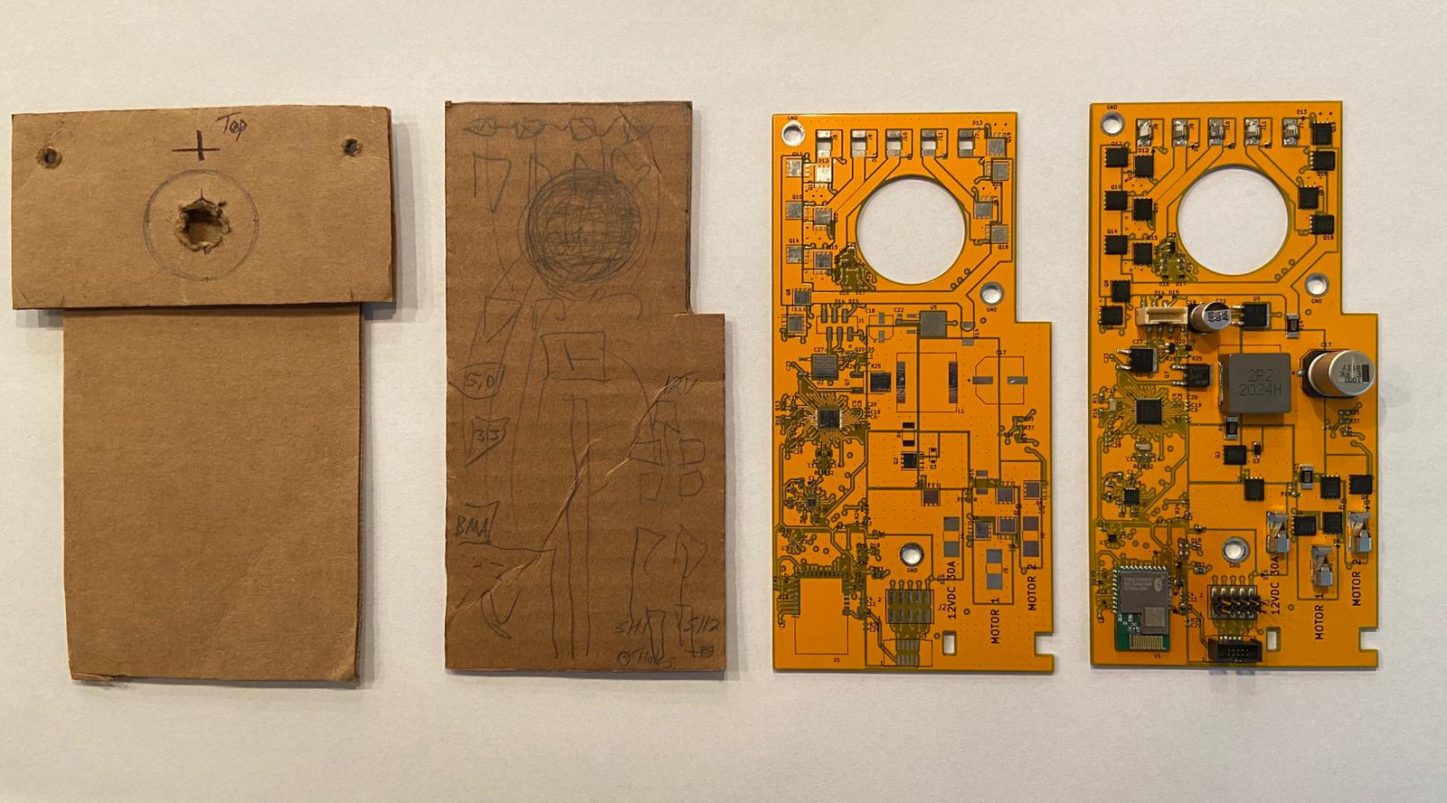

Slide 35
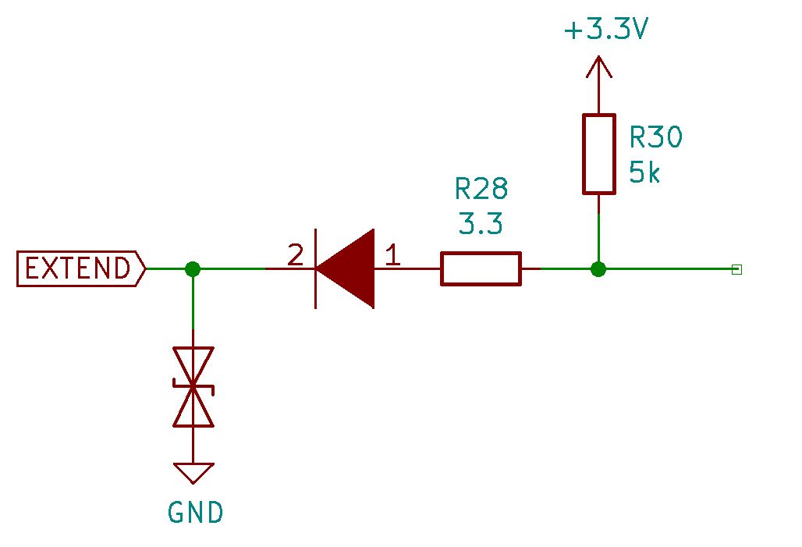
Troubleshooting
What Went Wrong
We designed a protection circuit to every switch signal so protect the microcontroller.
The circuit is consisted of a transient voltage suppressor, a shocky diode, a pull-up resistor, and a series resistor.
When the switch is turned on, we get a voltage of 2.4V at the anode of the diode which is too high to enable the GPIO which is active low
As a result, switches weren’t working
What we did
We removed the 3.3 Ohms series resistor

Slide 36
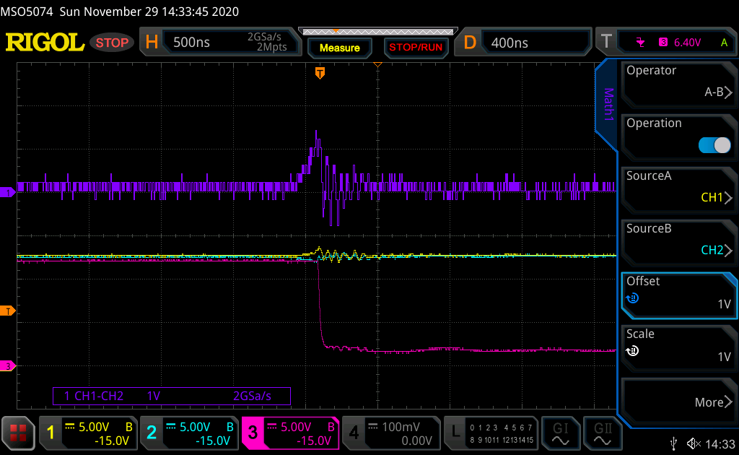
Troubleshooting
What Went Wrong
The MAX16141A protection circuit always gave a fault when we tried to start the motor
The part activates a fault if Vout is less that 90% of Vin
What we did
We tracked Vin, Vout, Vin – Vout , and the fault signal
The fault signal is active low, and it went low as Vin – Vout was more than 10% of Vin
We jumped a wire over the protection circuit to the regulator

Slide 37
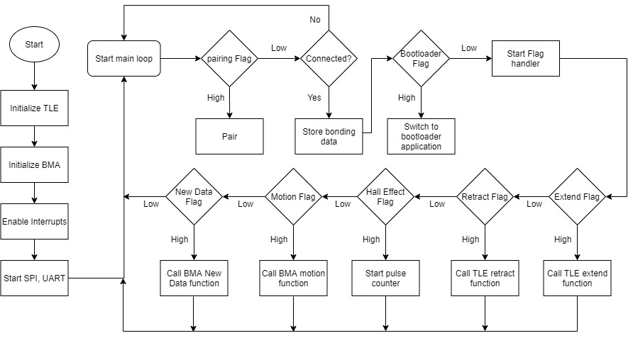
Software design

Slide 38
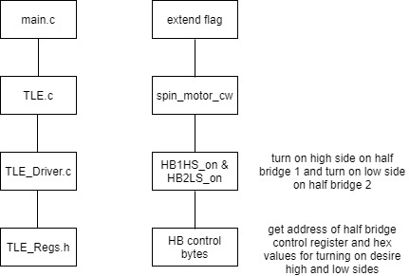
TLE Driver
In main the flags are set to start an action by either the physical switches or through Bluetooth
The corresponding functions are called in TLE.c to control make the action happen, such as turning off the brake and spinning the motor
The hex bytes are assembled and sent through SPI in TLE-Driver.c which gets the hex values and addresses from TLE-regs.h

Slide 39
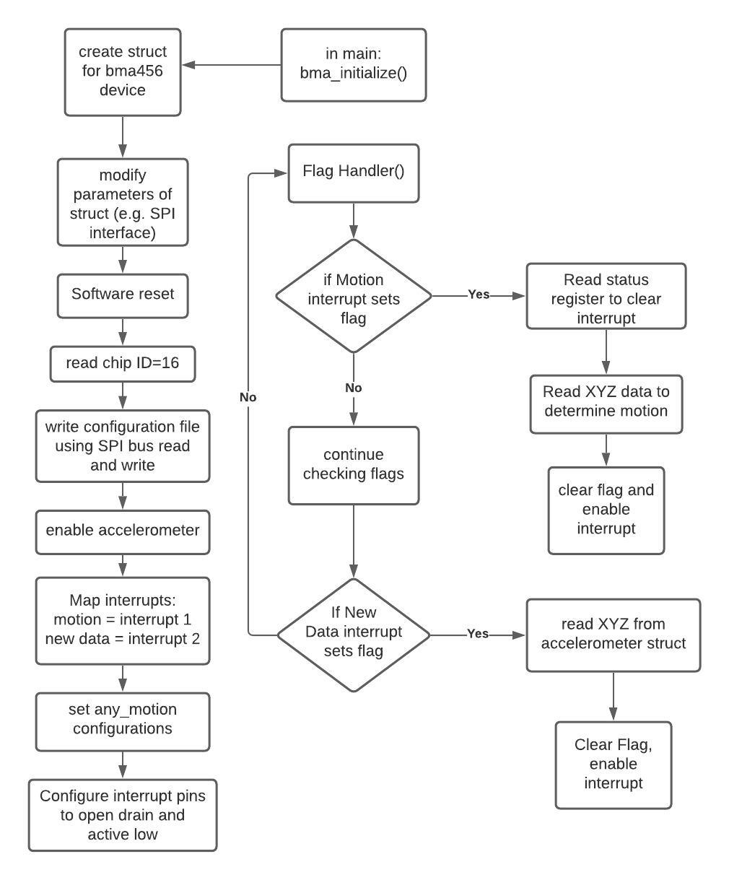
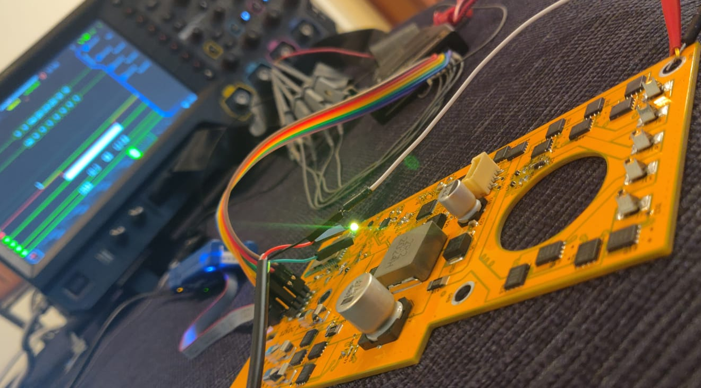
BMA456 Software Design

Slide 40
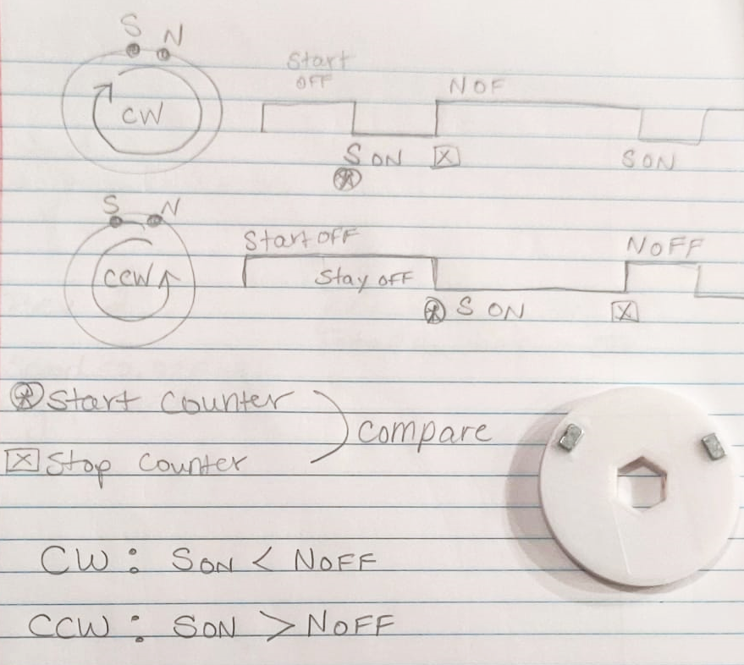
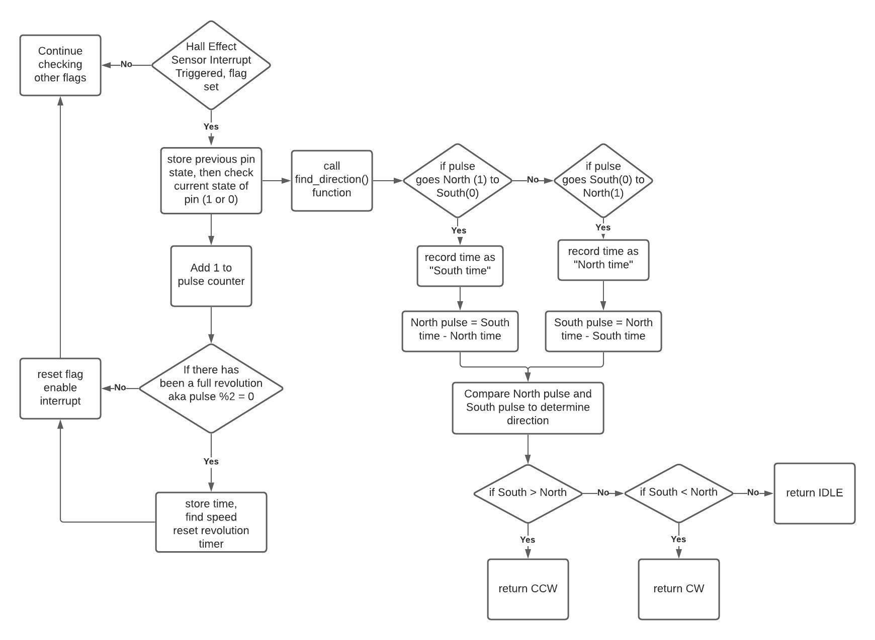
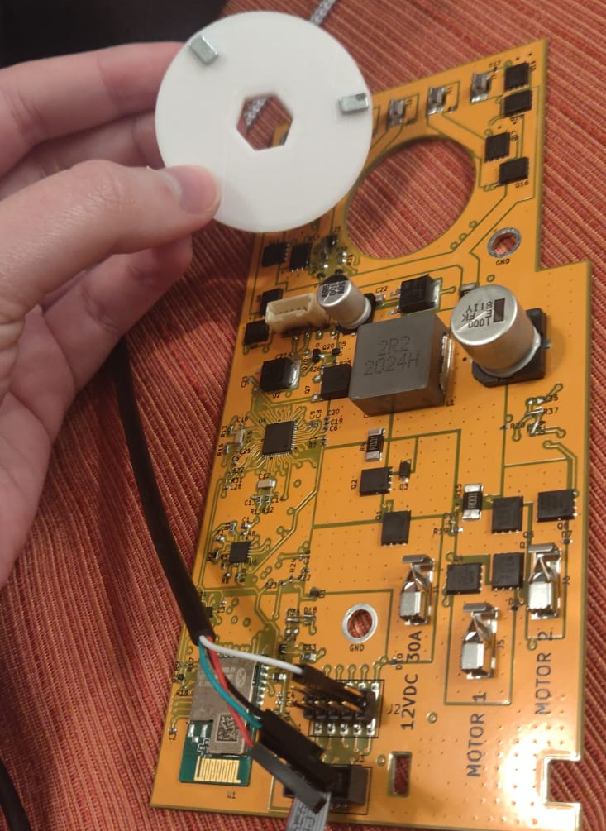
Hall Effect Sensor Software Design

Slide 41
