Slide 1
Smart Water Bottle
Group 5:
Ryan Koons ECE
Dean Pickett ECE
Neeil Gandhi PSE
Matthew Woodruff PSE

Slide 2
Goals and Objectives
Design a water-resistant opto-electrical device capable of sanitizing a quantity of water and analyzing contents for toxic contaminants
Output analysis to a mobile app
Contain the entire device within a bottle-top unit
Achieve goals with relatively low-cost implementation

Slide 3
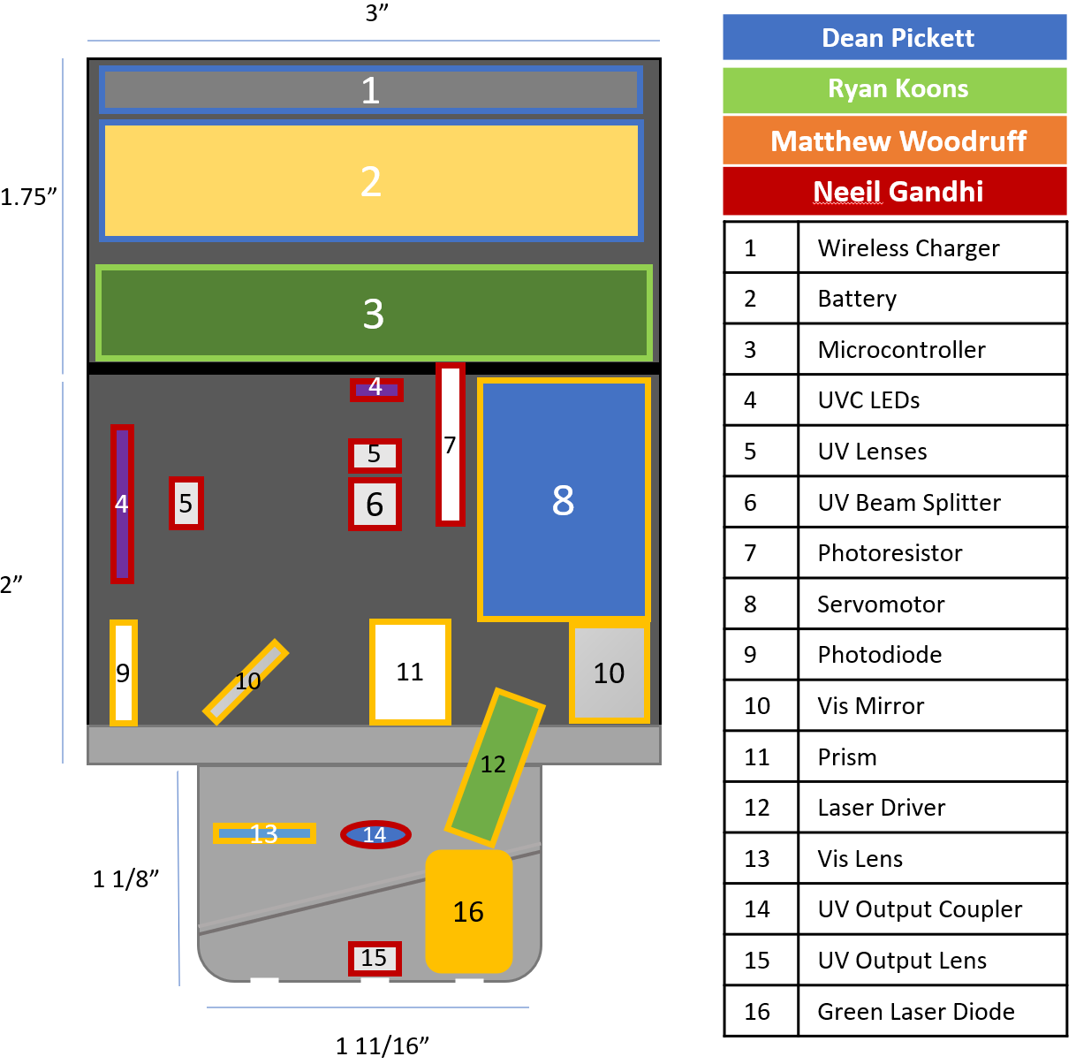
General Design
The structural layout of the system thus far (using the actual, physical sizes of the various parts) is projected to fit inside the physical size limitations, although prototyping may, of course, affect that claim.
The base of the design is currently a modified version of the original vessel’s cap’s base as the reflective, metal surface is preferable to a plastic printout that would absorb light. The majority of the device, however, consists of 3D-printed plastic.

Slide 4
Project Requirements
Highlight 3 for demo
  Nitrates: Detects concentrations in excess of 10 ppm
  Sanitized Water in 3 minutes
  Bluetooth TX: 10 feet or less, 30 s to TX data
  Wireless charging: less than 8 hours to full capacity
  Physical dimensions: Maximum 3 ¼” diameter x 5” height

Slide 5
Proposed implementation(overall)
Sanitization: UVC radiation
Trace Element Detection: Raman Spectroscopy
Wireless comm: BT
Water quality actuator: motor
Power: Rechargeable battery, PCB regulators
Charging: Inductive QI Standard

Slide 6
Trace element detector (TED)
TED uses a monochromatic light source (laser) to induce Raman and Stokes scattering in the sample, using the stainless-steel bottle interior as a reflective cavity. A sample of the light produced is then fed into the TED’s spectrometer and wavelengths other than the laser’s characteristic wavelength are measured on a photodiode.

Slide 7
TED Methods comparison
 | Infrared | Raman | Fluorescence | Inductive Coupled Plasma | Impedance
Senses | Atoms | Atoms | Micro-organisms | Atoms | Atoms
Rapidity | Rapid | Rapid | Rapid | Slow | Rapid
Cost | Mid-range | Mid-range | Low-cost | High cost | Mid-range
Destructive | No | No | No | Yes | Partially
Feasibility | Unfeasible, light absorbed by contents | Feasible | Feasible for demonstrations | Unfeasible, requires high temperatures | Feasible but undesirable as it will likely leave an aftertaste

Slide 8
TED Spectral Isolators Comparison
 | Prism | Diffraction Grating
Cost | Low | High-Medium
Compactness | Moderate | Moderate
Efficiency | Moderate | Moderate-Low

Slide 9
TED Sensors Comparison
 | CCD | CMOS | Photodiodes | Phototransistors
Cost | Low-Medium | Low-Medium | Low-High | Low
Compactness | Medium-High | Medium-High | Low-High | High
Sensitivity | Medium | Medium | Medium | High
Ablation | Possible | Possible | Unlikely | Unlikely

Slide 10
TED Rotational Mechanisms Comparison
 | DC Motor | Stepper Motor | Servomotor
Cost | Low | Low | Low
Precision | Low | Excellent | Decent
Resolution | Low | Medium | Decent
Feasibility | Unfeasible | Feasible with a gearbox, or as a linear stage | Feasible, may require a gearbox

Slide 11


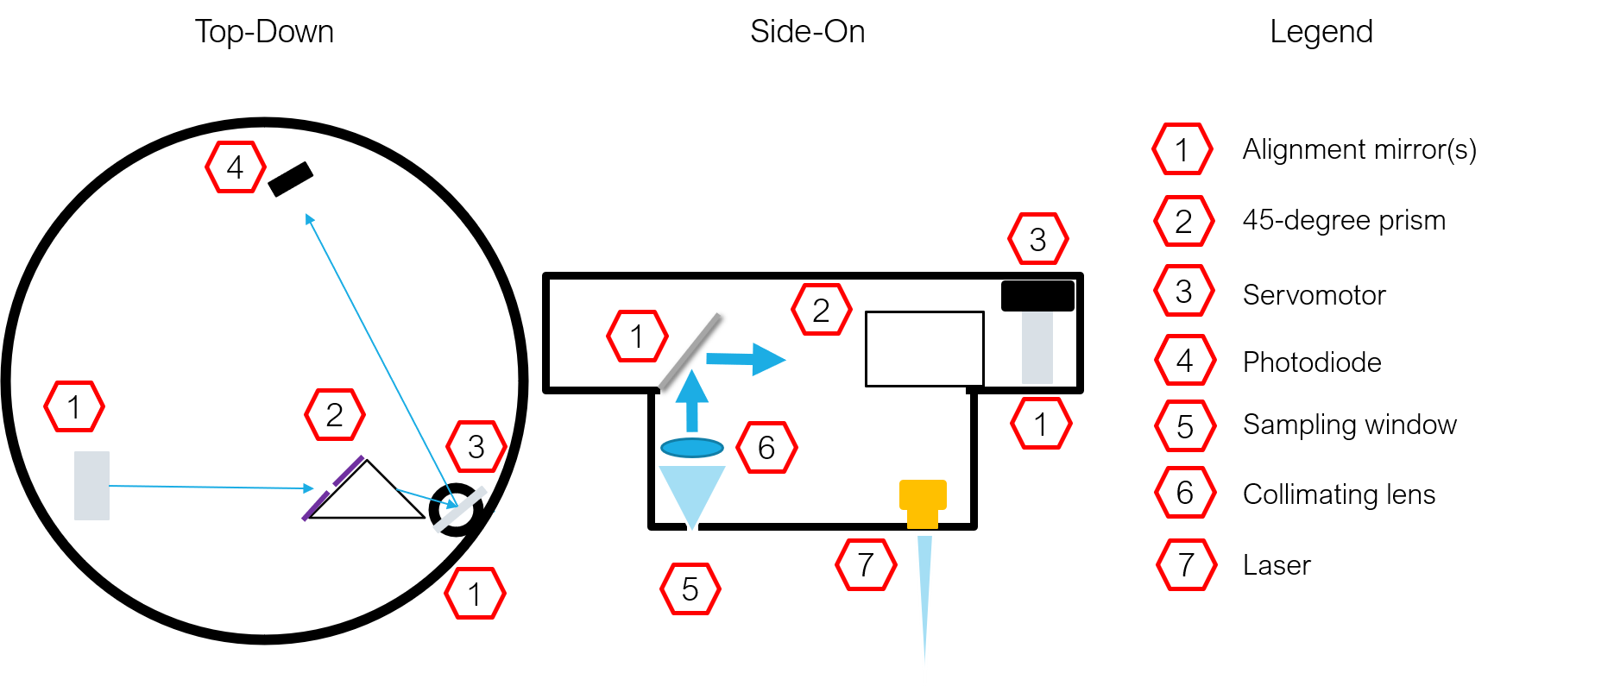
TED Design
This current design proposition shows a basic overview of how the TED is intended to operate. The actual implementation will vary as additional mirrors are added to the layout to increase the optical path length, and as a miniature, linear stepper motor is likely to be used in place of the servomotor. In either case, the mechanism translates the spectrum across the photodiode.

Slide 12

TED optical design
Lens Distance
  The lens should be a focal length (10 mm) from the aperture to collimate the sample.
Prism Deviation Angle
  $φ_{m}=2 \sin^{−1}(n\sin{(\frac{θ}{2}})) − θ,$ where $θ$ is the prism’s primarily angle, n is the refractive index, and $φ_{m}$ is the minimum deviation angle. Using the project’s equilateral NBK-7 prism’s expected values of $θ=$60 degrees and n ~1.52 (for 532 nm) yields a $φ_{m}$ of 38.9 degrees.
Prism Slit Size
  The prism’s slit size must be small enough to have a meaningful spectral dispersion without causing diffraction (the maximum width should be much less than the sensor’s width). A slit larger than ~10 microns will have little dispersion for green light. Thus, a slit of ~100 microns is ideal.
Optical Path Length
  The optical path length will be increased using additional mirrors inside the chamber. The target resolution of 5 nm (smallest discernible difference in wavelength) coupled with the prism’s change in deviation angle for a 5 nm difference in wavelength and the rotational mechanism’s step size will determine the optimal path length.

Slide 13
TED Specifications
Component | Aspect | Specification
Servomotor​ | Size | 23 mm long by 12.5 mm wide by 22 mm tall
 | Angular Range​ | 180 degrees​
 | Voltage | ~5 V
 | Current (unloaded) | 90 mA
 | Signal duration | .5-2.5 ms
Prism​ | Principle Angle​ | Equilateral
 | Material​ | NBK-7​
 | Size​ | ~5 mm³​
Laser​ | Intensity​ | 100 mW
 | Voltage | 3.7 V (maximum)
 | Current | 250 mA (maximum)
 | Wavelength​ | 532 nm​
 | Size | 12 mm in width and 35 mm height
Photodiode​ | Responsivity (at laser wavelength)​ | >= 0.3 A/W​
 | Biasing Voltage | -30 V (maximum reverse bias)
 | Rise time | ~400 ns
 | Size | 5.4 mm diameter and 17.8 mm height
Mirrors​ | Reflectance​ | >90% (at laser wavelength)​
 | Size​ | ½” x ½”​
Lens | Type | Fresnel Plano-Convex
 | Focal Length | 10 mm
 | Material | Acrylic
 | Size | 1/2" diameter and 1.5 mm height

Slide 14
TED Component Testing
Component | Tests
 | Results
Servomotor / Stepper Motor | Test 1: Verify that the PWM signal is properly configured and that the servo responds as intended. Test 2: Determine the minimum angular resolution or step length of the device. Test 3: Determine the angular accuracy of the device.
 | Result 1: Oscilloscope waveforms clearly show that the PWM demo code starts out with a 20 ms period and 1.5ms duty cycle. Then, then the duty cycle increases in 10 microsecond increments up to 1.506 milliseconds.
Prism | Test 1: The prism's refractive index will be experimentally determined using a known wavelength and the angular deviation induced
Laser | Test 1: The laser's IV characteristics will be experimentally observed. Test 2: The optical output power at both settings will be determined using a power meter.
 | Result 1: The laser's IV characteristics were plotted using a series ammeter and parallel voltmeter. The laser module begins lasing at 89 mA and 2.048 V, and was found to require ~2.07 V on the low setting (110 mA) and ~2.17 V on the high setting (220 mA).
Photodiode | Test 1: The linearity at the biasing voltage on the high-power setting will be verified.
Mirrors | Test 1: The reflectivity at the characteristic wavelength will be determined by measuring the loss in power after multiple reflections.
Lens | Test 1: The focal length of the lens will be verified by collimating a pinpoint light source and recording the intervening distance.

Slide 15
sanitization
Proposed Implementation:
  Sanitization by killing 99.9% pathogens.
  Sanitization time = 3 minutes.
  Getting the proper feedback (Voltage) from the photoresistor to know if the water is sanitized.

Slide 16
Sanitization method comparison
 | Boiling | Chemical Treatment | Ultraviolet Light
Effectiveness | Very High | Very High | 99.9% pure
Time | 1-3 min | 15-20 min | 10 sec – 2min
Cost | <$25 | <$20 | <$30
Residual Left | None | Yes | None
Electric Components feasibility | Not feasible due to heating and cooling | No electronic components required | Feasible
Implementation | Hard | Hard | Medium
Power | High | Low | Medium
Safety | Medium- can get too heated | Medium – because of the residuals left | Medium – UV light can be harmful for humans
User friendly | Low – water gets too heated | Low – User needs to keep refilling the chemicals | High – no user interaction needed
Portability | Hard | Medium | Easy

Slide 17
Safety and Precautions of Ultraviolet Light
Following are the risks caused by UVC radiation and they all depend on the wavelength, duration of exposure and dose:
It affects the skin and eye and can cause painful eye injuries and skin burns.
Some UVC lamps generate ozone. “Ozone inhalation can be irritating to the airway”. These ozone gases can cause several health complications like coughing, chest pain, lung damage, throat irritations, asthma, and more.
As we know it interrupts the DNA and RNA in the cells and same could happen in human cells and cause many health issues. If UV light is not exposed correctly, it might just modify the virus and hence causing mutations of the virus that might be difficult to kill later.
“High-exposure to radiation promotes the formation of cancerous tumors that can prove fatal if not detected in time”.

Slide 18
Types of UV sources
Low-pressure mercury lamp: These are the most common lamps which are used in most of the water irrigation systems to disinfect the pathogens. Its main emission is at a specific wavelength of 254 nm. They can also produce other wavelengths, but this is the main one for UVC disinfection.
Excimer lamp or Far-UVC lamp: These lamps are close to the infrared radiation and has a peak wavelength at 222 nm.
Pulsed xenon lamps: These lamps are mainly used in hospital settings to disinfect the air in the operating rooms or other spaces. They emit short pulse of broad spectrum which includes UV infrared and visible. These lamps can cause many health hazards and for safety purposes are mainly used when there are no humans in the desired space.
Light-emitting Diodes (LEDs): Light-emitting diodes emitting UV light are booming in the industry and are becoming very common in the industry and commercial use. They are getting commonly available and hence the demand is increasing. LEDs emits very narrow band of spectrum. There are multiple LEDs available in the market right now with different peak wavelengths like 265 nm, 275 nm, 280 nm, and others.

Slide 19
Comparison between uv led and uv lamp
UV LED | Section | UV Lamp
New, Light, Simple, Compact, Small | Technology | Old, Bulky, Heavy, Complex, Large
10,000 – 50,000 Hour | Lifetime | 2,000-10,000 Hour
Low | Energy Consumption | High
Zero | Warm-up time | Slow
No mercury, No Ozone | Environmentally Friendly | Mercury used, Ozone generation
Low | Heat Generation | High
Single UV Band, Customizable | Emission Wavelength | Multiple Peaks
None | Heavy Metal | Mercury (20 - 200 mg)

Slide 20
Led (Technology in the industry)
Multiple LEDs : The purpose of using multiple LEDs is for greater intensity of light, which results in more efficiency. Also, if one LED fails and does not output enough intensity there are other LEDs to take care of it and still purify the water. The disadvantages are it uses a lot of power and hence more electronics and higher voltages battery to supply enough current and voltage, requires a bigger space therefore not handy and easily portable and carried to different places and gets more expensive as it uses multiple LEDs.
Single LED : These LEDs can be placed anywhere in the system and does not require many electronics or optics and hence it is easily compatible to any use. They are very small and easily accessible. They are comparatively cheap as they are single piece. There are some disadvantages to it like if the LED does not produce enough intensity, then the water is not sanitized completely and could leave to false interpretation, therefore the system needs to take that into account too.
After the analysis, we decided to go with using 2 single LEDs as it is cost efficient, small to be fit anywhere like the bottle cap, easy to implement and does not require a lot of electrical power to function them and hence keeping the system small and compact. This would fit perfectly with our design and the requirements for the project.

Slide 21
Selecting the LEDS
The best option to pick LEDs are picking a semiconductor LED made from materials AlGaN, AlN or InGaN and choosing a couple of LEDs with different wavelength so we get a broad spectrum. In choosing the LED, we had to keep in consideration the size, cost, and energy constraint. The LED also needs to produce a good amount of intensity at the given wavelength to purify the water effectively.
After going through all these possibilities, we narrowed down to only 2 LEDs which match our product design and requirements. We had to look for size, material, cost, power, and electrical requirements. Due to these constraints the 3535 LED Diode from eBay have proven to be the best match as they are cheap ($4.5 - $5), easy to implement (comes with PCB), peak wavelength is 265 nm and 275 nm, small and does not require a lot of power to function it. The LEDs from Zhejiang Danse Electronic Technology and Dongguan Houke Electronic are great options too but they do not come with PCB and the shipping cost on Alibaba for it is around $20 which makes the product expensive, and we do not even know if it will work perfectly in that small UV range. I am still looking more into it and talking to the dealers for less shipping cost and warranty so we can get one of them which is 255 nm. We want a broad UV spectrum and that would definitely help.

Slide 22
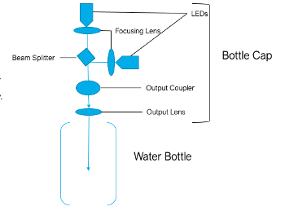
LED Design
Using a beam splitter to combine beams is only one of the ways to combine the two LEDs with different wavelengths. The other methods are using a dichroic mirror or diffraction gratings instead of the beam splitter. The reason to try these out is that due to the very small bandwidth difference between the two LEDs, optical components like beam splitter, diffraction gratings, and dichroic mirror will not work efficiently to combine the beams. Cannot be sure without testing it out. The phase matching is very difficult in LEDs and when we use optical components to combine beams, they should have a big difference in the bandwidths so one of them passes through and the other one reflects, but here the bandwidth difference being negligible (10 nm) it is very difficult to do so. If somehow, we manage to do it, it will be great. The other option is to just have two LEDs next to each other and have a broad beam projected. It should be broad enough so there is some overlapping and then project that out. The last option is to just drill two holes in the cap and without any interference let the LEDs project out the UV spectrum and sanitize the water. This would also be good as we will not be using any mirrors or lenses and hence no power will be lost giving greater efficiency.

Slide 23
Led feedback mechanism
In markets today there are several detectors available for UV wavelengths such as pyroelectrics, photodiodes, photomultipliers, thermopiles, and photoresistors. These systems work on converting the photon energy to current or voltage and then measuring that system to get the results.
Photodiode: Photodiodes are very sensitive and give better results. They need more electronics compared to others and the system gets complicated. Requires more space due to more electronic items.
Phototransistor: They are small and easy to implement. They can be used to measure the voltage and/or current easily. Do not require a lot of electronics.
Photoresistor: They are similar to phototransistor. Easy to implement, small and do not require a lot of electronics.
From this we decided to test and all three of them and after testing we decided to go with a photoresistor, due to better results. We had to keep in mind the light was UV and hence had to use a filter on top for more photon radiation. The results are showed later.

Slide 24
Sanitization Specifications
Component | Aspect | Specification
LED | Quantity | 2
 | Type | SMD LED
 | Peak Wavelengths | 275 nm and 285 nm
 | Voltage | 6 V
 | Current | 100 mA
 | Intensity | 6 -15 mW
 | Material | AlGaN-based Flip Chip
 | Mass | ~83 mg each
 | Size | 3.6 mm-3.6 mm, 1.71mm thick
 | PCB size | 20 mm diameter, 1 mm thick
 | PCB Material | Copper
Lens | Size | ~3.6 mm in diameter
 | Material | UV-Fused Silica
 | Focal Length | ~ 5 mm
Beam Splitter | Ratio reflected/transmitted | 1-1
 | Material​ | UV-fused silica
 | Size​ | ~1/2" x 1/2" x 1/2"
Photoresistor | Sensitivity | More sensitive to visible light

Slide 25
Testing of sanitization components
Component | Tests
 | Results
LED | Test 1: Check the optical spectrum of the LEDs to see what the actual peak wavelength values are. Test 2: How much is the optical output power of the LEDs to determine the sanitization time.
 | Result 1: For the 3535 LEDs the peak wavelengths for the 265 nm was 275 nm and for the 275 nm it was 285 nm. Result 2: The optical power produced was by both the LEDs was between 0.6 mW to 0.8 mW.
Lens | Test 1: Check if the beam is focused and collimated or not. Test 2: How much optical power of the LED is lost after passing through the lens.
Beam Splitter/Grating/Dichroic Mirror | Test 1: Check if the beams can be combined.
Photoresistor/Phototransistor | Test 1: The photoresistor and phototransistor will be tested to determine whether it can, in conjunction with a fluorescent filter or alone, reliably detect UV wavelengths.
 | Result 1: Voltage reading with darkness, UV light on and UV light on with a filter used in front of the detector. Photoresistor: 8 V, 7.02 V and 6 V without LEDs, with LEDs and with LEDs and filter respectively. Phototransistor: 0.112 V, 0.135 V and 0.185 V without LEDs, with LEDs and with LEDs and filter respectively.
Reed Switch | Test 1: Two Reed switches of different magnetic sensitivities will be purchased, and both will be connected to a multimeter separately to determine an average distance from the magnet that activates the switch.

Slide 26
Embedded Hardware
Proposed Implementation: A central PCB (motherboard) will be utilized to interface with all peripheral device components. Additionally, The PCB will be used for wireless communication, control logic and I/O, voltage regulation, and user interface. The PCB should be compact enough that it fits inside of the water bottle cap. Selected components also should not stick out farther than 1” vertically from the board. The PCB should have a 2.9” diameter to in order to fit in device housing.

Slide 27
Design Approach
Familiarity: Utilizing components that group members are familiar with helps minimize project overhead and speed up prototype time. This also helps better ensure device reliability.
Flexibility: Prototyping can be very indeterministic. It is important to account for future adjustments/revisions in a proactive manner. A versatile PCB design (works with multiple types of components) can eliminate future revisions and reduce project costs.
Modularity: Interfacing external devices with connectors will create a more efficient final product. Individual components can be easily swapped out without requiring any soldering or modification to the main PCB.
Functionality: The product must be efficient, reliable, and easy-to-follow. How individual sub-systems interact with the overall design must be considered. Compatibility between components is an important objective.

Slide 28
Embedded Hardware: overview
Microcontroller
Device Power
Wireless Module (BT)
Blue LED (Sanitization)
R/G/Y LED (Water Quality Mode and Status)
Charging/Status
Water Quality (Voltmeter)
Motor
Photodiode
Green Laser
Reed Switch
LEDs
Sanitization
UVC LEDs
Button
Button
UART (Tx, Rx)
UVC LED Feedback

Slide 29
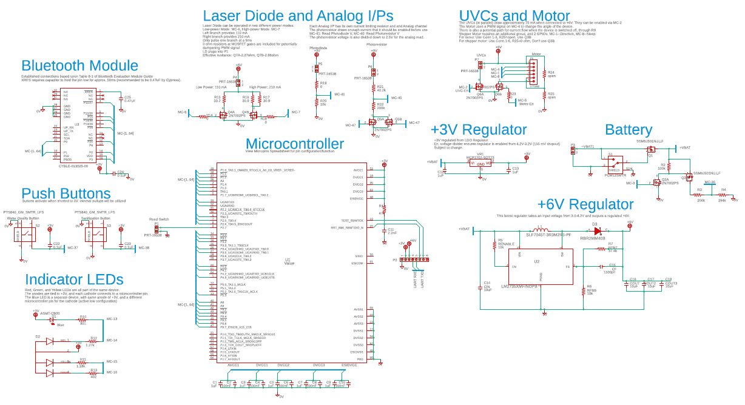
Rev. 1 schematic

Slide 30
Microcontroller: Initial Desired Features
Feature | Desired Value/Quality
Voltage supply | 2-5 V from on-board regulators
Low-Power Draw | < 10 µA
Cost | < $10
On-board Wired Comms Protocols | UART, I2C (possibly SPI)
Current-Driving Pins | Potentially drive Two UV-C LEDs and green laser directly
Low-level Wake-up (LLWU) Pins | Approximately 8 in total (to account for various inputs to the microcontroller).
GPIO Pins | At least 20 pins (including LLWU)
ADC resolution | 10-12 bit for millivolt precision sensing
Analog Input Pins | Water quality sensor (1 pin required)
PWM Capability | < 100 µs, at least 2 pins (Servo, and green laser)
Interrupts | Operational Safety, and Process Hierarchy
Memory | Around 50 kB (Overestimate of water quality data/analysis)
Prior to microcontroller comparisons, it was first important to derive a rudimentary assessment of features necessary for the project. Some of these features were subject to change based on dynamic project scope.

Slide 31
Microcontroller: Comparisons
Controller | ATmega328-PU | MSP430G2553IN20 | MSP430FR6989IPN
Pins | 28 | 20 | 80
Active Mode Current | 200 µA/MHz @ 1.8V | 230 µA/MHz @ 2.2V | 100 µA/MHz @ 3V
Standby Mode Current | 0.1 µA @ 1.8V | 0.5 µA @ 2.2V (LPM3) | 0.4 µA @ 3V (LPM3)
Price | $2.63 | $3.38 | $9.43
Availability | 46,400 (DigiKey) | 7400 (TI) | < 300 (DigiKey)
Software Overhead | 3 | 2 | 1
Team Familiarity | 3 | 2 | 1
Supply Voltage | 1.8 V to 5.5 V | 1.8 V to 3.6 V | 1.8 V to 3.6V
Wired Comm. Protocols | I2C, USART, SPI | I2C, UART, SPI | I2C, UART, SPI
Current Driving | 20 mA (Vcc=3V, Vo=2V) | 25mA (Vcc=3V, Vo=2V) | 25 mA (Vcc=3V, V0=1.5V)
GPIO Pins/Interrupt | 23/23 | 24/16 | 63/32
Analog Input Pins | 8 | 8 | 16
PWM Output Signals | 6 | 6 | > 6
ADC Resolution | 10-bit | 10-bit | 12-bit
Timing Modules | 3 | 2 | 5
Memory | 32 KB | 16 KB | 128 KB
Max Clock Speed | 20 MHz | 16 MHz | 16 MHz
Development Board | Arduino UNO | Launchpad | Launchpad
Controller | MSP430F5529 | MSP430FR5989IRGC
Pins | 80 | 64
Active Mode Current | 290 µA/MHz @ 3.0V | 100 µA/MHz @ 3V
Standby Mode Current | 2.1 µA at 3.0V (LPM3) | 0.4 µA @ 3V (LPM3)
Price | $5.50 | $3.09
Availability | 1000 on order (DigiKey), 0 (TI) | 35,000 (TI)
Software Overhead | 2 | 1
Team Familiarity | 2 | 1
Supply Voltage | 1.8 V to 3.6 V | 1.8V to 3.6V
Wired Comm. Protocols | I2C, UART, SPI | I2C, UART, SPI
Current Driving | 40 mA (Vcc=3V, Vo=2V) | 25 mA (Vcc=3V, V0=1.5V)
GPIO Pins/Interrupt | 63/16 | 48/32
Analog Input Pins | 14 | 16
PWM Output Signals | > 6 | > 6
ADC Resolution | 12-bit | 12-bit
Timing Modules | 4 | 5
Memory | 128 KB | 128 KB
Max Clock Speed | 25 MHZ | 16 MHZ
Development Board | Launchpad | Launchpad

Slide 32
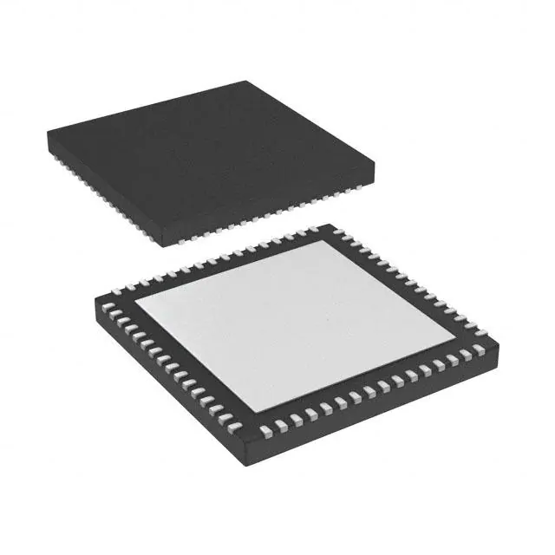
Microcontroller: Selection
Controller | MSP430FR5989IRGC
Pins | 64
Active Mode Current | 100 µA/MHz @ 3V
Standby Mode Current | 0.4 µA @ 3V (LPM3)
Price | $3.09
Availability | 35,000 (TI)
Software Overhead | 1
Team Familiarity | 1
Supply Voltage | 1.8V to 3.6V
Wired Comm. Protocols | I2C, UART, SPI
Current Driving | 25 mA (Vcc=3V, V0=1.5V)
GPIO Pins/Interrupt | 48/32
Analog Input Pins | 16
PWM Output Signals | > 6
ADC Resolution | 12-bit
Timing Modules | 5
Memory | 128 KB
Max Clock Speed | 16 MHZ
Development Board | Launchpad
Final Selection: TI MSP430FR5989IRGC.
This microcontroller was relatively available—some were purchased in advance and shipped to China for PCB assembly. The microcontroller provides extra unconfigured pins for features that may need to be added later. It is relatively affordable, and has desirable power consumption specifications.
64-VQFN Package
Dim: 9x9 mm

Slide 33
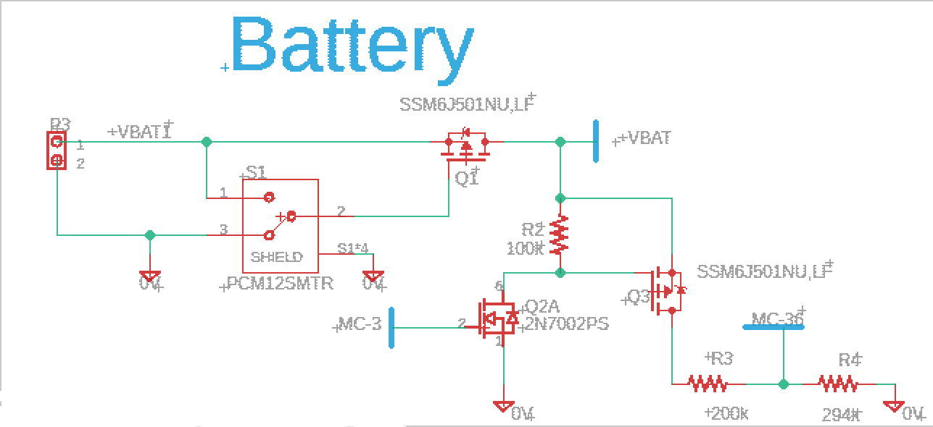
Battery read Circuit
Power from external circuit enters via P3.
S1 is for user to turn device on and off. A switch capable of supporting device current was hard to find, so a power P-channel MOSFET was included to perform switching.
When MC-3 is enabled, +VBAT is divided down by a ratio of 4.2/2.5 for the ADC read.
Device Specification | Quantity/Value
V_{DSS} | -20V
V_{GSS} | +/- 8V
I_{D} (DC) | -10 A
R_{DS(ON)} @ V_{GS}= -4.5V | 15.3mΩ

Slide 34
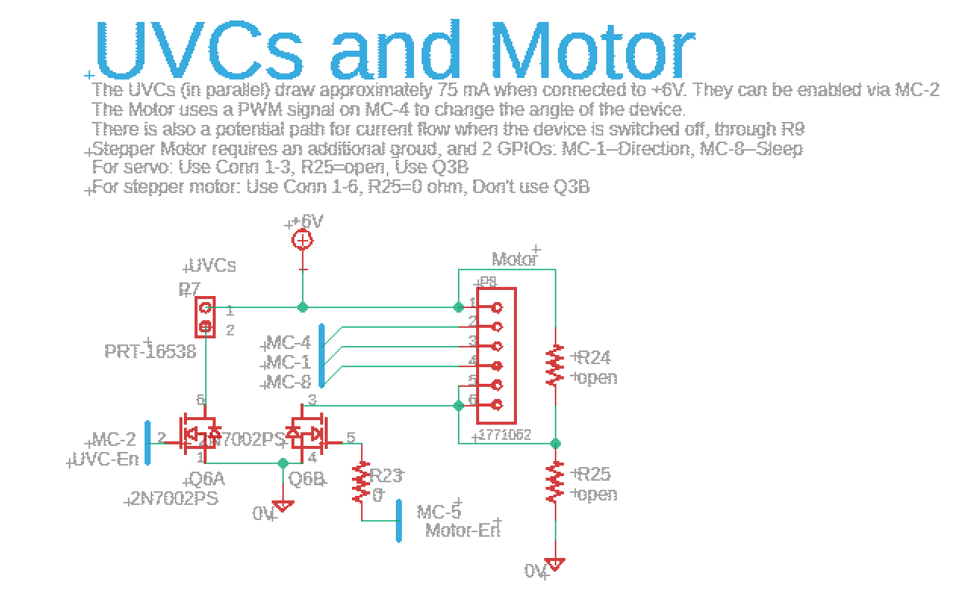
UVCs
2 UVC LEDs in parallel measured to draw 75mA total when connected directly to +6V.
Regulating methods were considered for LEDs, however it was determined that a simple project application would be sufficient.
MOSFET is utilized to enable/disable the UVC LEDs
Connector P8 can be used to interface motor and UVCs.
Virtually all connectors in the design work with standard 20-26 AWG wires

Slide 35
Motor
Servomotor: Utilizes MC-4: PWM to change angle, and connects to +6V and 0V.
Stepper motor: Also requires MC-1: GPIO for changing direction, and MC-8: GPIO for sleep.
Additional conductive path provided for servomotor to “discharge” when switching states. Since inductors cannot abruptly change current.
MOSFET is used for connecting and disconnecting the servomotor. If the stepper motor is used, the MOSFET is not necessary since minimal current is drawn.

Slide 36
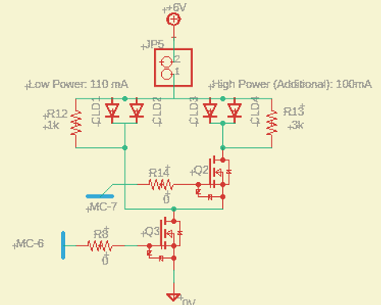
Laser diode: Original Design
Desired: Low power mode: 110mA, High power mode: 210 mA
The original laser diode circuit utilized current limiting diodes. Most current limiting diodes had a lower regulating current than desired. So, CLD’s were to be placed in parallel to cumulatively regulate the desired amount of current. However, the CLD’s were designed for this use case, since their current was adjustable based on the resistance in parallel. Additionally, the CLD’s took a significant amount of time to settle at the desired current. Therefore, when pulsing the laser diode on and off, it would always be above the desired value and run the laser diode at too high of a power setting for obtaining the desired optical phenomenon.
The original design required Low power mode to always be enabled, and then MC-7 could also be utilized to gain an additional 100mA for the desire optical phenomenon.

Slide 37
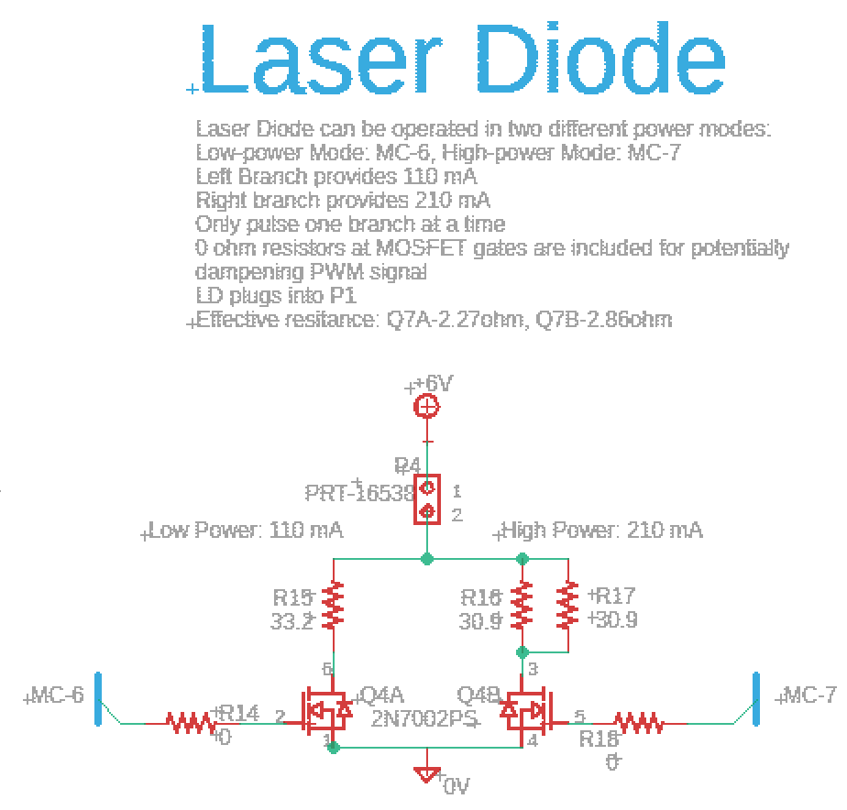
Laser diode
Final Design: Use one branch at a time—depending on desired power mode. Final calculations come from I-V curve trace of the laser diode. Resistors were included along MOSFET gates for potentially modifying the time constant of the signal.
 | Power Mode
 | Low | High
Desired Current (mA) | 110 | 210
Laser Diode Voltage (V) | 2.071 | 2.133
Resulting Resistor Voltage (V) | 3.929 | 3.867
Initial Resistance (Ω) | 35.7 | 36.8
MOSFET Est. Resistance (Ω) | 2.27 | 2.86
Adjusted Resistance (Ω) | 33.4 | 31.1
EIA-Resistor value (Ω) | 33.2 | 30.9
Estimated Final Current (mA) | 111 | 211.1961
Total Resistor Power (W) | 0.43 | 0.812

Slide 38
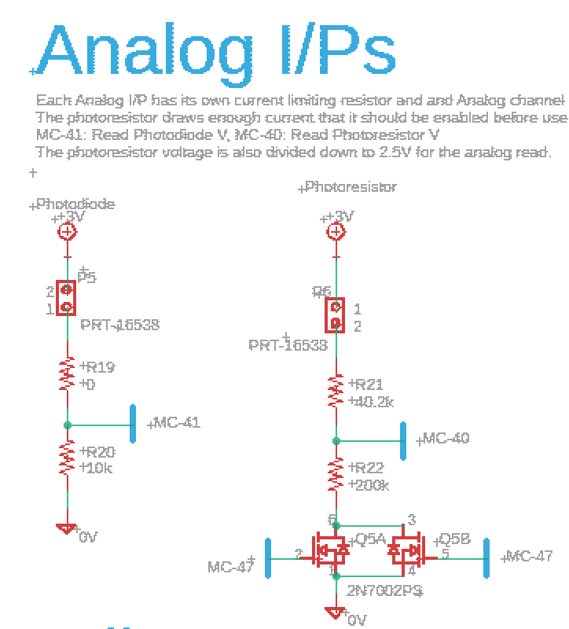
Analog inputs
Photodiode: Connected to +3V, has a simple voltage divider for easily detecting changes in voltage at ADC read pin.
Photoresistor: Connected to +3V, has a voltage divider that converts VCC to +2.5V for ADC read. This value can be converted back up in the code at a later time.

Slide 39
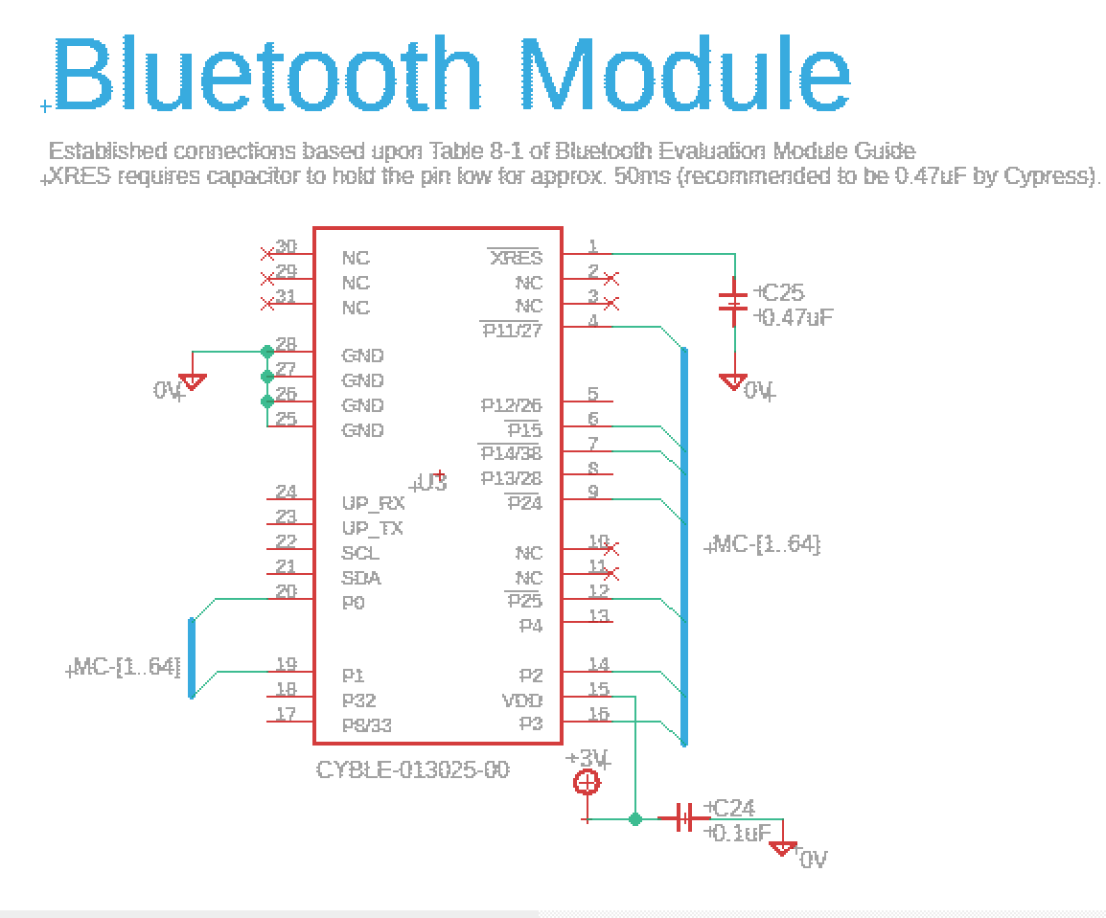
Wireless communication
Pin Configuration follows evaluation module layout. Bypass capacitor on VDD pin for noise filtering. C25 is used for holding XRES pin low for approx. 50 ms during boot-up.
Utilizes the Bluetooth Wireless Standard, maintained by the Bluetooth Special Interest Group.
Controller | CYBLE-013025-00 | RN4871 | EYSPBNZUA
Supply Current Transmitting | 26 mA | 13 mA | 14.2 mA
Lowest Power Mode Current | 1.5 µA | 60 µA | 1.1 µA
Price | $5.94 | $7.38 | $12.70
Availability | 881 | 16 | 76
Shielded | Yes | Yes | Yes
Moisture Sensitivity Level | 3 | 2 | 3
Bluetooth Protocol Version | 4.1 | 5.0 | 5.2
MCU Interface | I2C, UART, SPI | UART, AIO, PIO | I2C, UART, SPI
Earliest Shipping Arrival | 2nd day, overnight | December 24, 2021 | 2nd day, overnight

Slide 40
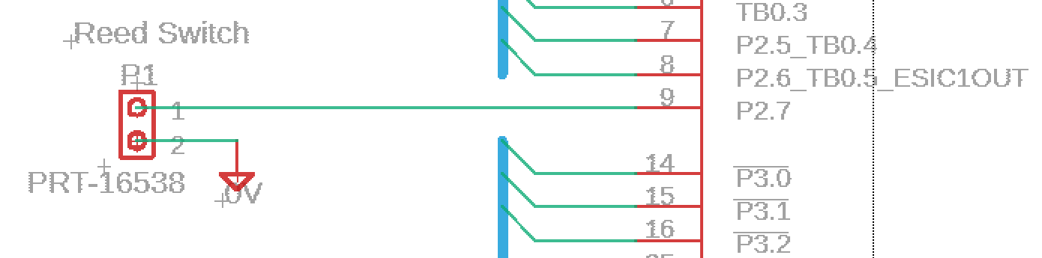
Reed switch
Different reed switches have been considered for different sensitivities. Each will be tested, and the best overall switch will be selected for project implementation.
The schematic involves an active low interrupt to the micrcontroller. P2.7 should be a pulled-high input and whenever it is shorted to ground all device features should immediately stop.
 | MS-2431-3-1-0300 | MS-2431-3-2-0300 | MS-2431-3-3-0300
Cost | $2.03 | $2.03 | $2.03
Output type | SPST-NO | SPST-NO | SPST-NO
Must Operate | 10 ~ 15 AT | 15 ~ 20 AT | 20 ~ 25 AT

Slide 41
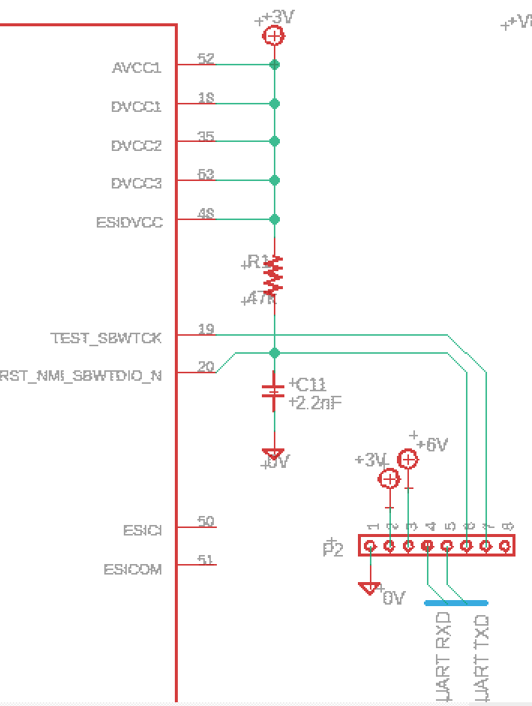
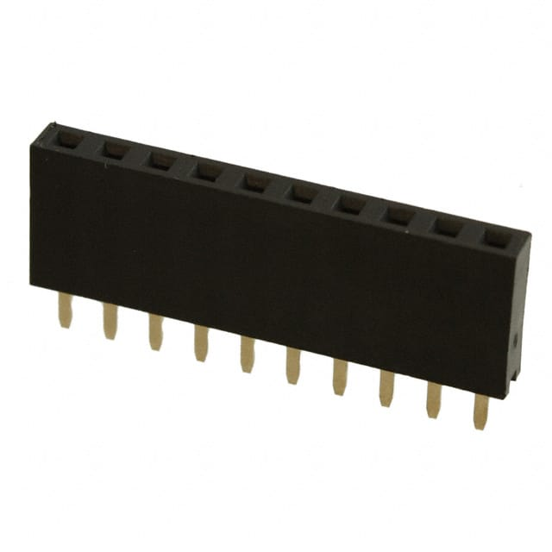
Programming header
Programming header provides access to +3V, +6V, backchannel UART to PC, and two-wire flashing pins connecting to EZ-FET on Launchpad.
R1 and C11 included per TI recommendations.
Programming header makes it easy to quickly attach standard breadboard wires between board and Launchpad and flash the device.

Slide 42
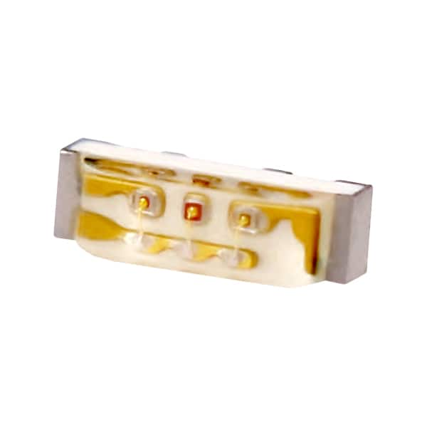
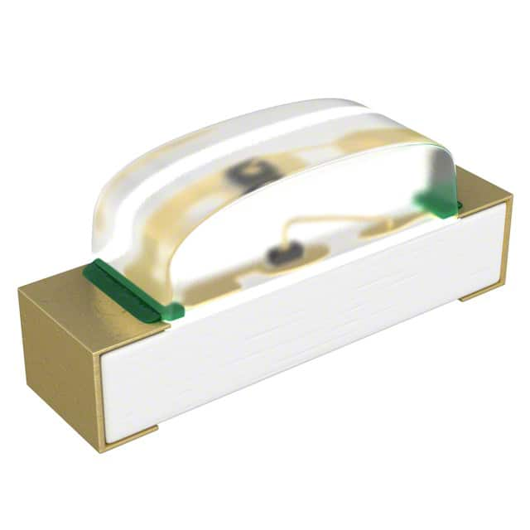
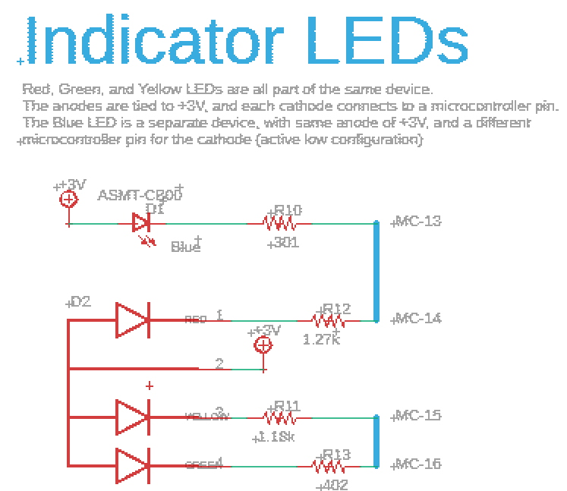
User Interface: Indicator LEDs
Indicator LEDs used to display different modes/water quality results to the user. All LEDs were designed for 1mA current when ON. Current limiting resistor values were estimated, and then the nearest EIA-96 value was selected. LEDs are right angle surface mount components so that the lights can be viewed by the user at the edge of the board/cap.
LED | Approx. Forward V | Approx. Current | Approx. Resistance
Red | 1.73 V | 1 mA | 1.27 kΩ
Yellow | 1.83 V | 1 mA | 1.18 kΩ
Green | 2.6 V | 1 mA | 402 Ω
Blue | 2.7 V | 1 mA | 301 Ω

Slide 43
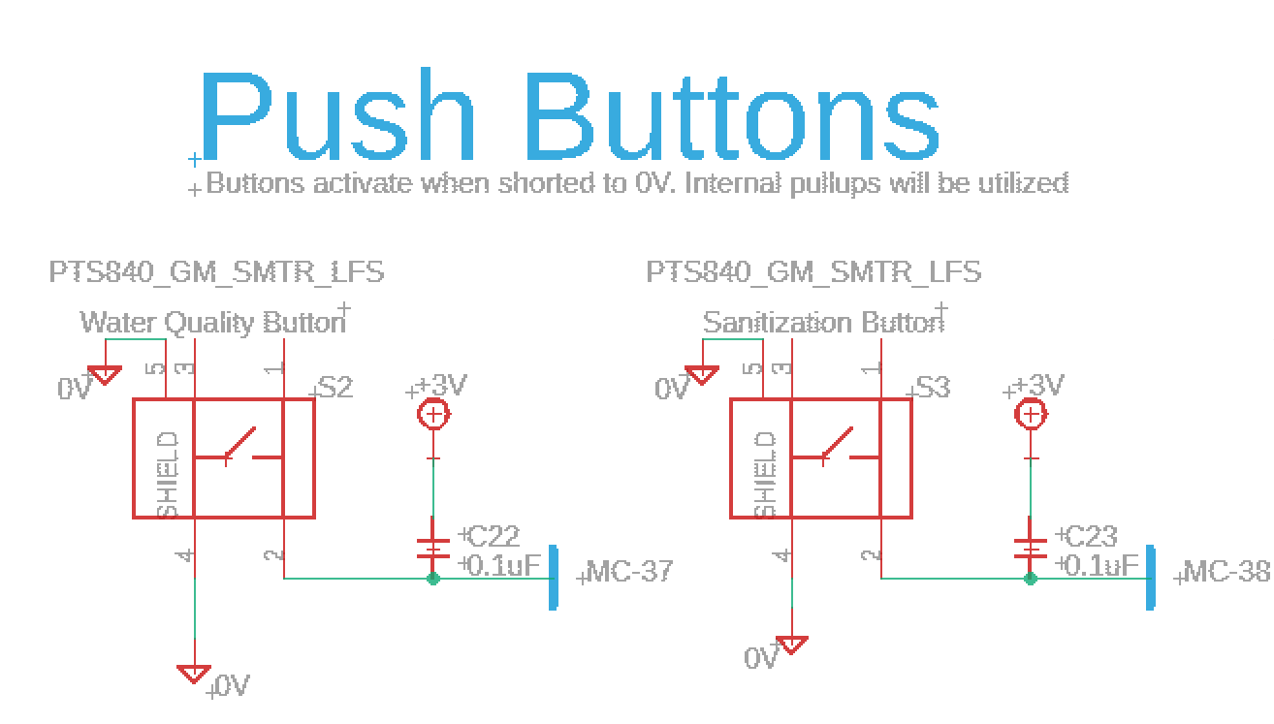
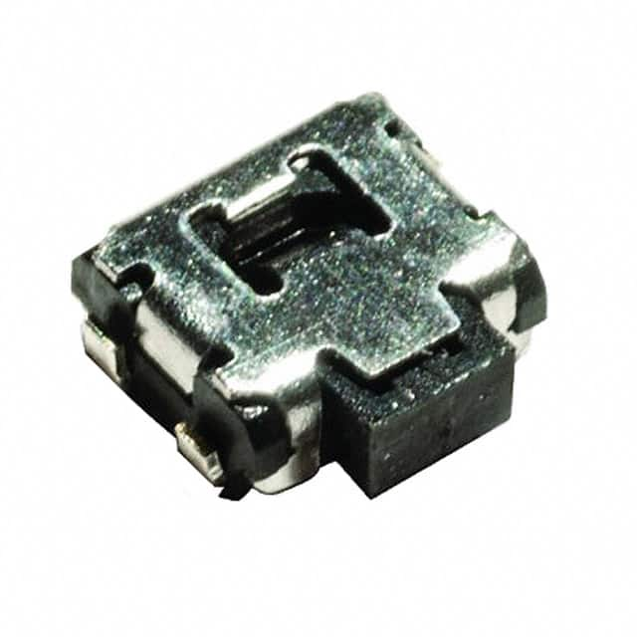
User interface: push buttons
One push button is pressed to trigger sanitization, and the other activates water quality analysis.
Noise filtering capacitors included on micrcontroller pins for button signals.

Slide 44
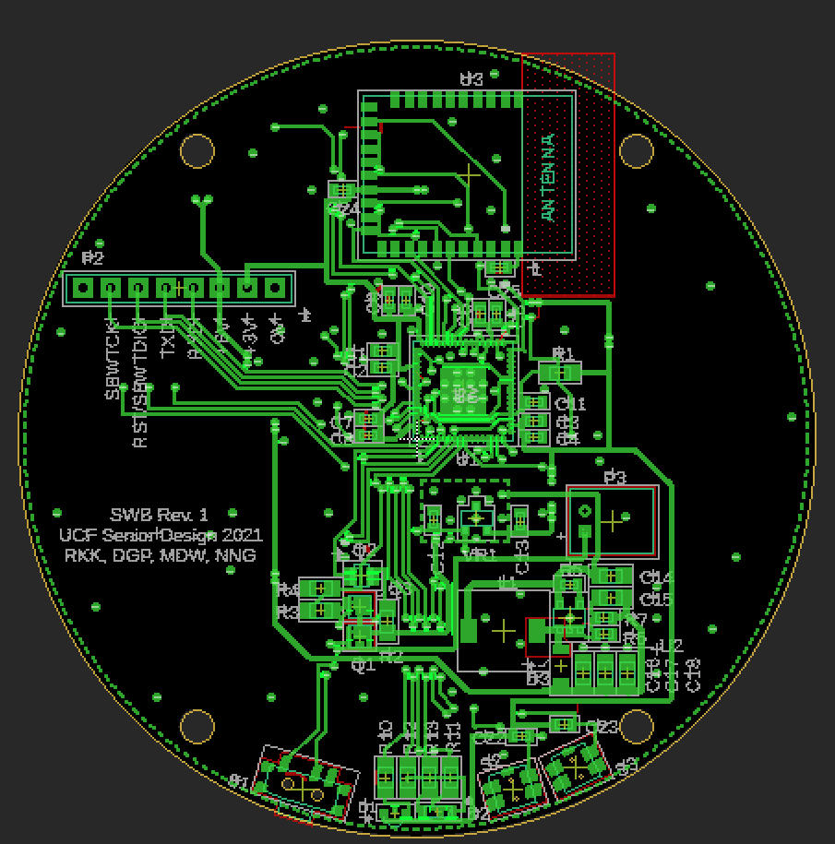
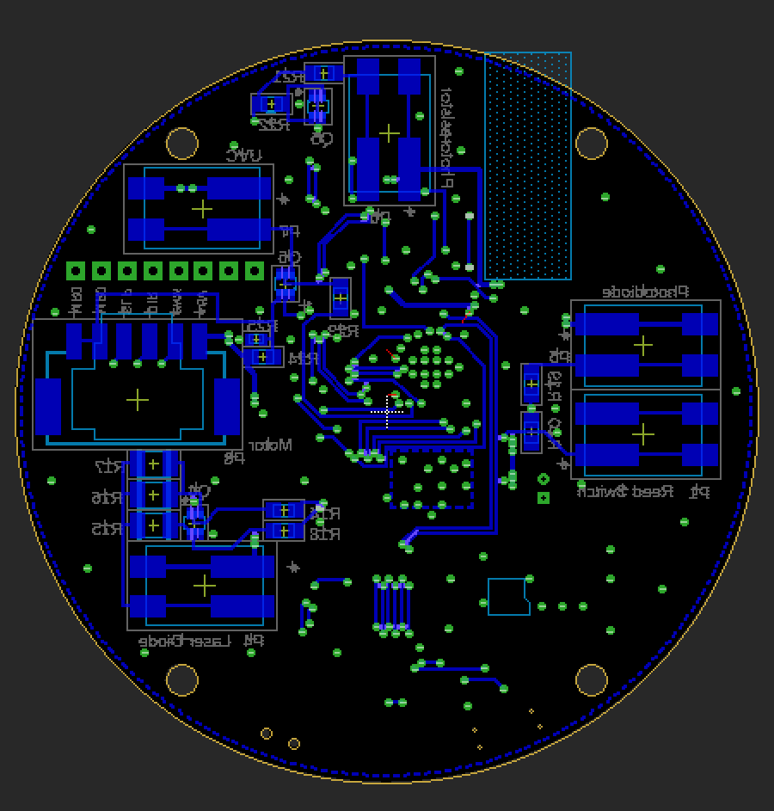
Board layout:

Slide 45

Power System
Proposed Implementation: Rechargeable battery will be actuated with a switch, which will then feed into voltage regulators providing two output voltage rails. The battery will be charged with inductive charging pads that are used for other smart devices and therefore will adhere to the Qi (“chee”) wireless standard. The battery should provide enough energy for at least 10 cycles of sanitization and quality analysis.

Slide 46
Power system: design approach
Safety: Product will be safe from electrocution and fires to ensure consumer well being and project success.
Energy Efficiency: Fully enclosed casing limits thermal dissipation , maximizing efficiency will minimize wasted heat in system.
Space Efficiency: Power components must fit in proposed casing size of 2.9” inner diameter.
Versatility: The device should be operable with any Qi certified charging pad that is sold for various smart devices

Slide 47
Power system: overview
120 VAC Power input
Inductive Power Transmitter
Inductive Power Receiver
Power Switch
Voltage Regulator
Battery
DC-DC Converters
Battery Management System

Slide 48
Power system: specifications and standards
Component | Aspect | Specification
Battery | Capacity | 2,500 mAh
 | Type | Lithium Polymer
 | Mass | 43 g
 | Nominal Voltage | 3.7 V
 | Size | 1.8" x 2.4" x 0.26"
Charger | Max Charging Current | 500 mA
 | Pass Transistor ON-Resistance | 0.35 Ω
Power Receiver | Type | Inductive
 | Output Voltage | 4.8V – 5.2V
 | Current | 500 mA
 | Size | 1.2” x 1.8” x 0.01”
Battery Pack
Battery Composition | RoHS2: The Restriction of Hazardous Substances in Electrical and Electronic Equipment was put into force by the European Commission via the RoHS Directive on July 21, 2011 [72]. This law restricts the use of particular hazardous substances in electrical and electronic equipment.
Qi Wireless Charging Standard
Induction Charging | The Qi Wireless charging standard is maintained by the Wireless Power Consortium [8], and the power receiver that will be purchased for this project will adhere to this standard.

Slide 49
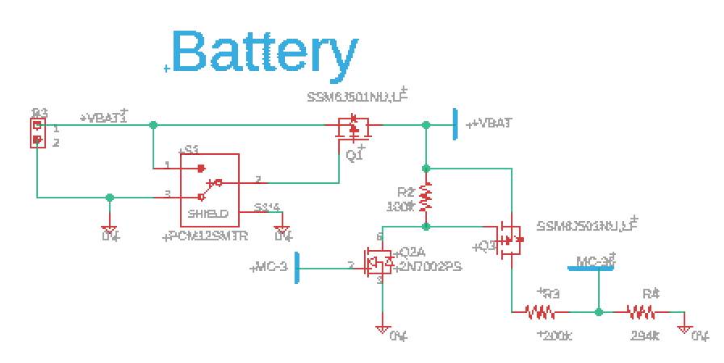
Power system: Battery, charger, and power receiver
Design Decisions: The Qi standard includes data communication protocol, which was outside of the scope of this part of the project. Properly charging a Li-Po battery is very important for device safety. Therefore, a premade charger and Qi receiver were bought from Adafruit, along with the battery.

Slide 50
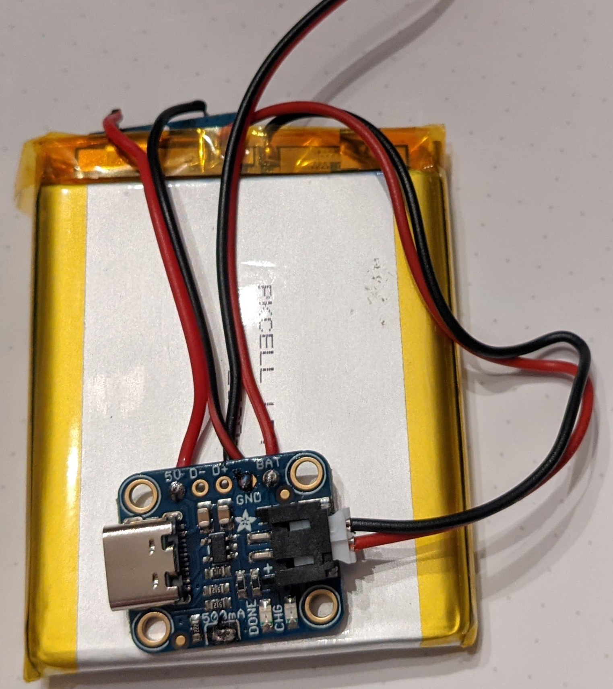
Power system: Battery, charger, and power receiver (contd.)
Successes: The stock, shipping time, and assembly of the units was seamless. The ability to charge the battery via the Qi wireless receiver was achieved after minor soldering was completed.
Difficulties: Handling this unit requires care in order to preserve the integrity of the Qi receiver (located on opposite side of shown battery).

Slide 51
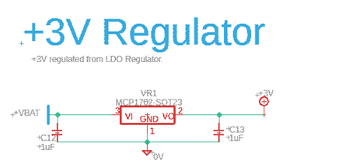
Power system: 3 Volt regulator
Design Decisions: A low-dropout (LDO) linear voltage regulator was chosen to supply the 3V rail. TI recommends that voltage input for the analog to digital converter (ADC) should have minimal noise for best performance of the ADC. Therefore, the efficiency of the switching regulator was sacrificed for the sake of voltage regulation.

Slide 52
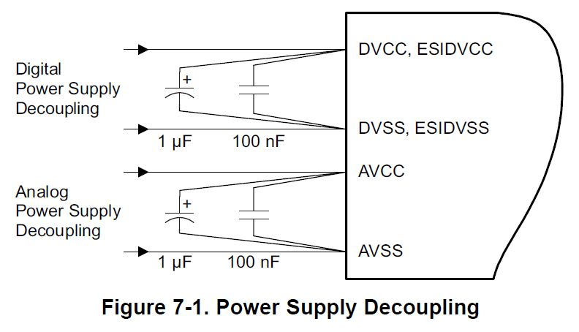
Power system: 3 Volt regulator (contd.)
Difficulties: LDO regulator stock seemed unavailable when the PCBs were being ordered. The only replacements seen online were rated for an output of 3.3V, which would have required redesign of more components.
Successes: PCBWay notified us after design submission that they would be able to obtain the part we were looking for
Taken from MSP430 datasheet: SLAS789D (pg. 156)

Slide 53
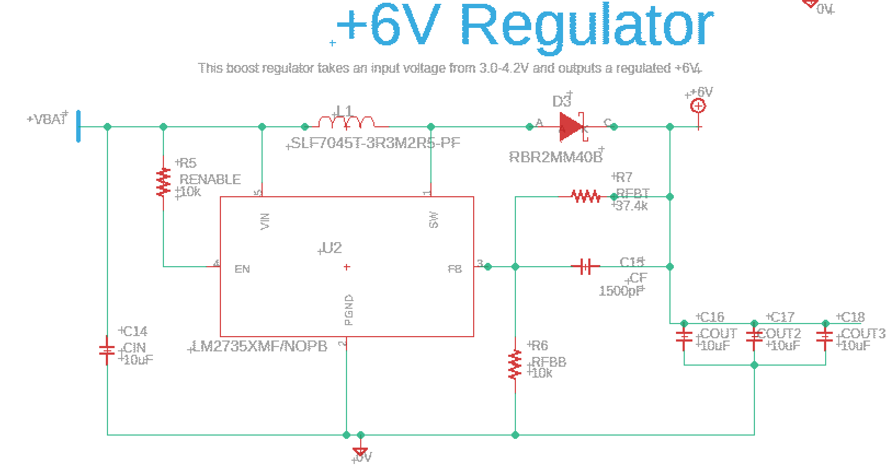
Power system: 6 Volt regulator
Design Decisions: The 6V rail will be supplying the most power in the system, so the most important consideration for this regulator was efficiency. The main reason for this focus was to minimize the heat waste from powering the optical components. Switching regulators provide high efficiencies, so TI WEBENCH was used to design a Boost regulator

Slide 54
Power system: 6 Volt regulator (contd.)
Difficulties: The online stock of TI switching integrated circuits (ICs) was scarce. After PCBWay confirmed that the needed part was unavailable, we had to find the highest efficiency design on WEBENCH with available components.
Successes: We were able to complete the redesign of this regulator, redo the schematic, and board layout within 24 hours of being notified.
 | TPS61089 (old) | LM2735XMF
BOM Area | 91 mm² | 149 mm²
BOM Cost | $2.37 | $1.47
BOM Count | 14 | 11
Efficiency | 95.4% | 85.6%
Frequency | 493.58 kHz | 1.6 MHz

Slide 55

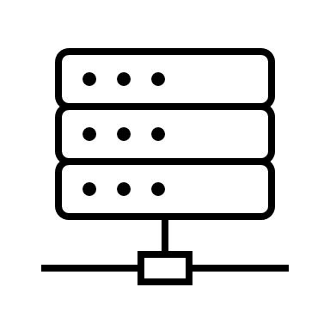
Software
Proposed Implementation: The selected microcontroller is a TI MSP430, therefore the firmware will be coded in C. This will control peripherals, take water quality readings with the ADC, and send data to the BLE module via UART. The firmware for the Bluetooth module comes pre-installed and will connect to a smartphone app using Bluetooth Low Energy (BLE).

Slide 56
Software: design approach
Code Familiarity: Microcontroller coding is focused on techniques learned in prior classes.
IDE Accessibility: The Integrated Development Environment (IDE) chosen for code development must be easily accessible on each team member’s PC.
Ease of BLE Connectivity: It was highly desirable to choose user friendly devices and coding languages, since none of the team has coded for Bluetooth communication before.

Slide 57
Software: overview
Firmware
App
Reed Switch Interrupt
Engage sanitization mode
Determine water quality (Yellow LED)
Wired comm. Protocol: UART
Turn on Blue LED
Wireless Protocol: BLE
Low Power Modes
BT Pairing
Report Water Quality Statistics
Mobile Processor and Computation
Display status with R/G/Y LED
Send water quality status to app

Slide 58
software: specifications and standards
Aspect | Specification
Interrupt Handling | System responds within 1 second of Reed switch and button press.
Time for one sanitization cycle | 3 minutes
Wired Communication Protocol | UART: Full-duplex serial system
Water Quality Sensor | ADC used to detect photodiode output to the resolution of microvolts.
Connection Distance | Device should be able to pair with a smartphone from 10 feet or less.
Pairing Time | The device should take no longer than 30 seconds to pair/connect with a smartphone.
Bluetooth
RF Communication | The Bluetooth wireless standard is maintained by the Bluetooth Special Interest Group (SIG) and the selection of wireless communication transmitter will comply to the standard.

Slide 59
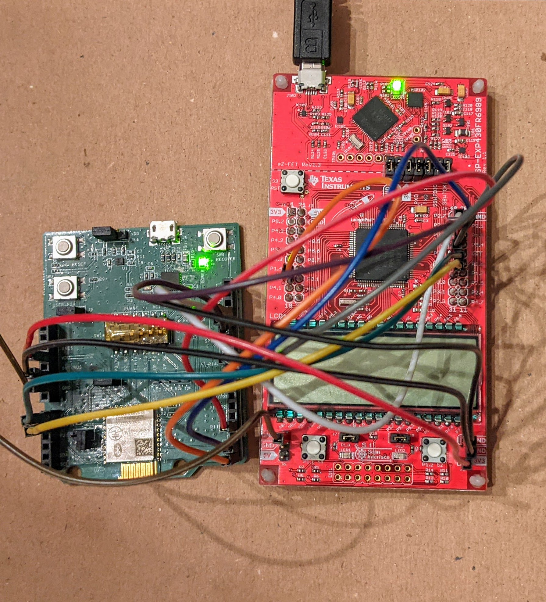
Microcontroller firmware
Design Decisions: Code Composer Studio will be the IDE for the MSP430 firmware. MSP430 will communicate with BLE module via UART.
Successes: Many functions developed in previous classes will be easily modified for project use.
Difficulties: Purchased development boards are made with MSP4306989 chips, while the selected microcontroller is the MSP4305989. This means that not every port will be the same as we develop code prior to custom PCB arrival.

Slide 60

Smartphone app software
Design Decisions: Due to OS requirements for Xcode (iOS) vs. Android Studio (Android), it is most convenient to create an Android app coded in Kotlin. Android API 21 will be used for app development since it is the earliest version to support BLE.
Successes: Many helpful online resources have been found to assist in the creation of the app
Difficulties: We have yet to begin writing this code and it is not a familiar coding language to our team.

Slide 61
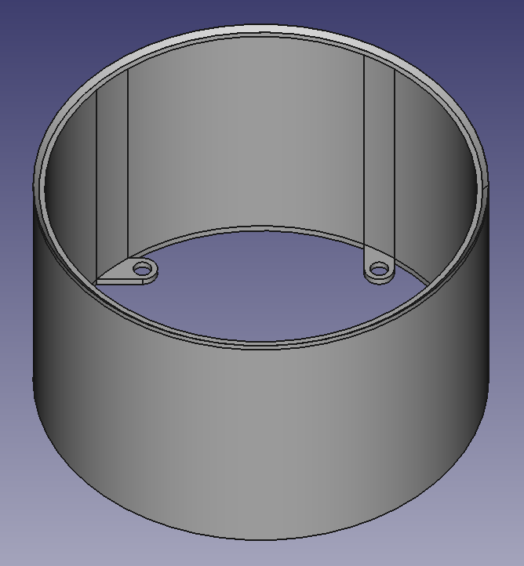
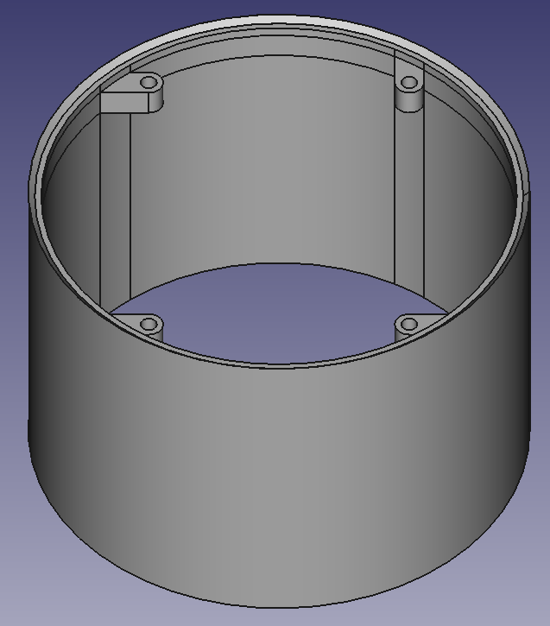
Device Housing
The device housing will be 3D printed using PLA filament at the Optics Senior Design lab's Prusa printers.
The design emphasizes modularity to allow for less wasteful and more efficient modification of parts as the design evolves.
Shown on the upper right is the base of the battery layer, and on the lower-right the top of the micro-controller section. The sections are secured by beveled edges and mounting screws.

Slide 62

Project constraints/Impact
Economic: Project is self funded and personal team funds are limited.
Environmental/Sustainability: Reusable water bottle tech helps to reduce use of disposable water bottles.
Social/Ethical: Despite care given to design cost, this project will not be able to accommodate consumers of lower socioeconomic status.
Health/Safety: Due to risk of waterborne illness, it is critical that designs are as effective and accurate as possible. The use of high-powered lasers requires extra precautions in project design to prevent accidental exposure.
Manufacturability: Global semiconductor device shortage restricts design choices significantly.

Slide 63
Budget
Component | Cost
Device Housing
Bottle | $13.99
Custom Housing | $0
Total: | $13.99
Bluetooth Module
Cypress Bluetooth CYBLE-013025-EVAL Board (+tax & ship) | $54.51
Total: | $54.51
Power
4 Batteries, 4 JST connectors, 4 LiPo chargers, 2 Qi receivers (+tax & ship) | $140.74
Total: | $140.74
Sanitization
LED 275 nm (including sales tax and shipping) | $11.67
LED 265 nm (including sales tax and shipping) | $8.83
Bacteria Test Kit (2) | $7.01
Total: | $27.51
Spectrometer
Prism | $19.98
Photodiode | $14.58
Laser diode | $16.15
Servomotor | $11.99
Stepper Motor | $5.99
Stepper Motor Driver | $5.95
Mirrors | $8.99
Lens | $18.83
Shipping + Tax | $20.62
Total: | $123.08
Embedded Hardware
Microcontrollers (MSP430FR5989IRGC x6) from TI | $38.62
PCB (x5) and Assembly (x4) | $297.00
Total: | $335.62
Grand Total: | $695.45

Slide 64
progress
Hardware
Software
Water Analyzer
Sanitization
90%
20%
40%
60%

Slide 65
Immediate Plans for success
Deep dive into codebase for project. Write code to flash the microcontroller.
Creating simple App on android platform.
Testing prototype boards arriving from PCBWay.
3D print device housing.
Assemble sanitizer sub-system and finish testing.
Construct functional spectrometer within size limitations.

Slide 66
QUESTIONS?

