Slide 1
Group 14
Motor Assisted Cooler (M.A.C.)

Slide 2
Meet the M.A.C. Team
David Crumley (CpE) Min Park (CpE) Aqeel Ahmed (EE) Phuong Thi Y Duong (EE) Phuong Thi Y Duong (EE)

Slide 3
Project Description
A motor assisted cooler that will provide more time for fun outdoors and less strain going back home.

Slide 4
Motivation
EASE OF MOBILITY ON MOST TERRAINS
KEEPS YOUR DRINKS COOLER FOR LONGER
LESS STRESS WHILE HAVING FUN

Slide 5
Goals and Objectives
Research and Development.
Four major component mobile cooling system.
Motor assisted cart
Solar Charging
Peltier Cooling Device
Power distribution

Slide 6
Specifications
Component | Parameter | Design Specification
Battery x2 | Discharge Time | 2 hours
Battery x2 | Charge Time | 6 hours
Peltier Cooling Device | Cooling Time | 12 qt cooler to 50°F in 10 minutes
Thermostat | Temperature Control | -50° to 150° C
Solar Panels | Power Output | 50 Watt
Motors x2 | Torque | 155 ea. And 310 oz per inch / 1 newton meter
Motors x2 | RPM | 480

Slide 7
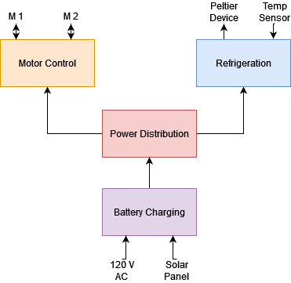
Overall Block Diagram
Task Allocation
Battery Charging | Aqeel & Phuong
Power Distribution | Aqeel & Phuong
Refrigeration | Min
Motor Control | David

Slide 8
Motor Control

Slide 9
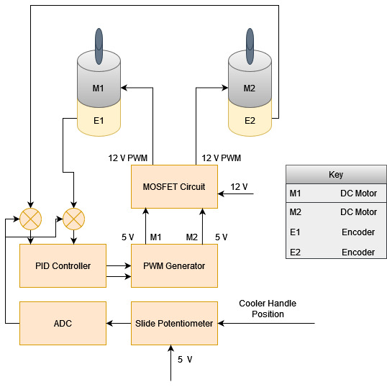
Motor Control
Slide Potentiometer measures user input
ADC converts to digital
PID controller outputs desired speed
PWM adjusted to generate desired speed
H-Bridge circuit outputs 12 volt for motors

Slide 10
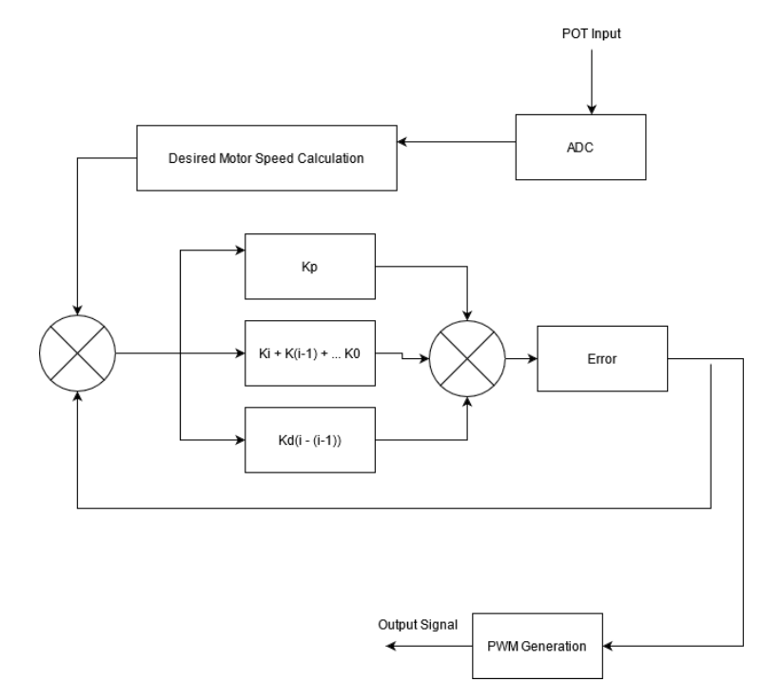
PID Controller
Implemented in the MCU
Desired motor speed based on voltage reading of potentiometer
Error is calculated based on current speed
Output calculated using function below

Slide 11
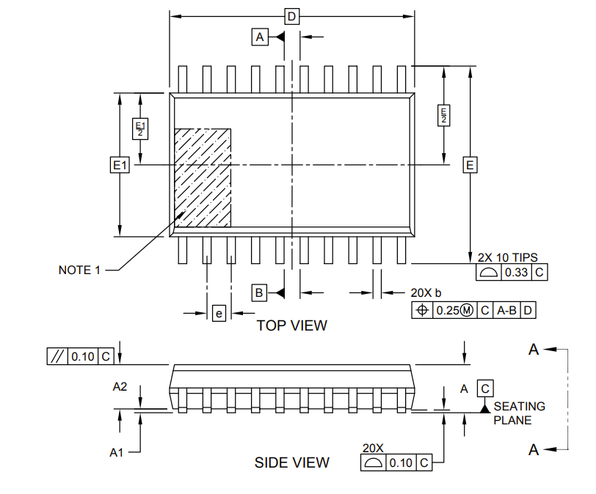
PIC18F14Q40 Microcontroller
Manufacturer | Microchip Technologies
Price | $1.08
No. of I/O pins | 20
Clock Frequency | Up to 64 MHz
Operating Voltage | 1.8 V to 5.5 V
Average Current Draw | 6 mA
Program Flash Memory | 64 KB
Converts analog user input to digital using ADC
Calculates actual motor speed using digital encoder input
Responsible for PID algorithm
Enables the MOSFET driver based on user presence sense input
Generates PWM signal for motor speed control

Slide 12
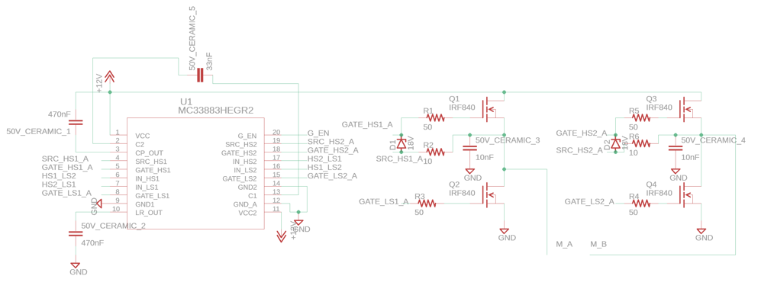
MOSFET Circuit

Slide 13
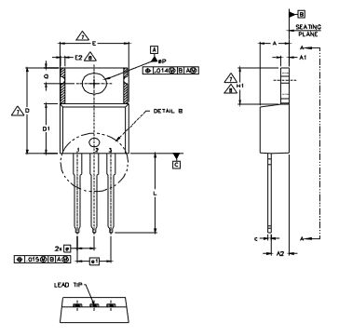
IRFZ44NPB MOSFET
Manufacturer | International Rectifier
Price | $1.43
Max Voltage (VDSS) | 55 V
Max Current (ID) | 49 A
On-resistance RDS(on) | 17.5 mΩ
Allows high current to flow to motors without damaging sensitive integrated circuits
4 MOSFETs used in H-Bridge configuration to enable polarity reversal of motor for forward and reverse operation
HEXFET power MOSFET achieve extremely low on-resistance

Slide 14
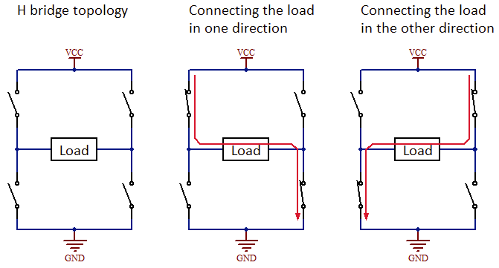
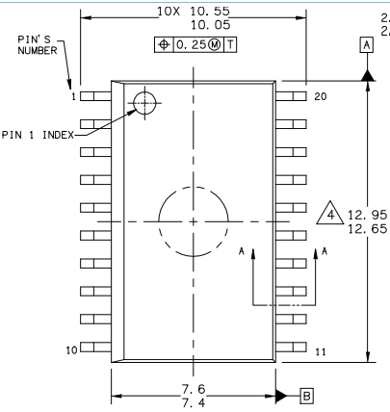
MC33883 H-Bridge Gate Driver
Manufacturer | NXP
Price | $5.72
Type | Full bridge
Input Voltage | 5.5 V to 55 V
PWM frequency | Up to 100 KHz
Switches the MOSFETS based on 4 input channels
Protects against shoot-through
Makes it easier to switch output polarity

Slide 15
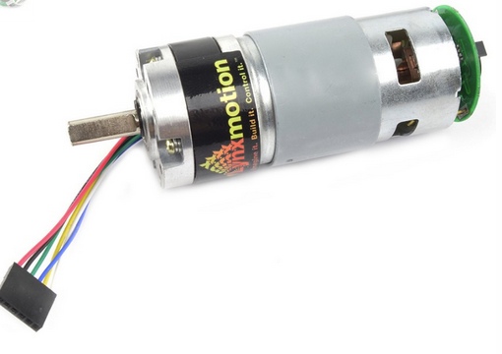
Lynxmotion 12V Motor
Manufacturer | Lynxmotion
Motor part no. | RS775
Gear box no. | PG45
Price | $28.16
High torque brushed DC motor with 1:5.2 internal gearing
1.58 Amp average current draw
155 oz-in torque rating
Digital hall-effect encoder

Slide 16
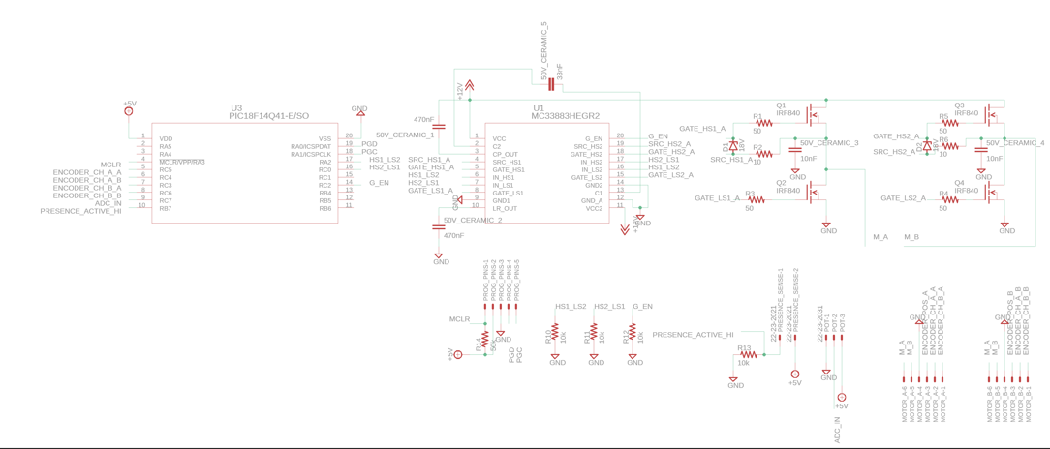
Motor Control PCB Schematic

Slide 17
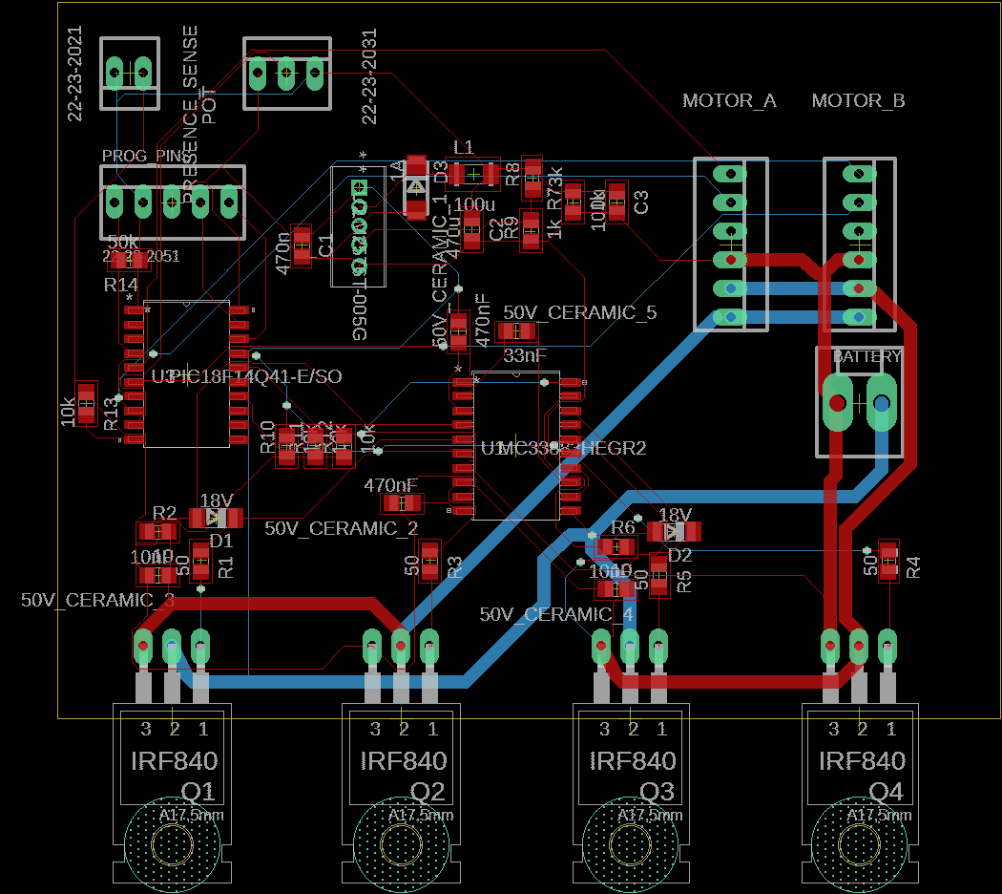
Motor Control PCB Layout
Wider traces for high current flow to motors
5v switching regulator integrated into PCB design
External programming pins for debugging

Slide 18
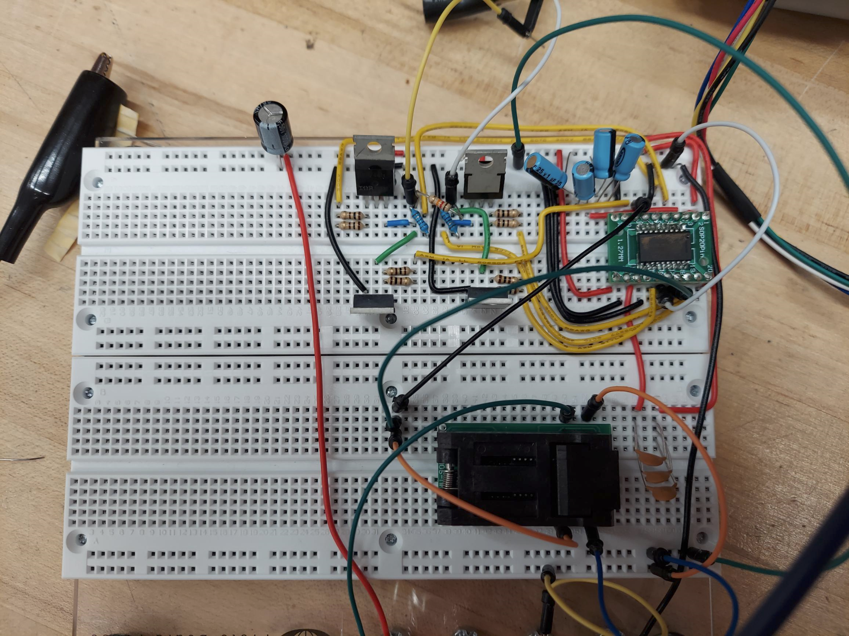
Circuit Testing
Power supply from the lab used to simulate 12 volts from battery and 5-volt from regulator
Potentiometer position was moved to produce variable PWM signal
Circuit output was measured on oscilloscope

Slide 19
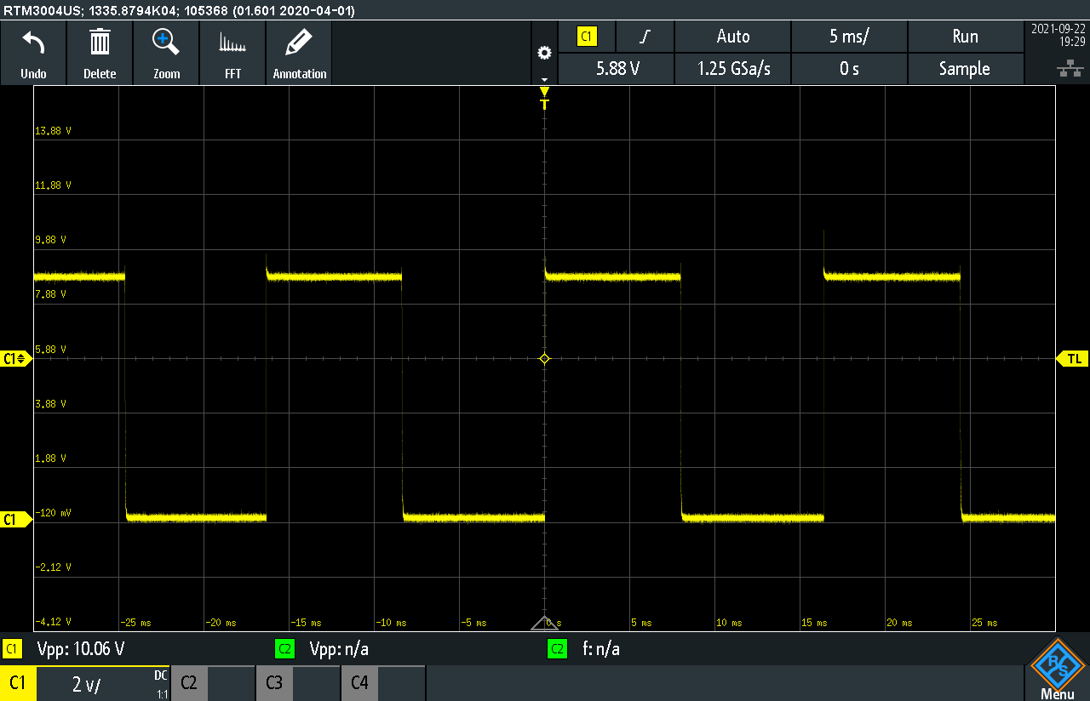
Circuit Testing Results
Output is 50% duty cycle PWM with peak-to-peak close to 12 volts
Positive Polarity

Slide 20
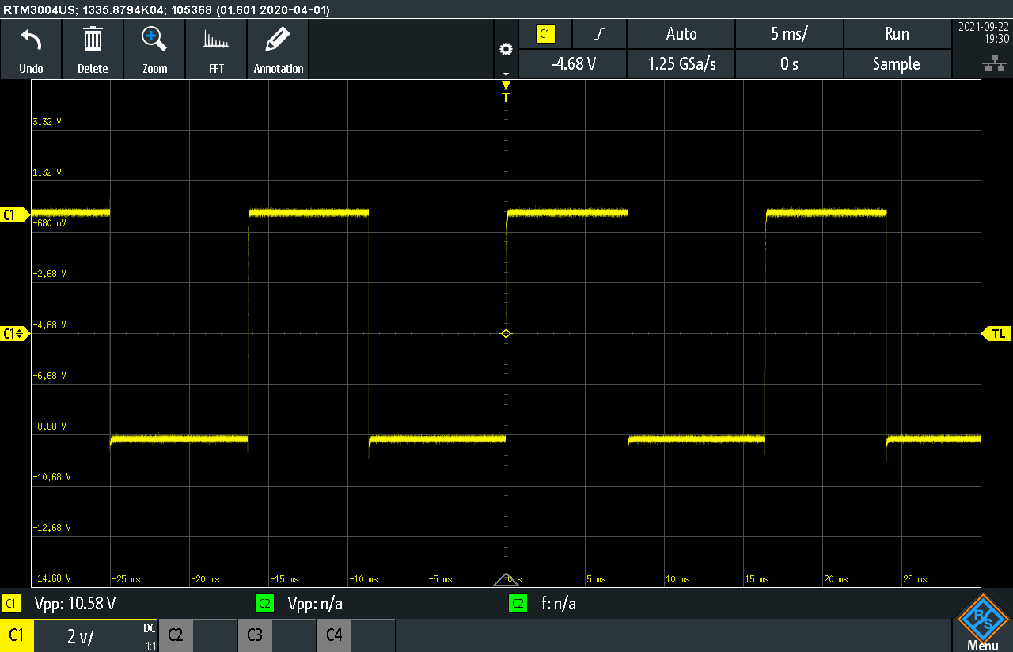
Circuit Testing Results
Potentiometer position is changed
Output is polarity switched

Slide 21
Motor Control Layout
Safety handle used to engage the system
Motors attached to front wheels of the cart with belt drive
Sensor module with potentiometer attached to the handle

Slide 22
Refrigeration

Slide 23
Refrigeration Methods
4 Types
Mechanical Compression
Absorption
Evaporative
Thermoelectric

Slide 24
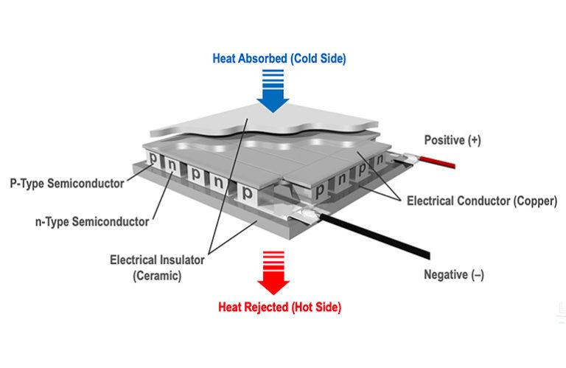
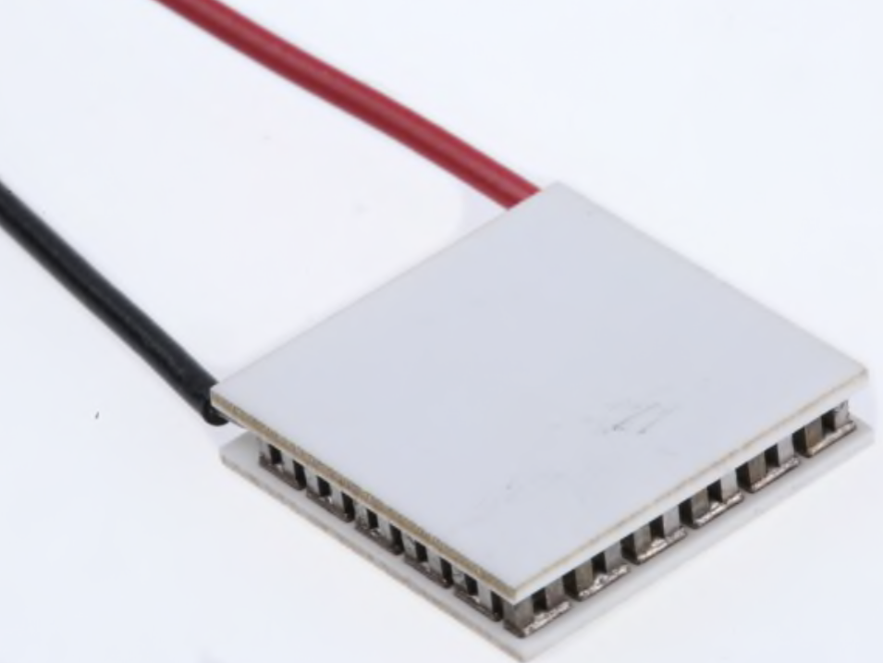
Peltier Device
Thermoelectric Peltier’s consist of equal amounts of N-type semiconductors and P-type semiconductors in series with two ceramic tiles placed on top and bottom.
Absorbs heat on one side and rejects heat on the other.

Slide 25
Peltier Device Cont.
Hot side problem:
Getting too hot on one side
Added heatsink and fan
Cold side problem:
Cooling area not getting cold fast enough
Added smaller heatsink and fan.

Slide 26
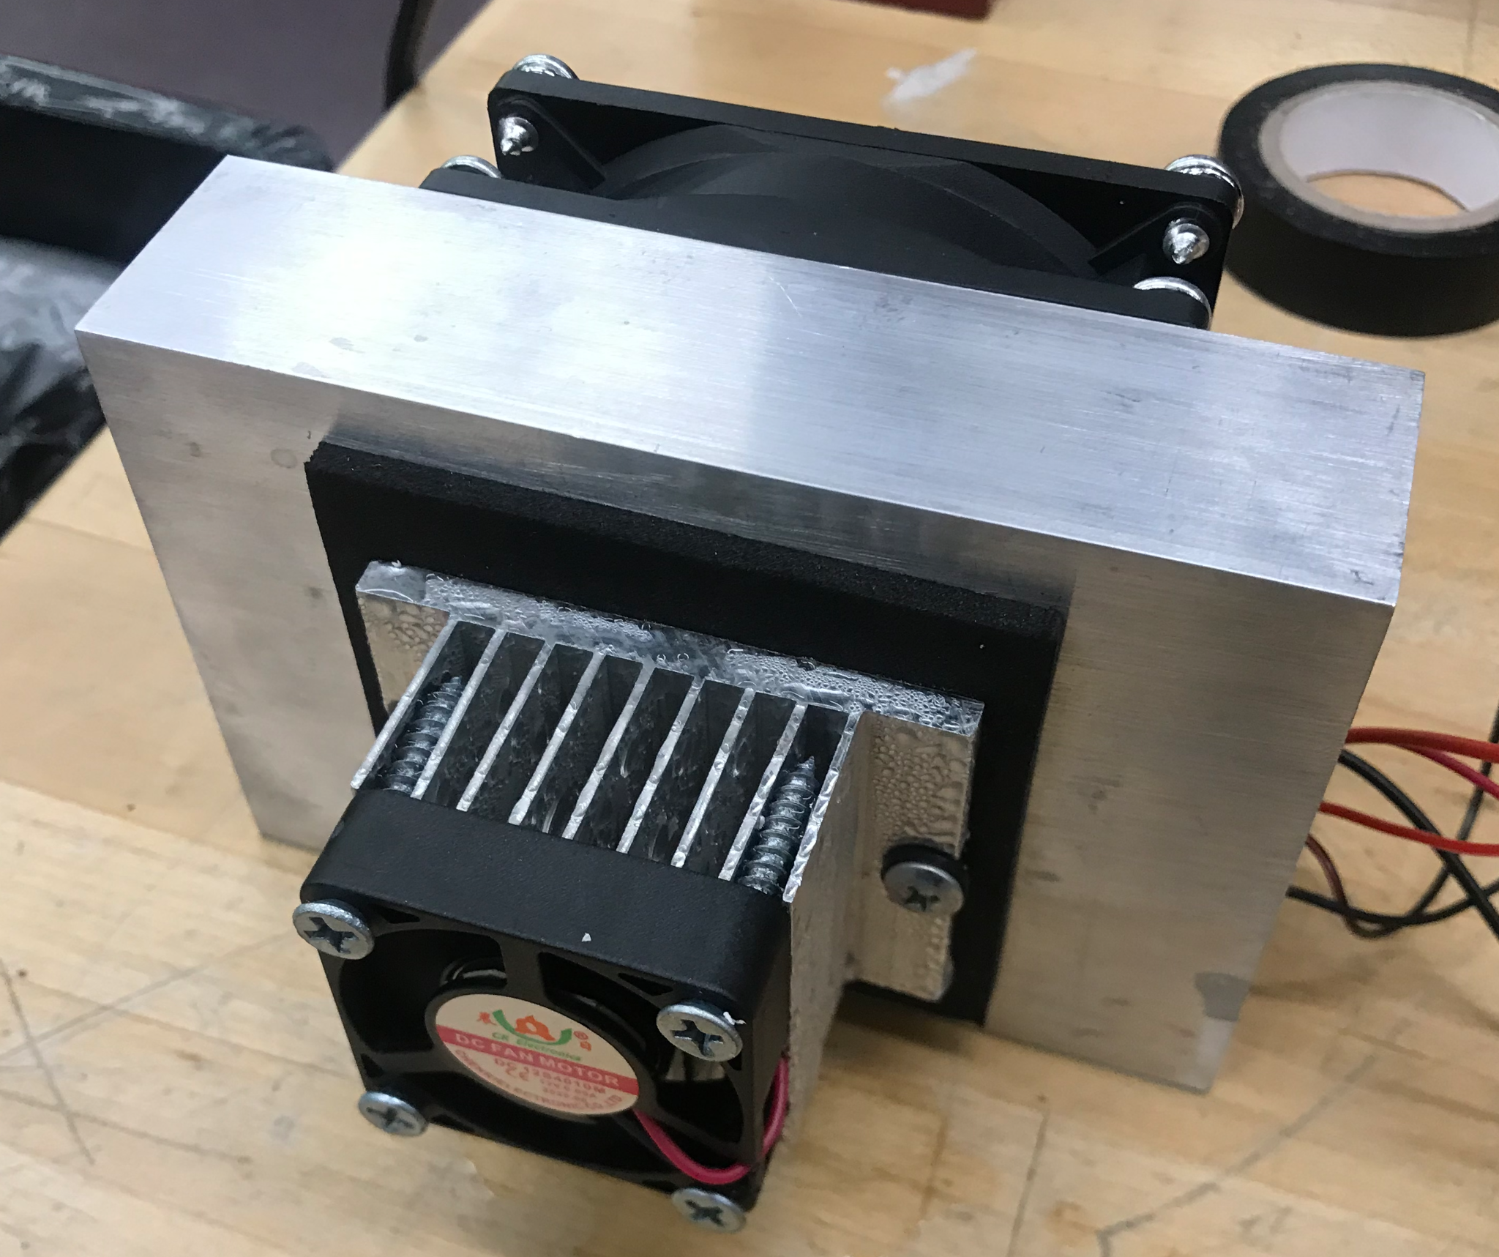
Peltier Refrigeration
Final Design Components:
Model: | Voltage | Current
TEC1-12710 | 12V | MAX: 10A Actual: 4.5A
Small Fan 12S4010M | 12V | 0.09A
Big Fan | 12V | 0.20A
Heatsinks x2 | na | na

Slide 27
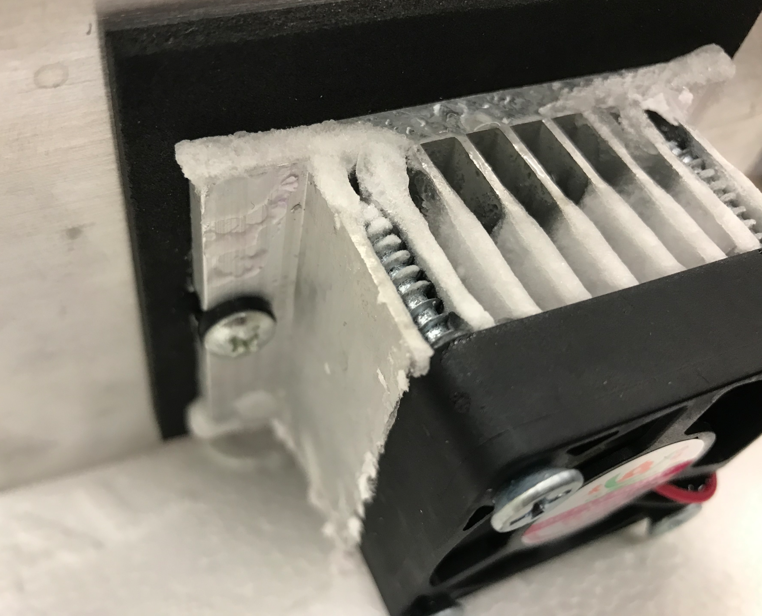
Peltier Refrigeration Testing
Reached 40° F /5° C ambient temperature within the cooler.
Ice formation on heatsink.

Slide 28
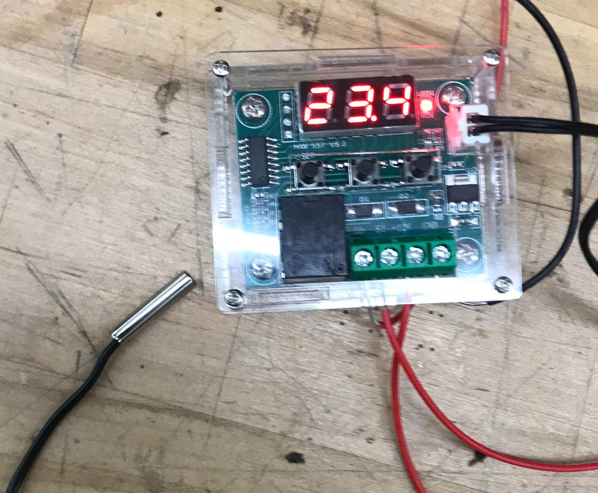
Temperature Control
Temp. Module: | Voltage | Current
W1209 | 12V DC | 65mA

Slide 29
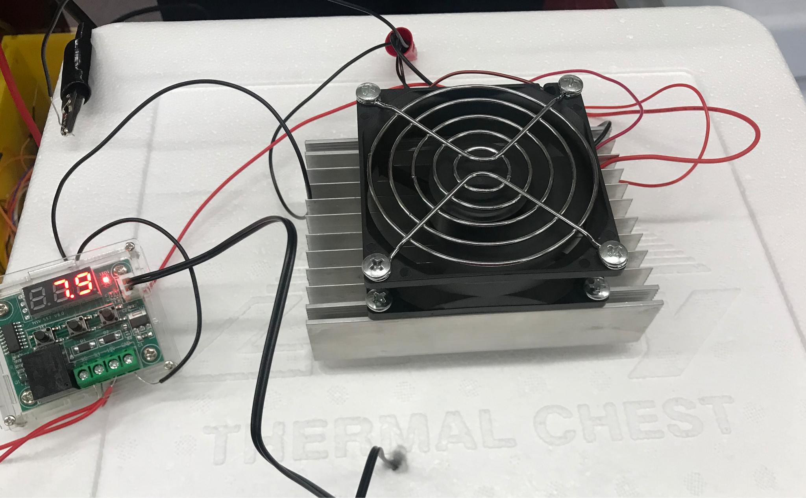
Peltier Refrigeration Testing
Parts:
Peltier Refrigeration Device
12 qt Cooler
Temperature sensor w/ relay control

Slide 30
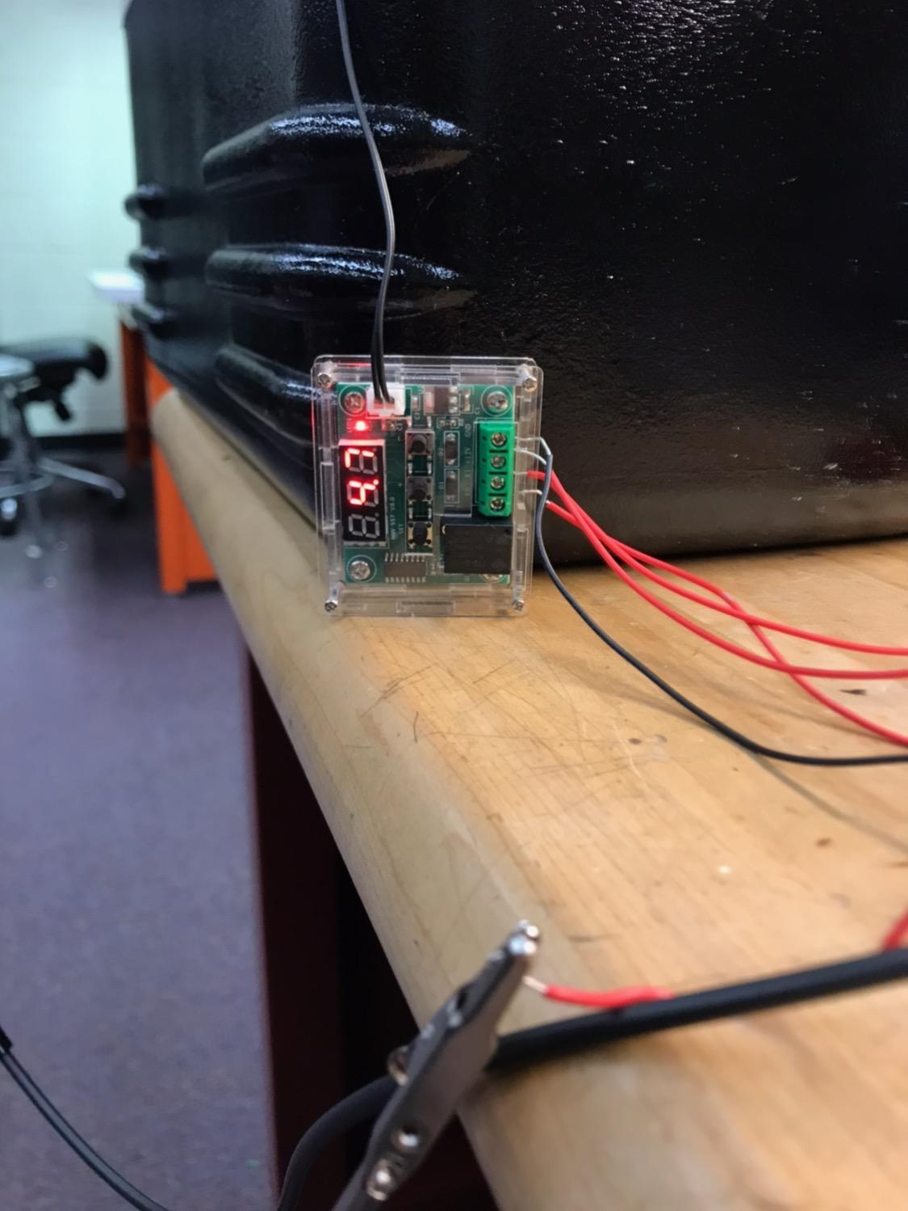
Change of Plan
asdfasdfasdf
 | Igloo PlentiKool
Voltage: | 12V
Current: | 4.5 A
Size: | 24 Qts

Slide 31
Power Storage

Slide 32
Expected Design
Solar Panel
Buck Converter
Battery
Sensors
Controller
Switching Circuit
Load

Slide 33
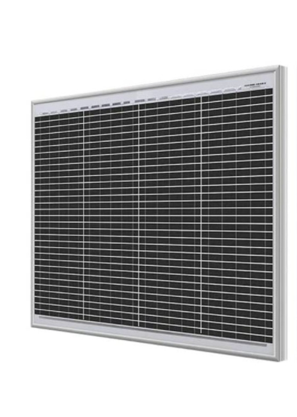
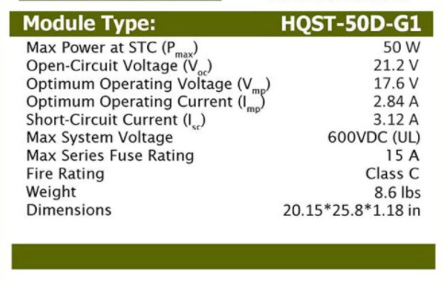
Solar panel

Slide 34
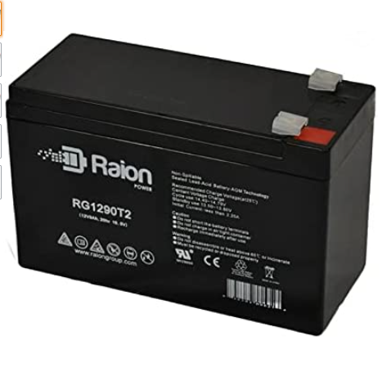
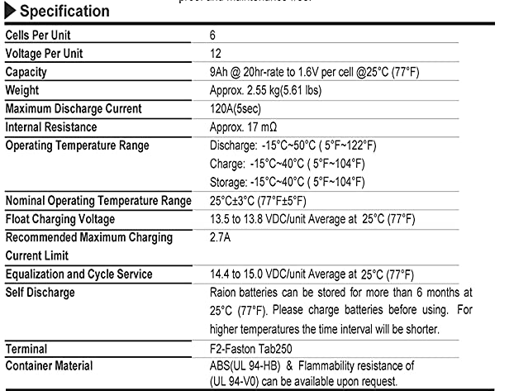
Batteries
Specification

Slide 35
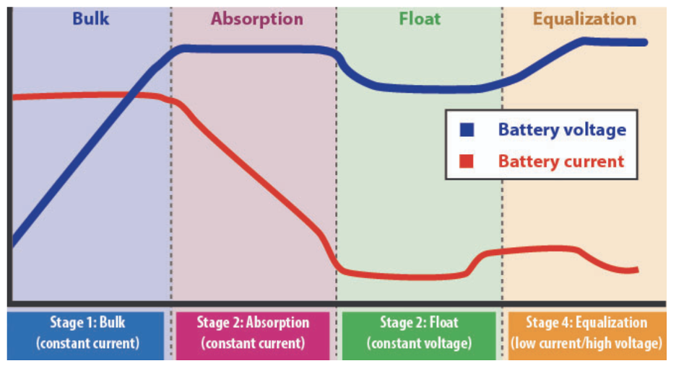
Battery Charging Stages

Slide 36
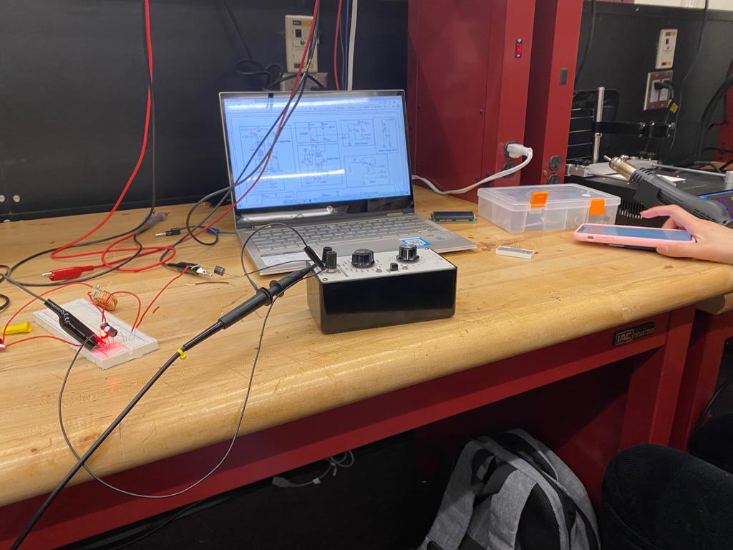
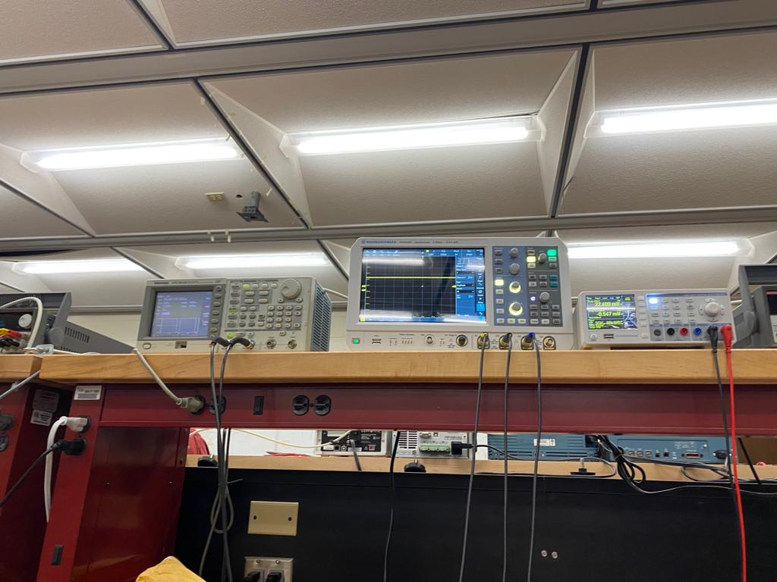
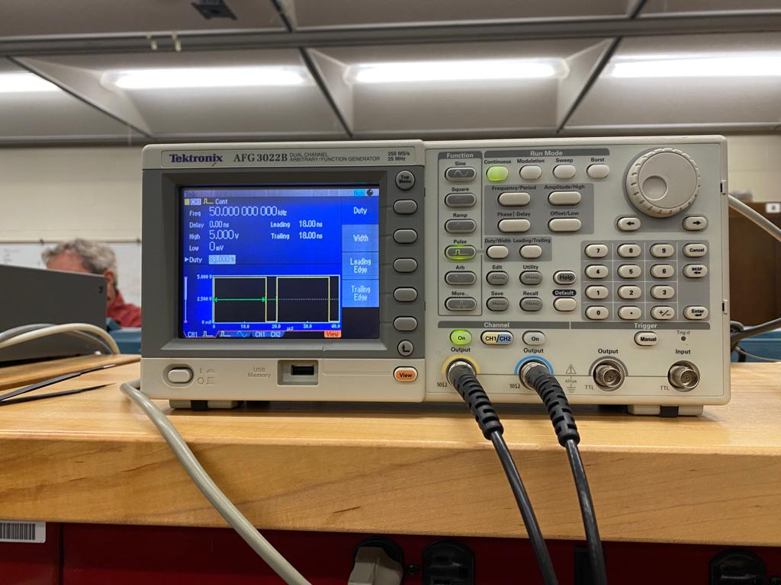
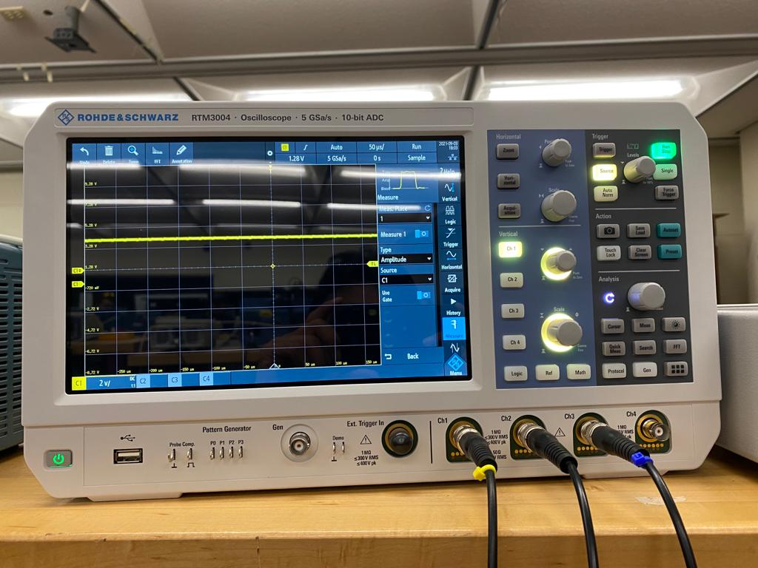
Buck Converter Testing
Inductor | 50uH
Capacitor | 470uF
Diode | 15A, 45V

Slide 37
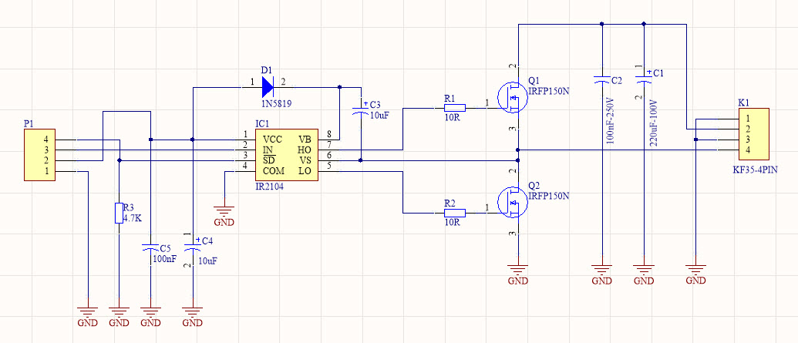
Switching Circuit Tested for 20kHz
Mosfet | IRZ44N
Driver | IR2104

Slide 38
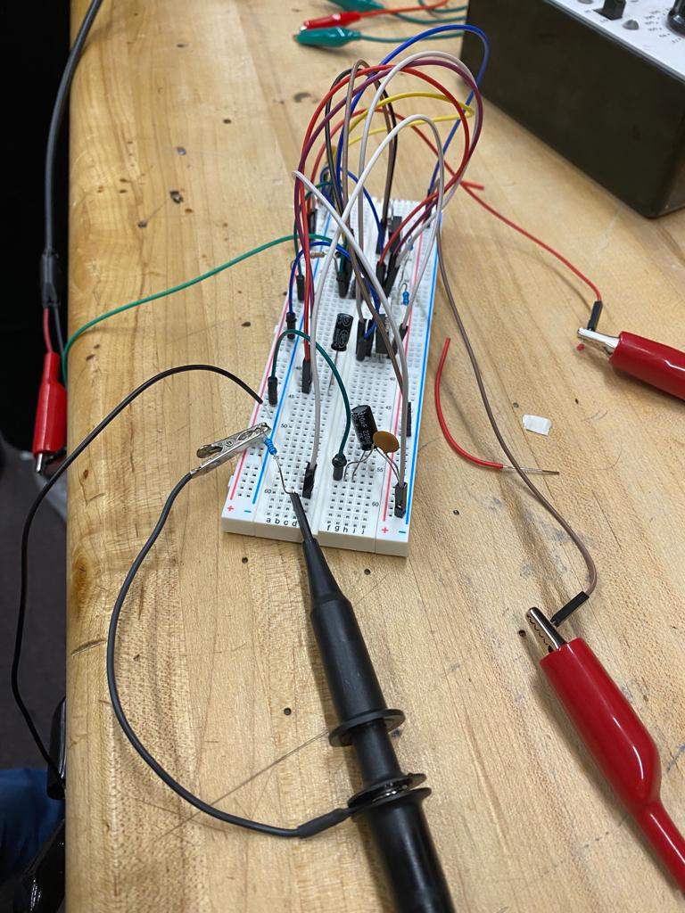
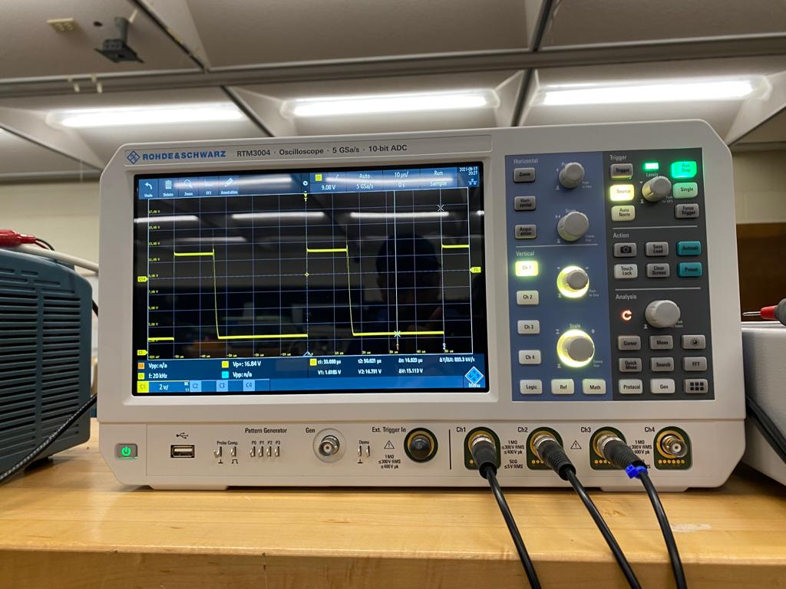
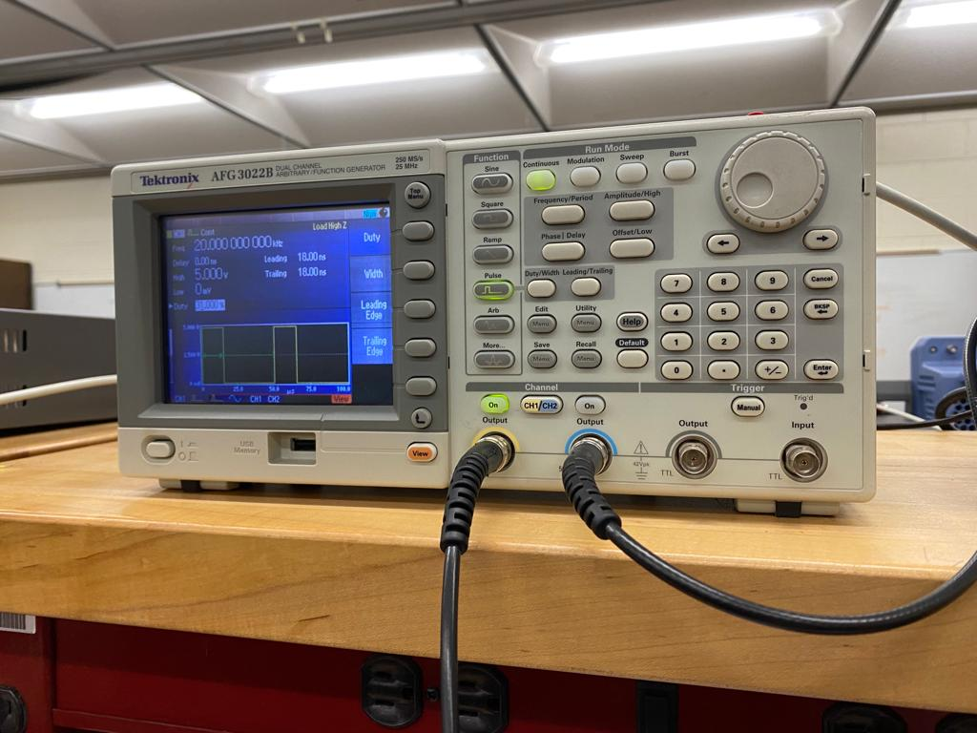
Switching Circuit Tested for 20kHz

Slide 39
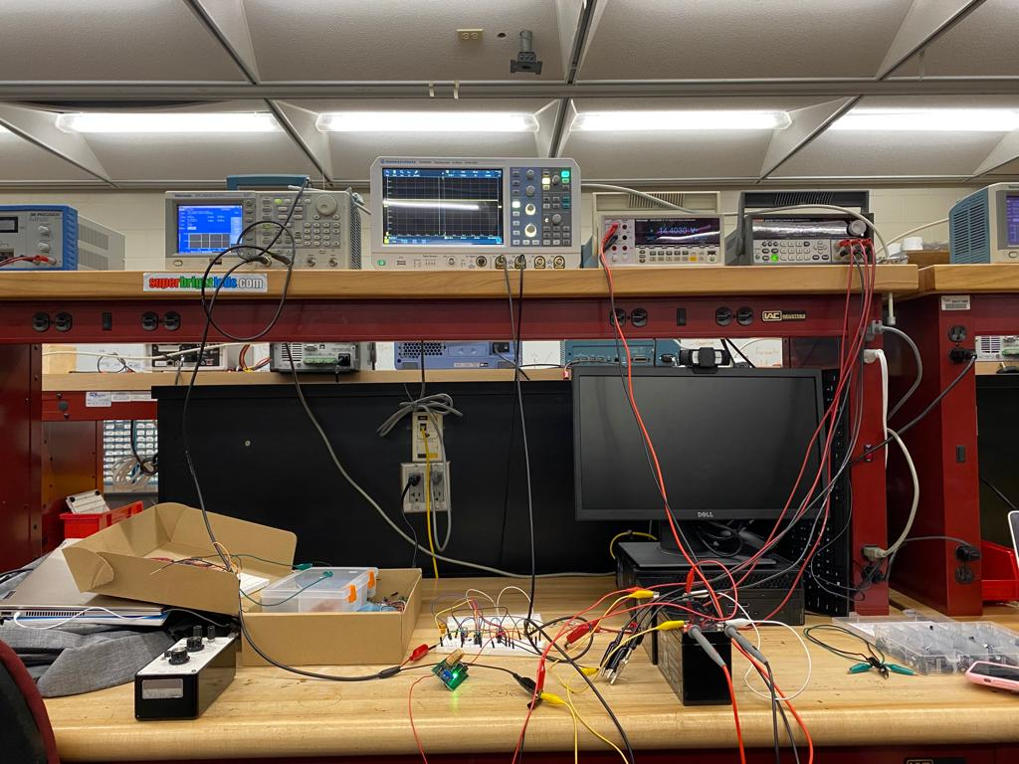
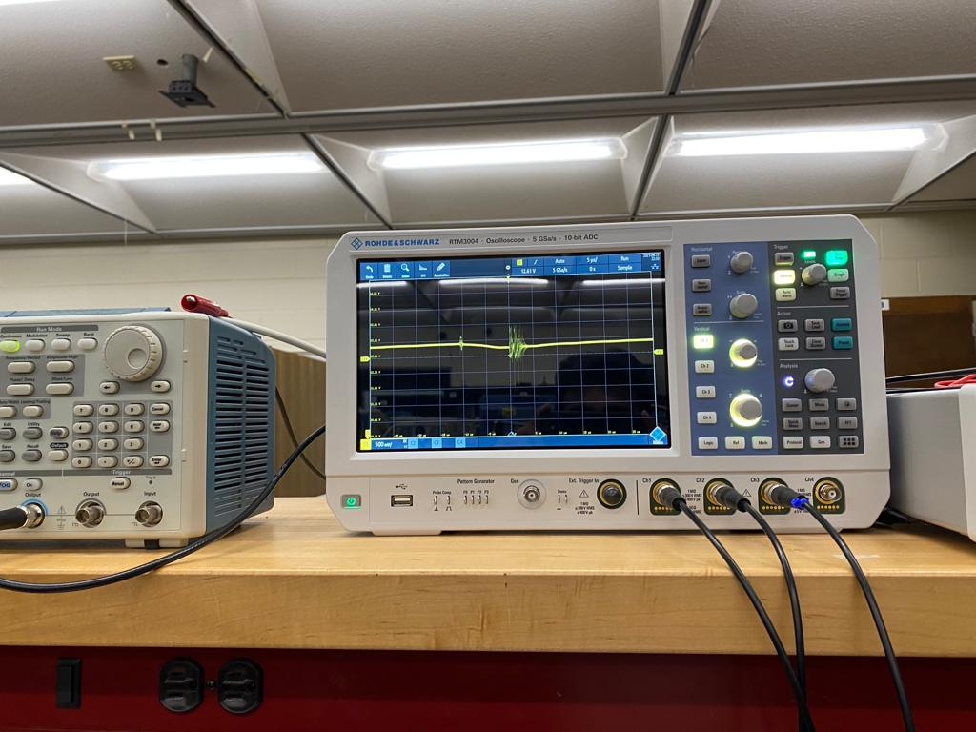
Charging Battery Using PWM of PIC
PIC18F14Q40

Slide 40
In progress
PWM from pic was not giving us desired output, so we are also thinking to use nodemcu esp32 as a controller since they have fast time response.
Currently working on display and sensors reading part. After that actual algorithm will be implemented in controller.

Slide 41
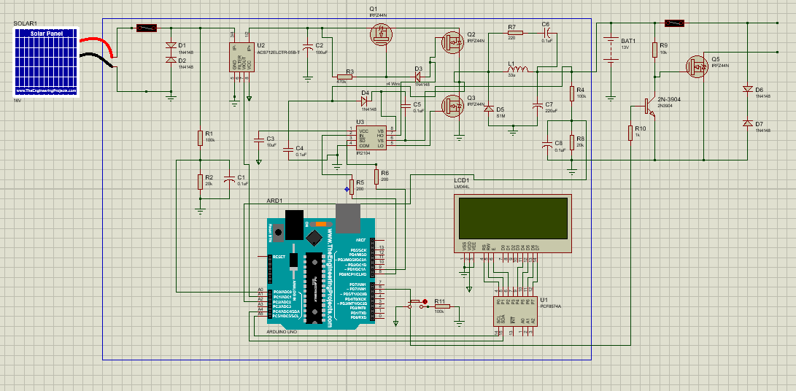
Complete Circuit
PIC18F14Q40 is not available
in simulation
Various parts have been
modified based on hardware
testing e.g buck, mosfet
switch etc

Slide 42
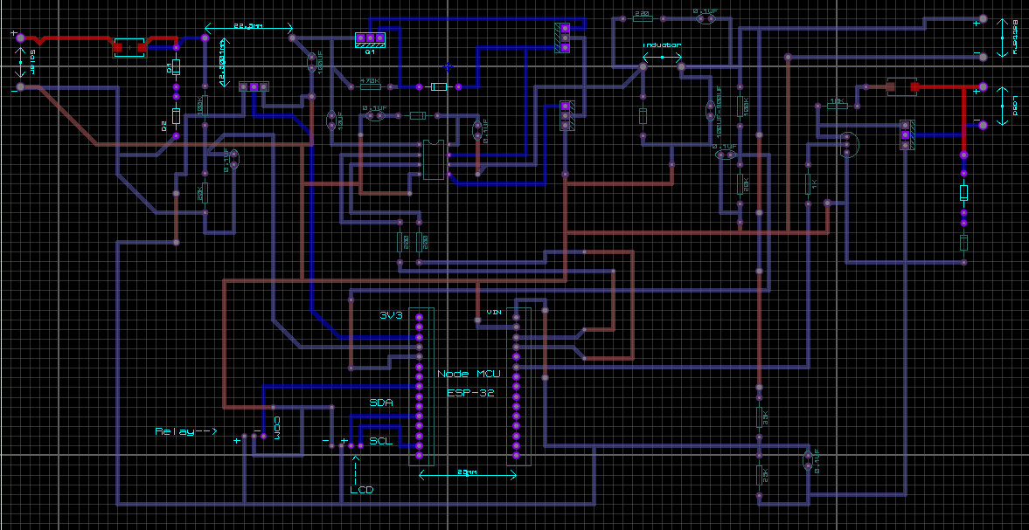
PCB (Solar Charging Circuit)

Slide 43
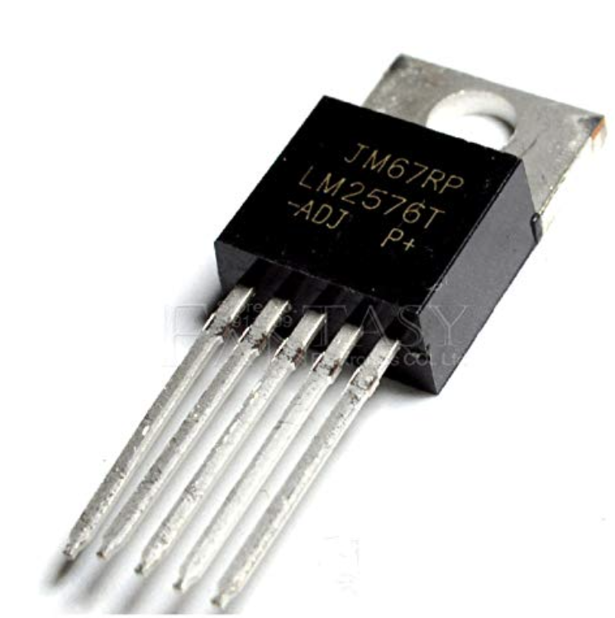
Voltage Regulator
Series | LM2576 (Adjustable)
Manufacturer | Onsemi
Input Voltage | 7 - 40 V
Output Voltage | 1.23 - 37 V
Output Current (max) | 3 A
Frequency | 52 kHz
Buck regulator to step down 12V to 5V
Simple and high-efficiency
Thermal Shutdown and Current Limit Protection

Slide 44
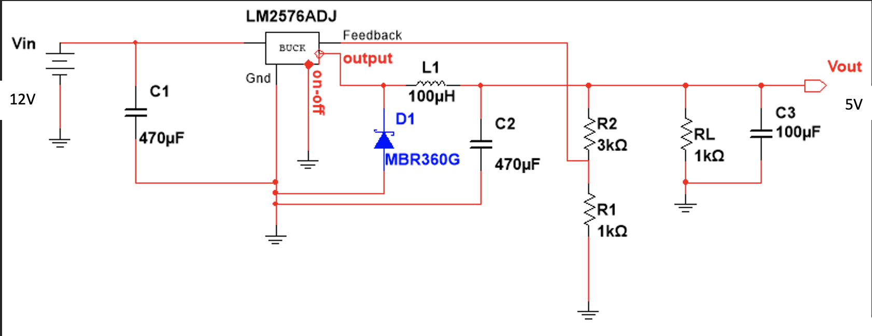
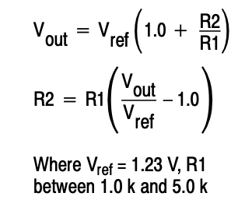
Voltage Regulator Schematic

Slide 45
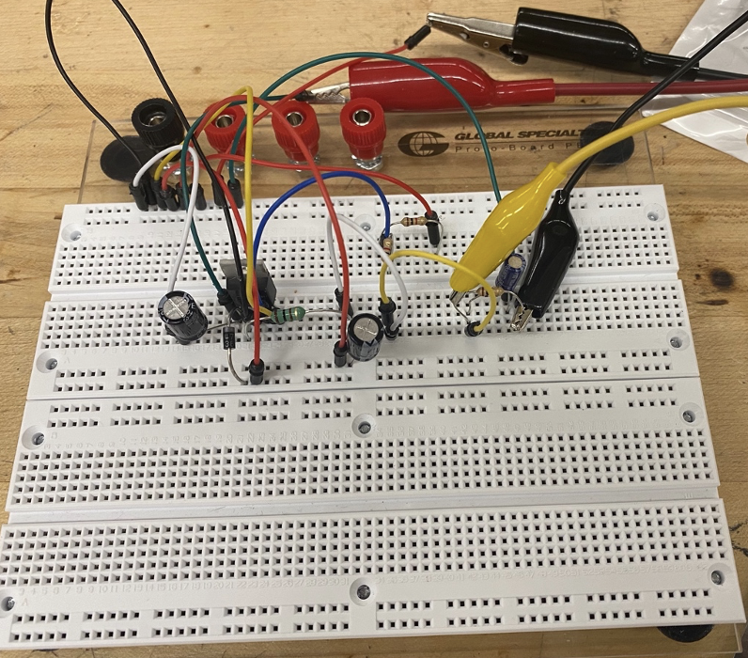
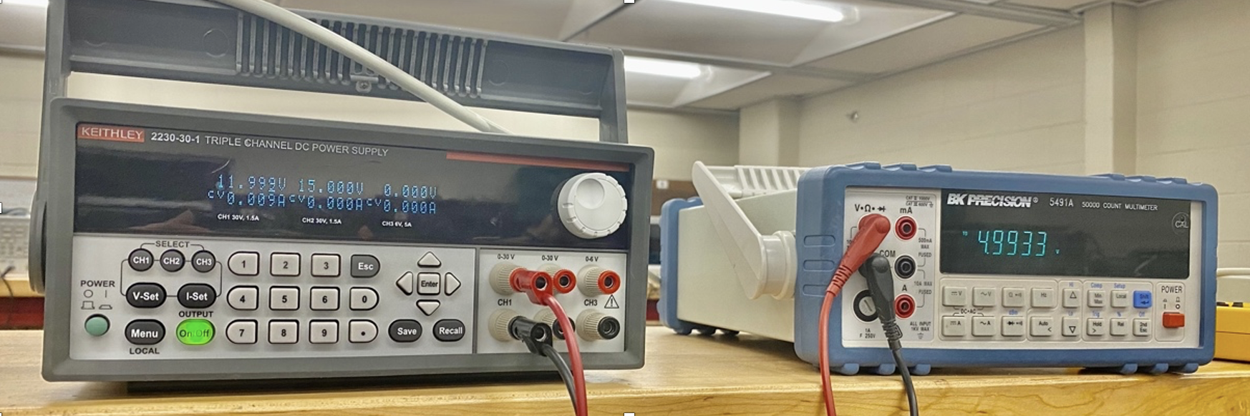
Circuit Testing
Input
Output

Slide 46
Administrative Content

Slide 47
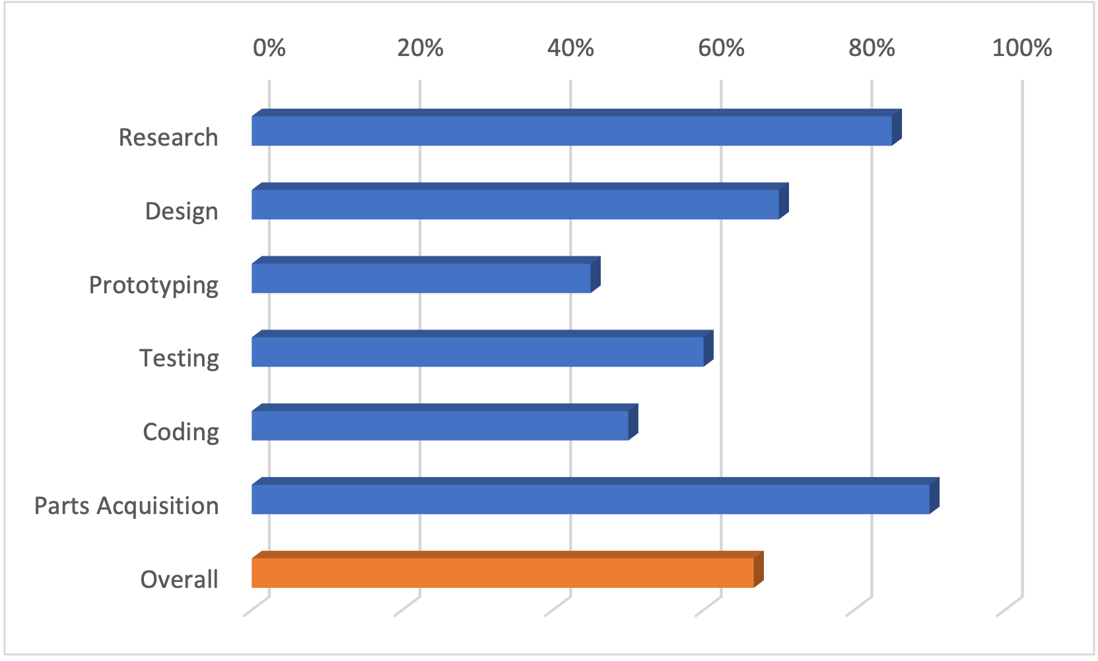
Milestone Chart

Slide 48
Bill of Goods
Component | Qty | Cost
Solar Panel | 1 | $55
Battery | 2 | $22.09
PCB | 2 | ??
MCU | 2 | $1.08
Motor | 2 | $28.16
Peltier Device | 1 | $7.95
Small Heatsink | 1 | $10.99
Large Heatsink | 1 | $10.39
Small fan | 1 | $5.95
Big fan | 1 | $10.99
Component | Qty | Cost
Cart | 1 | $139.99
Thermostat | 1 | $9.99
Arduino Board | 1 | $14.90
Cooler | 1 | $40
So far the total is |  | $408.71
Total so far: |  | Add total here!

Slide 49
Financing
This project has no sponsors and is entirely funded by the M.A.C team…. :(

Slide 50
Questions?

