Slide 1

Automated Optical Inspection
Group 1
Anthony Badillo (PSE)
Joseph Sauceda (CPE)
Valery Jean (EE)
Garin Arabaci (EE)
Sponsored by

Slide 2

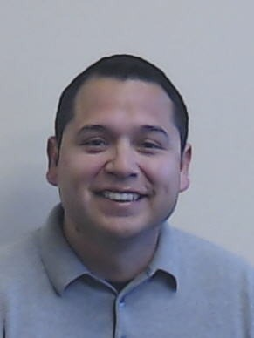


Meet the Team
Anthony Badillo (PSE)
Joseph Sauceda (CPE)
Valery Jean (EE)
Garin Arabaci (EE)

Slide 3
Introduction – Technology summary
Automated Optical Inspectors (AOIs) are a device that scans small parts on production lines to determine the quality of the product
Use high resolution imaging systems
Compiles said imagines and determines quality with machine learning and AI
Higher end systems can use 3-D modeling for a more immersive analysis

Slide 4
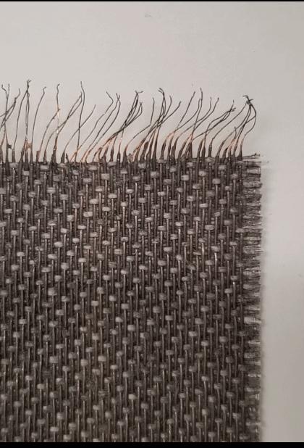
Motivation
Designing an AOI that is cost efficient that will help the UCF Photonic MOFD Team with their manufacturing Quality Control (QC)
The product that they are developing is a color changing fabric, with individual copper wires that heat thermochromic pigments
Operating in the IR range in order to determine if the heat signature from the fabric matches noted patterns that resemble pass/fail patterns
System will also have an attached laser counter in order to further help the MOFD keep track of the amount of material being used

Slide 5
Goals & Objectives
Create a device that can take photos at a set rate
System can process images at the same interval
System can determine whether the image of the product passes or fails through machine learning
Laser counter that can keep an accurate count of the fabric material

Slide 6
Engineering Specifications
Description | Project Minimum Targets
A.I. Positive Detection rate | >70%
Error rate | <30%
Rate of reading and processing | >1 ft/s
Thermal inspection area | <100 um
Cost | <$2500
Photo Rate | >360 threads/sec

Slide 7
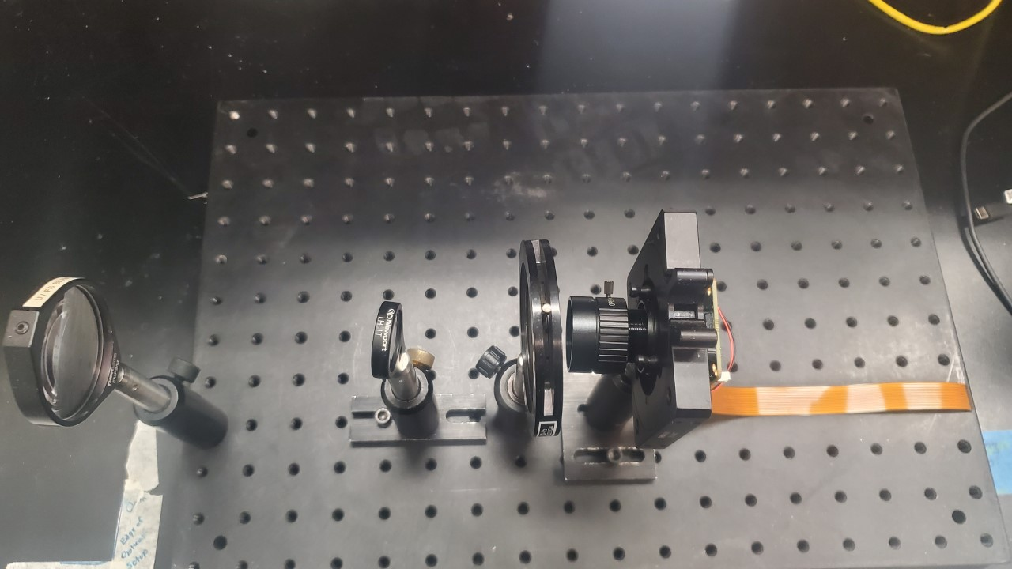
AOI System Diagram
Image of the fabric is captured on the production by our 150 mm front-end optic
The image is further focused by a 75 mm lens
The image is then focused and magnified by our camera system with an aperture to help correct most ambient light

Slide 8
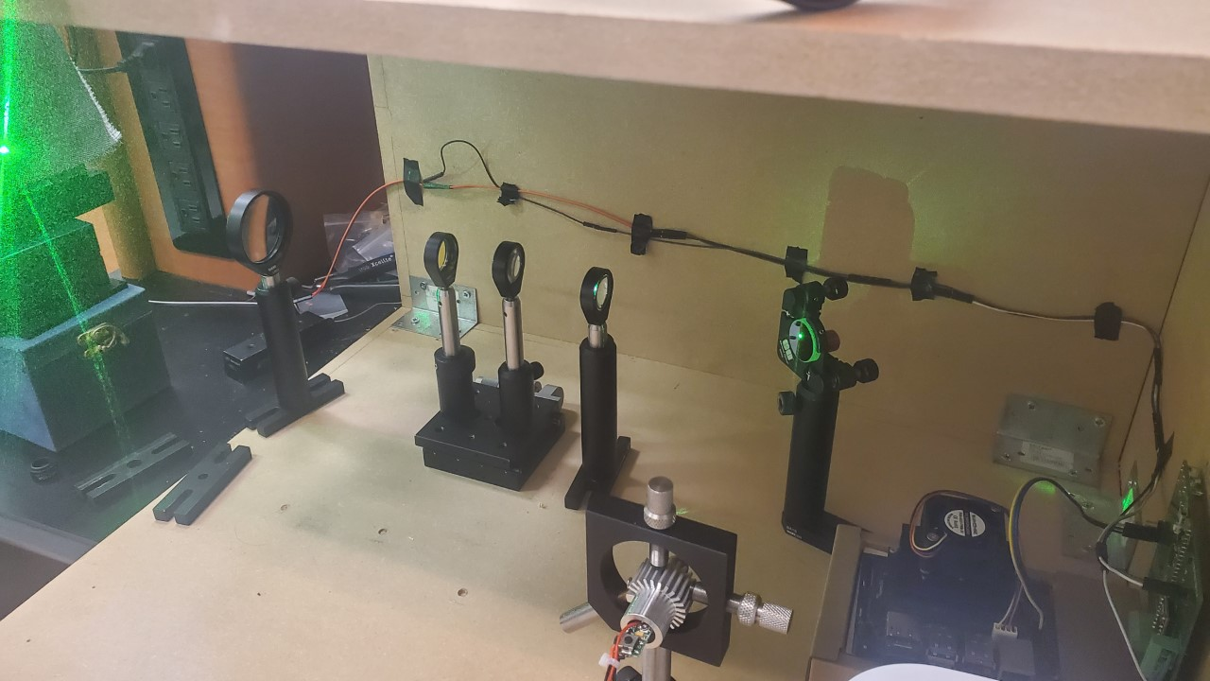
Laser counting system
Our laser is put through a Galilean Beam expander in order to expand the diameter by a rough factor of 3.
The laser is then focused through a 150 mm Plano Convex lens in order to focus the beam so that it has an appropriate spot size of 50 microns

Slide 9
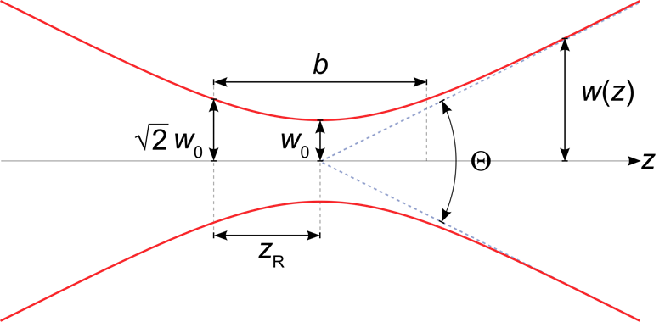
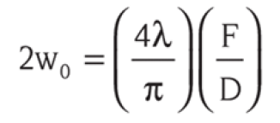
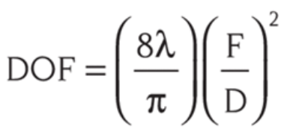
Optics Theory – Gaussian Beam Propagation
The beam waist and the Depth of Focus can be solved for with the following equations
Finding the parameters in order to get an ideal value is also possible since the wavelength, diameter, and focal length can be constants

Slide 10
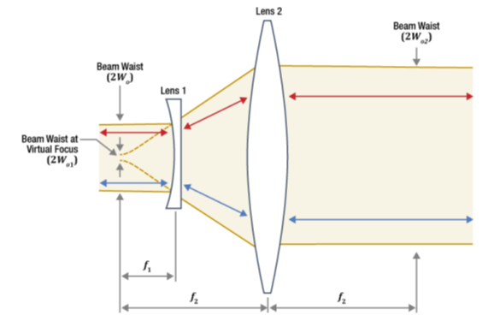
Optics Theory – Galilean beam expansion
To achieve the proper beam diameter for target beam waist and depth of focus, a beam expander is used
The Galilean Beam Expander is used with a convex and concave lens to increase the diameter by a factor of 3.
This telescopic methodology is the same process for our camera

Slide 11
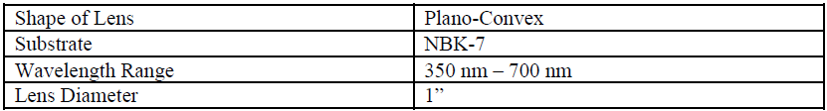
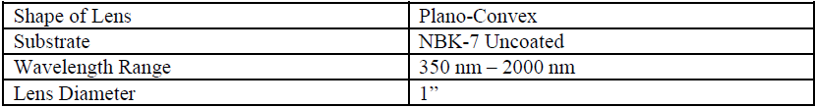
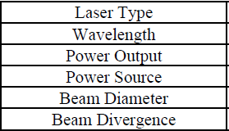
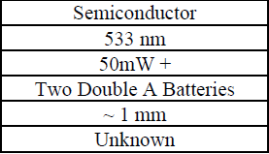
Optics hardware
Lenses : $280 from Thorlabs
Laser: Procured from MOFD Team

Slide 12
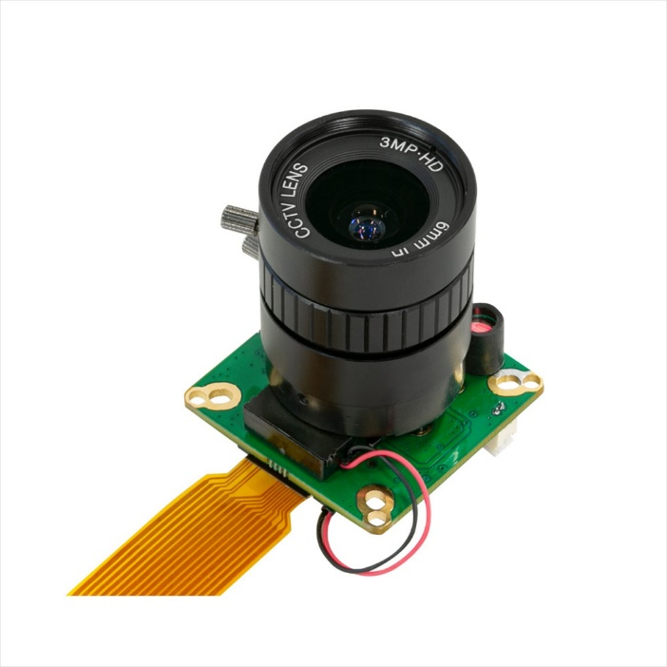
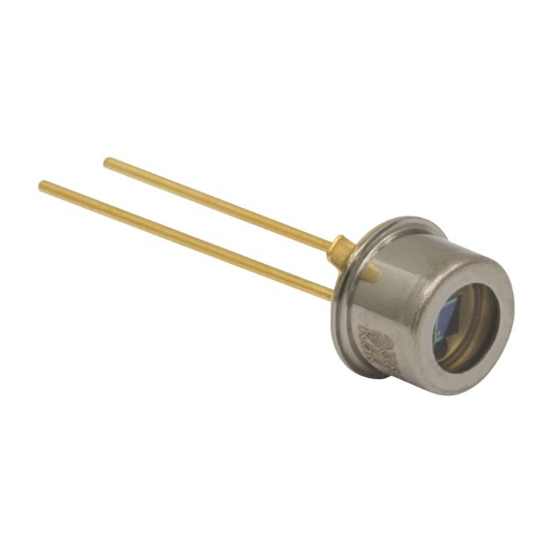
Optics hardware Cont.
Arducam HQ IR-CUT Camera 12.3MP 1/2.3-In IMX477 w/ 6mm CS Lens for Jetson Nano ($80)
FD11A Si Photodiode (2 pack - $32)

Slide 13
Work Distribution
Power Supply: Valery Jean
AOI: Anthony Badillo
Laser Counter: Anthony Badillo
Stepper Motor: Garin Arabaci
Control System PCB: Garin Arabaci
Image Processing Software: Joseph Sauceda
Secondary MCU Software: Joseph Sauceda
Alert Interface (LEDs): Garin Arabaci
Photodiode RC Filter: Garin Arabaci
Notes:
Here is our work distribution
The power supply system will be handled by Valery, this will include supplying the 5V and 12V necessary to power the microcontroller units and the stepper motor as well as powering the laser for the laser counter.
The Infrared camera and laser counter will be handled by Anthony Badillo, as well as collaborating with me to incorporate auto-focusing for the optical systems via a stepper motor and belt drive.
The PCB that will handle our control signals between the two MCUs, the stepper motor driver, the leds, and the laser counter will be handled by me
The software that will process the IR images and the software to manage the secondary MCU and the laser counter will be handled by Joseph

Slide 14
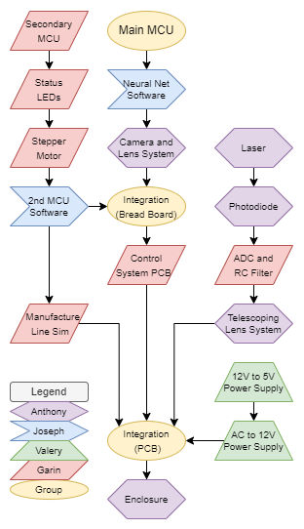
Design Flow Diagram
Notes:
Here is our design flow diagram, this outlines the process in which we will attempt to finalize our project. Starting with the power supply and control system PCBs.
In parallel the laser counter and its telescoping lenses will be developed
Once the PCBs have been completed, we can start uploading basic software such as the secondary MCU software to test systems such as the stepper motor, LEDs, and UART communication between the two MCUs
With the PCBs and laser counter completed, we can start to form an appropriate enclosure for those systems.
With this enclosure the IR-AOI and its mirror system can start to be incorporated and the belt drive for the auto focusing can also be incorporated.
Finally, our final testing of the hardware and software can be completed, and Image Processing software can be refined further

Slide 15
Control System
Notes:
Introduce myself (Garin Arabaci)
I will be discussing the design for our Control System; this will be the PCB handling all our data and control signals as well as some power protection.
We will be separating our Control System and Power Systems to avoid any noise interference and to allow for the design of each to happen in parallel rather than sequentially.

Slide 16
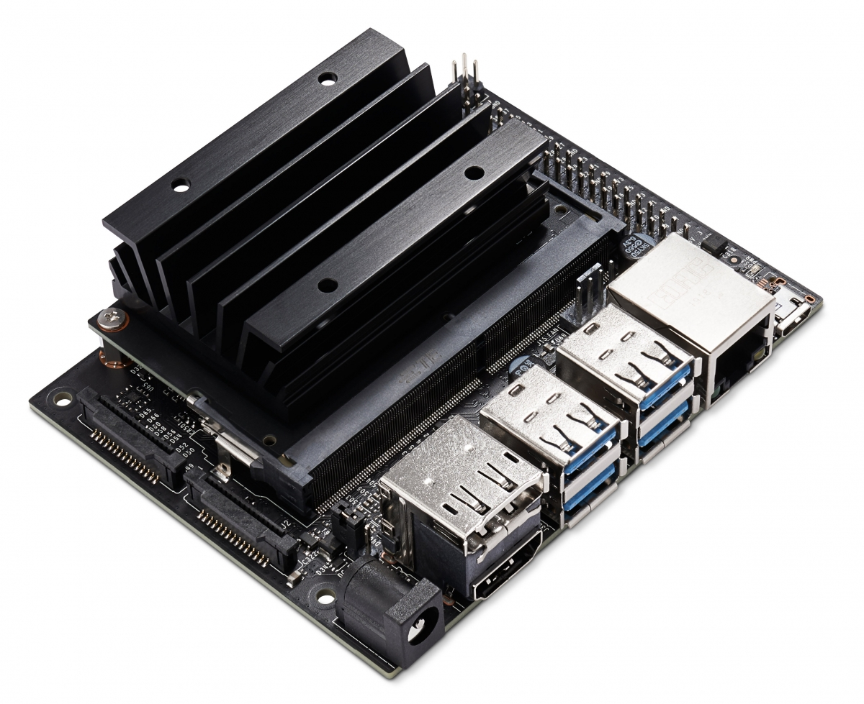
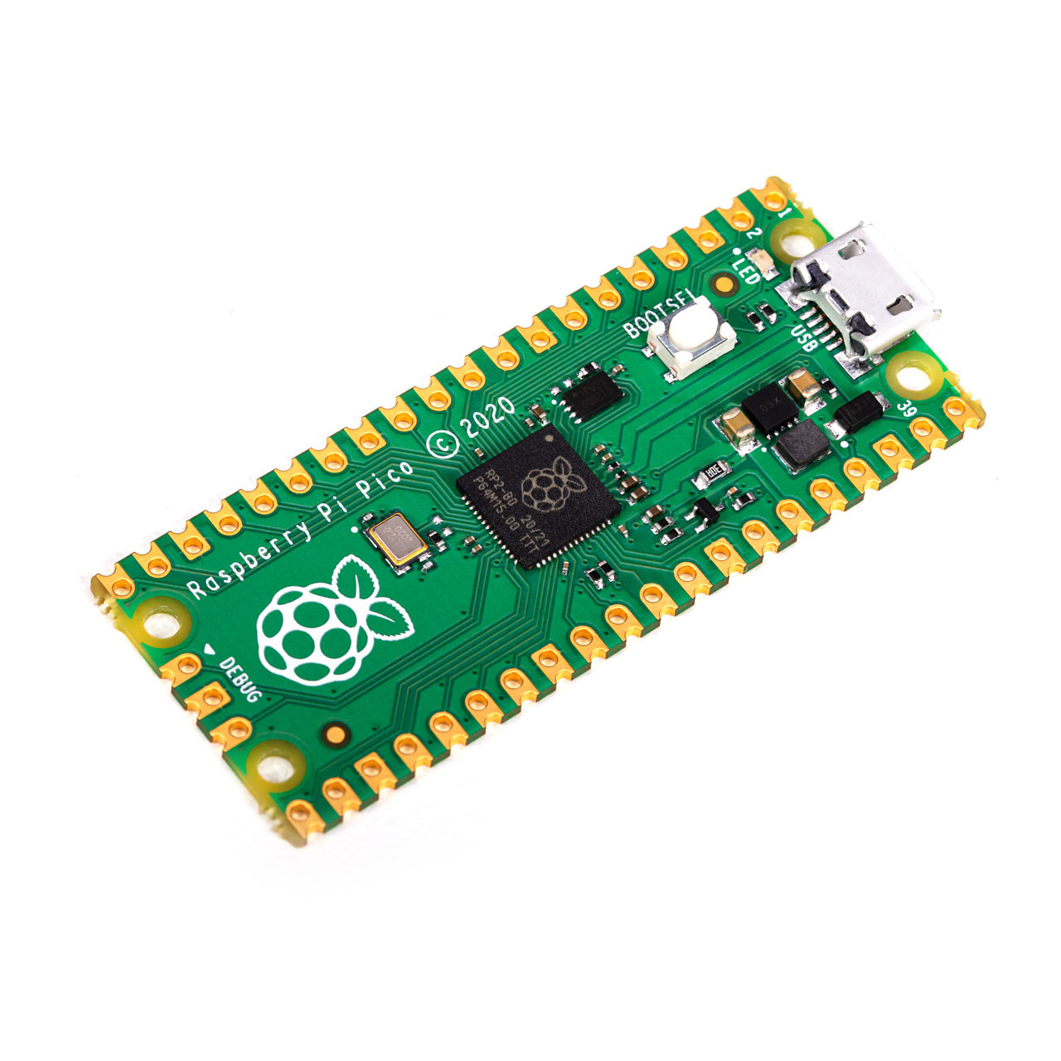
Micro Controller Unit Selection
 | MSP430FR6989 | ESP32 | Raspberry Pi Pico (Secondary) | Raspberry Pi 4B | Jeston Nano (Main)
CPU Cores | 1 core | 1 or 2 core | 2 cores | 4 cores | 4 cores
CPU Speed | 16 MHz | 240 MHz | 133 MHz | 1.5 GHz | 1.43 GHz
Memory | 2 KB | 520 KB | 264 KB | VideoCore VI 3D | 128 core Maxwell
GPU | N/A | N/A | N/A | 1,2, or 4 GB | 2 or 4 GB
GPIOs | 83 pins | 36 pins | 26 pins | 28 pins | 28 pins
Communication Protocols | UART, I2C, SPI | UART, I2C, I2S, SPI | UART, I2C, SPI | UART, I2C, SPI | UART, I2C, I2S, SPI
ADC | 12-Bit | 12-Bit | 12-Bit | N/A | N/A
PWM | 5 Channels | 16 Channels | 16 Channels | 2 Channels | 2 Channels
USB3.0 | N/A | N/A | N/A | YES | YES
Ethernet | N/A | N/A | N/A | YES | YES
Storage | 128 KB | 16 KB | 2 MB | microSD | microSD
Power Maximums | 3.3V/1.6mA [0.005W] | 3.3V/0.5A [1.65W] | 5V/100mA [0.5W] | 5V/3A [15W] | 5V/5A [25W]
MISC | Low Power Modes | Bluetooth/Wi-Fi | Wi-Fi Variant | Bluetooth/Wi-Fi | Dedicated GPU, AI
Notes:
We are unsure the processing power required to process the IR images, so we wanted to achieve the maximum processing power possible to achieve 1ft per second of fabric inspected
Jetson is a compromise, if more computational power is needed, the software we build can be ported to a NVIDIA GPU such as a Quadro 2000, etc.
Outside of processing power, USB3.0 was a requirement in order to interface with the IR camera.
Internet connection is a plus to allow for remote monitoring of the system
In order to minimize strain on the Main MCU, a secondary MCU will be implemented to handle auxiliary functions. So, the PICO
The Jetson will only process IR images and communicate its results with the PICO.
The PICO will handle all other functions including status reporting with 3 LEDs.
The Jetson and PICO will communicate via UART (originally SPI) to relay any inspection issues detected. Jetson detecting defects via IR images, PICO detecting via laser thread counter.

Slide 17

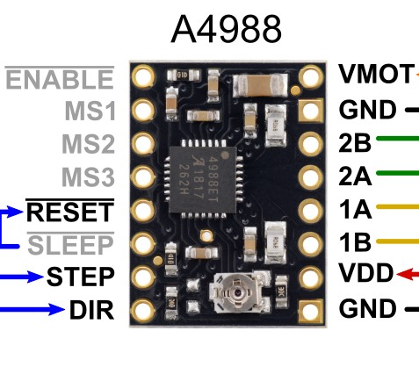
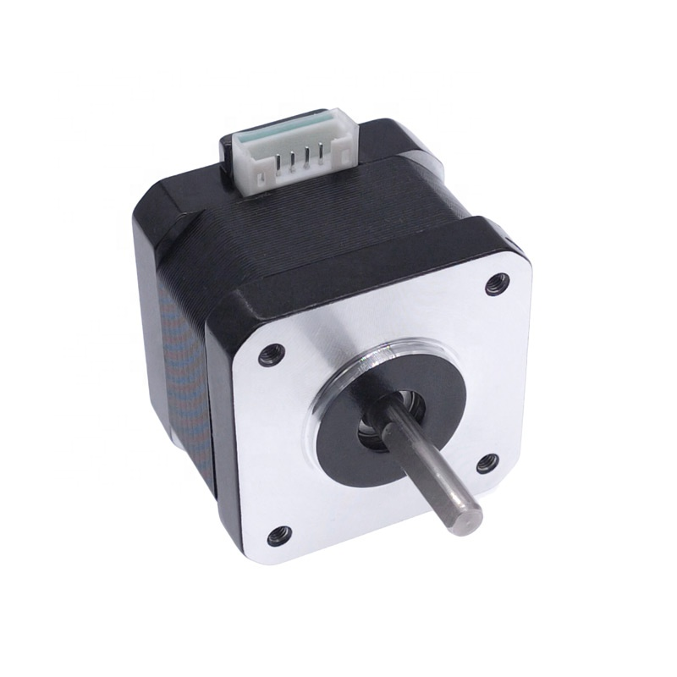

Stepper Motor for Auto-Focusing
The desired resolution of movement for the auto-focusing system was 0.1mm minimum.
Using a belt driven system, with the following parameters we can achieve a resolution of 0.01mm.
  NEMA17 motor with 200 steps per revolution (Srev)
  A4988 at 1/16 steps (fm)
  2mm pitched belt (p)
  16 tooth pulley (Nt)
 | Allegro A4988 (Selected) | TI DRV8825 | TB6560AHQ
Min Motor Voltage | 8V | 8.2V | 4.5V
Max Motor Voltage | 35V | 45V | 34V
Continuous Current | 1.2A per phase | 2.2A | 3A per phase
Max Current | 2A per phase | 2.2A | 3A per phase
Min Logic Voltage | 3V | 1V | 4.5V
Max Logic Voltage | 5.5V | 3.5V | 5.5V
Microsteps | Full, 1/2, 1/4, 1/8, 1/16 | Full, 1/2, 1/4, 1/8, 1/16, 1/32 | Full, 1/2, 1/4, 1/8, 1/16
Notes:
Read the bullet points
As shown at the bottom was the equation, I found in my research for the movement resolution of a belt driven system and how I calculated the maximum resolution of this system.
The inspiration for this step stemmed from my experience with 3D printers, so I essentially mimic'd the same system 3D printers use for precise movement
The table outlines the few options I considered as the stepper motor driver
Talk about the table
I then made use of a stepper motor that followed the NEMA17 standard since I had spare motors from an old 3D printer.
This motor is to be replaced with a new one as during our breadboard testing, we got the motor to move, but we had an issue moving the motor as we desired. Which was either the result of the motor windings being damaged, the way I wired the motor, or a software issue. So that issue still requires troubleshooting, but all 3 potential issues do not halt my PCB design.
Pictured under the comparison table is the basic wiring diagram of the stepper motor driver from the supplier's site.
This board will require MS1 2 and 3 to be all pulled high (in this case 3.3V from the PICO for logic power supply) in order to configure 1/16 stepping.
Using the potentiometer on the board as well, I configured the current limiting for a 1A continuously

Slide 18
Power Requirements and Protections
The Jeston will be powered via 3 pins found in its 40-pin jumper. Pins 2 and 4 both accept 5V, but each have a maximum of 2.5A. Pin 6 will be GND.
In order to protect the Jetson, 2 eFuses will be implemented to restrict the current and voltage that can be delivered to these pins.
The PICO will be powered via the VSYS pin at 5V.
As detailed by the PICO's datasheet a Schottky diode is recommended.
  The same Schottky diode used internally to protect the VBUS pin will be used in this case. Which is a 20V 1A Schottky.
Device | Estimated | MAXIMUM
Jetson GPU | 5V/2A (10W) | 5V/5A [2.5A per pin] (25W)
Jeston USB (IR CAM) | 5V/0.77A (3.85W) | From GPU power
PICO | 5V/?A | 5V/100mA (0.5W)
PICO ADC | 3.3V/?A | Only for Reference
A4988 Logic | 3 to 5.5V/?A | 3.3V/8mA (0.03W)
A4988 Motor | 12V/1A (12W) | 12V/2A (24W)
Totals | 26W | 50W
Notes:
Read the bullet points
This power will be delivered to the board via a 4-block terminal with +5V, 5V GND, +12V, 12V GND
Given the expensive price of the Jetson, the eFuses will be implemented to provide the specialized protection required to pull specifically 5V at 2.5A max from a 5V line capable of higher amperages, and to do so for two pins.

Slide 19
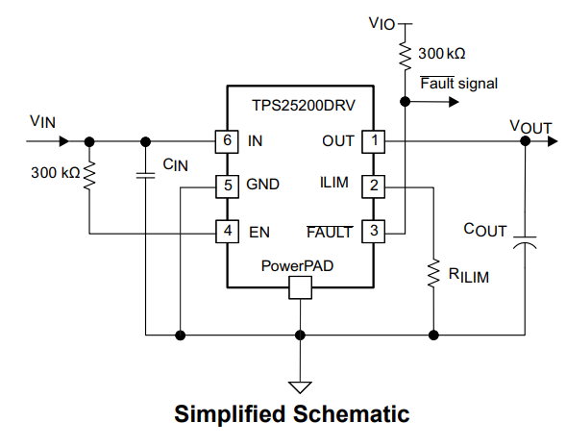
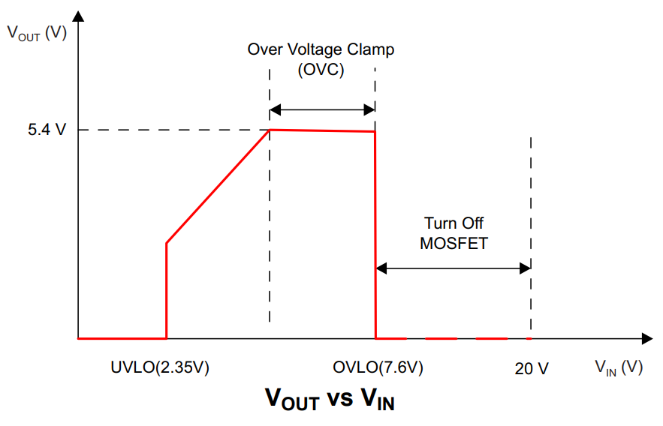
eFuses
The eFuse allows for precision current limiting and overvoltage clamping
In this case, I made use of the TPS25200 from TI which I configured for exactly 2455.12mA max current limiting. This was accomplished with the following value
  Rlim = 42.2K Ohm 1%
  Cin = 0.1uF ceramic bypass
  Cout = 20uF (using 2 10uF in parallel) low ESR ceramic
4 Operational Modes
  Undervoltage Lockout (UVLO)
  Overcurrent Protection (OCP)
  Overvoltage Clamp (OVC)
  Overvoltage Lockout (OVLO)
Feature's fault signaling which will be routed to the PICO and is Active-Low. This will trigger for Overcurrent or Overvoltage, or Overtemperature situations.
Notes:
Read bullets
From the calculations of the current based off my component selections, I max is 2.46mA, I nominal is 2.3mA, and I min is 2.15A. Minimum should not be an issue as the Jetson GPU was throttling during our breadboard testing with 4A maximum.
Cin was specified by the datasheet to be a 0.1uF or greater ceramic bypass capacitor
Cout was selected to minimize peak output voltage. Due to the reasonability of capacitor sizes and availability, 2 10uF low ESR ceramic capacitors in parallel were utilized to achieve approximately 6.5V output transient voltage.
Functional modes
Undervoltage Lockout, the circuit disables the power switch until input reaches the turn on threshold
Overcurrent protection, when within 2.35V and 5.4V Vin, the circuit acts as a power switch based the configured current limiting
Overvoltage clamp, when within 5.4 V and 7.6V Vin, the circuit clamps the output voltage to 5.4V. Current limiting is still active during this mode
Overvoltage Lockout, if Vin Exceeds 7.6V, the circuit turns off the power switch

Slide 20
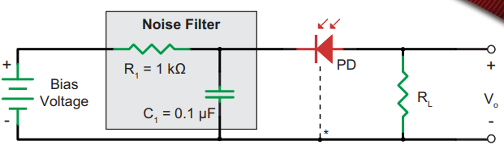
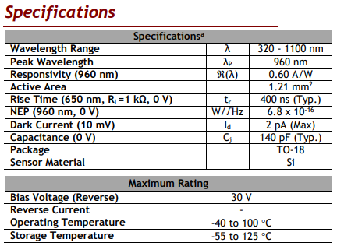
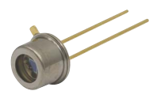
Photodiode
THORLABS FD11A
Reverse biased the diode with 3.3V from the Pico
RC Low Pass Noise Filter
  Cutoff Frequency of 1500Hz
Connects to pin ADC2 of the Pico

Slide 21
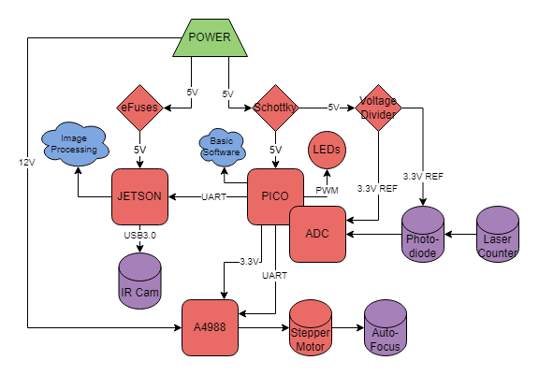
Control System Block Diagram
Notes:
With all the systems that will be controlled now defined, the following block diagram was made as the basis for creating the subsequent schematic and PCB.

Slide 22
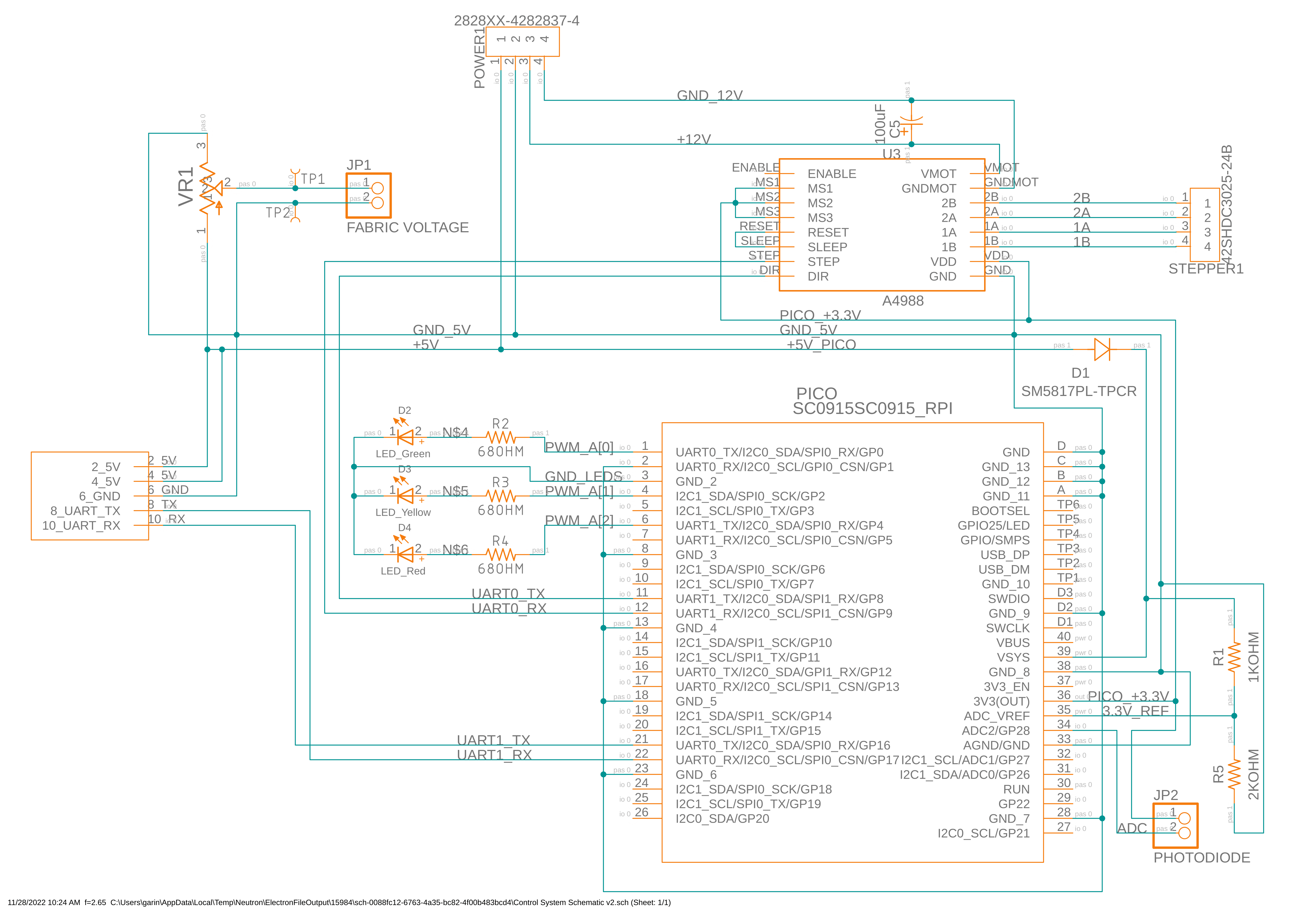
Control System Schematic
Notes:
Here is the resulting schematic for the control system
Interfacing with the Jetson will be done via a 5-pin jumper
Interfacing with power and the stepper motor will be done via 2 4 block terminals
Due to potential variation in photodiode selection, a 2-pin jumper was made to make the connection in the future

Slide 23
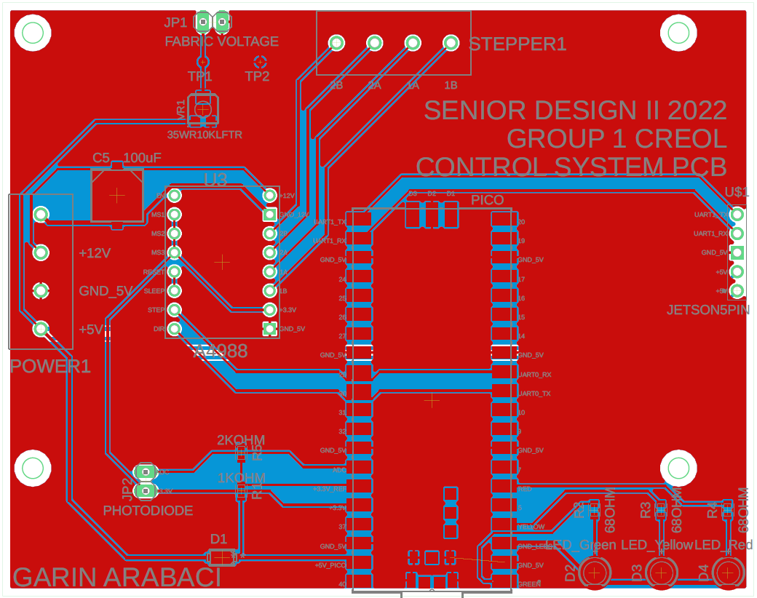
Control System PCB
Notes:
Here is a render of the PCB layout
The PICO will be surface mounted directly to this board
The PCB size and mounting holes match the dimensions of the Jetson to allow for stacking
I originally intended to line up the 5-pin jumper between this board and the Jetson to allow for a ridged connection. However, the orientation of the pins on the Jetson would require this board to be mounted above the jetson or for me to unsolder and reorient the jetson pins. Neither option was reasonable given the high cost of the jetson and the risk of damage in unsoldering and resoldering a 40-pin jumper and mounting this board above the Jetson was undesirable as well due to the Jetson's heatsink and the potential need for a cooling fan, making the vertical space requirement arbitrary.
The A4988 stepper driver board required through hole pins and will be mounted as such

Slide 24
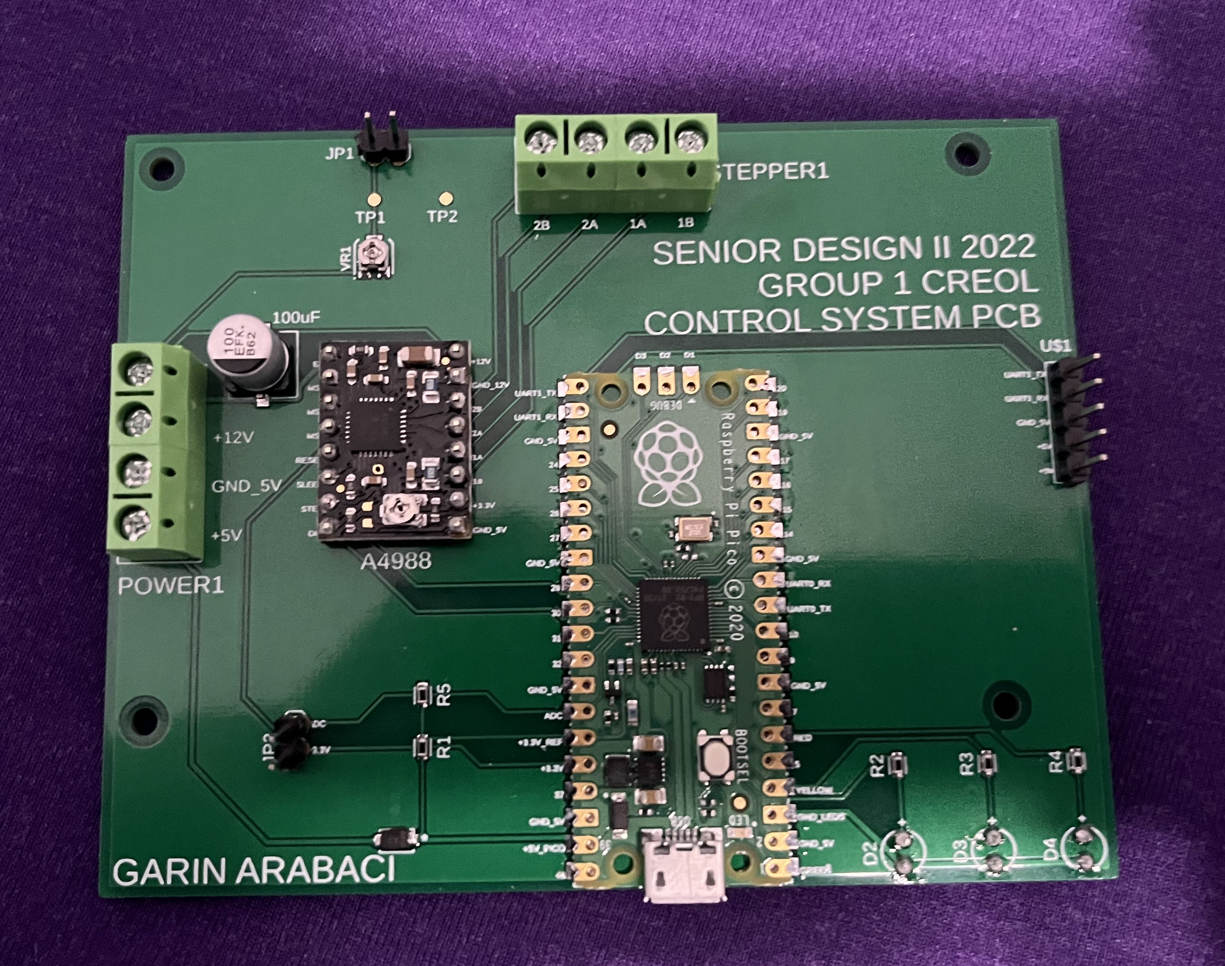
Control System PCB
Notes:
Here is a render of the PCB layout
The PICO will be surface mounted directly to this board
The PCB size and mounting holes match the dimensions of the Jetson to allow for stacking
I originally intended to line up the 5-pin jumper between this board and the Jetson to allow for a ridged connection. However, the orientation of the pins on the Jetson would require this board to be mounted above the jetson or for me to unsolder and reorient the jetson pins. Neither option was reasonable given the high cost of the jetson and the risk of damage in unsoldering and resoldering a 40-pin jumper and mounting this board above the Jetson was undesirable as well due to the Jetson's heatsink and the potential need for a cooling fan, making the vertical space requirement arbitrary.
The A4988 stepper driver board required through hole pins and will be mounted as such

Slide 25
POWER CONTROL
Two Types of Power Supply
AC/DC Converter
DC/DC Converter

Slide 26
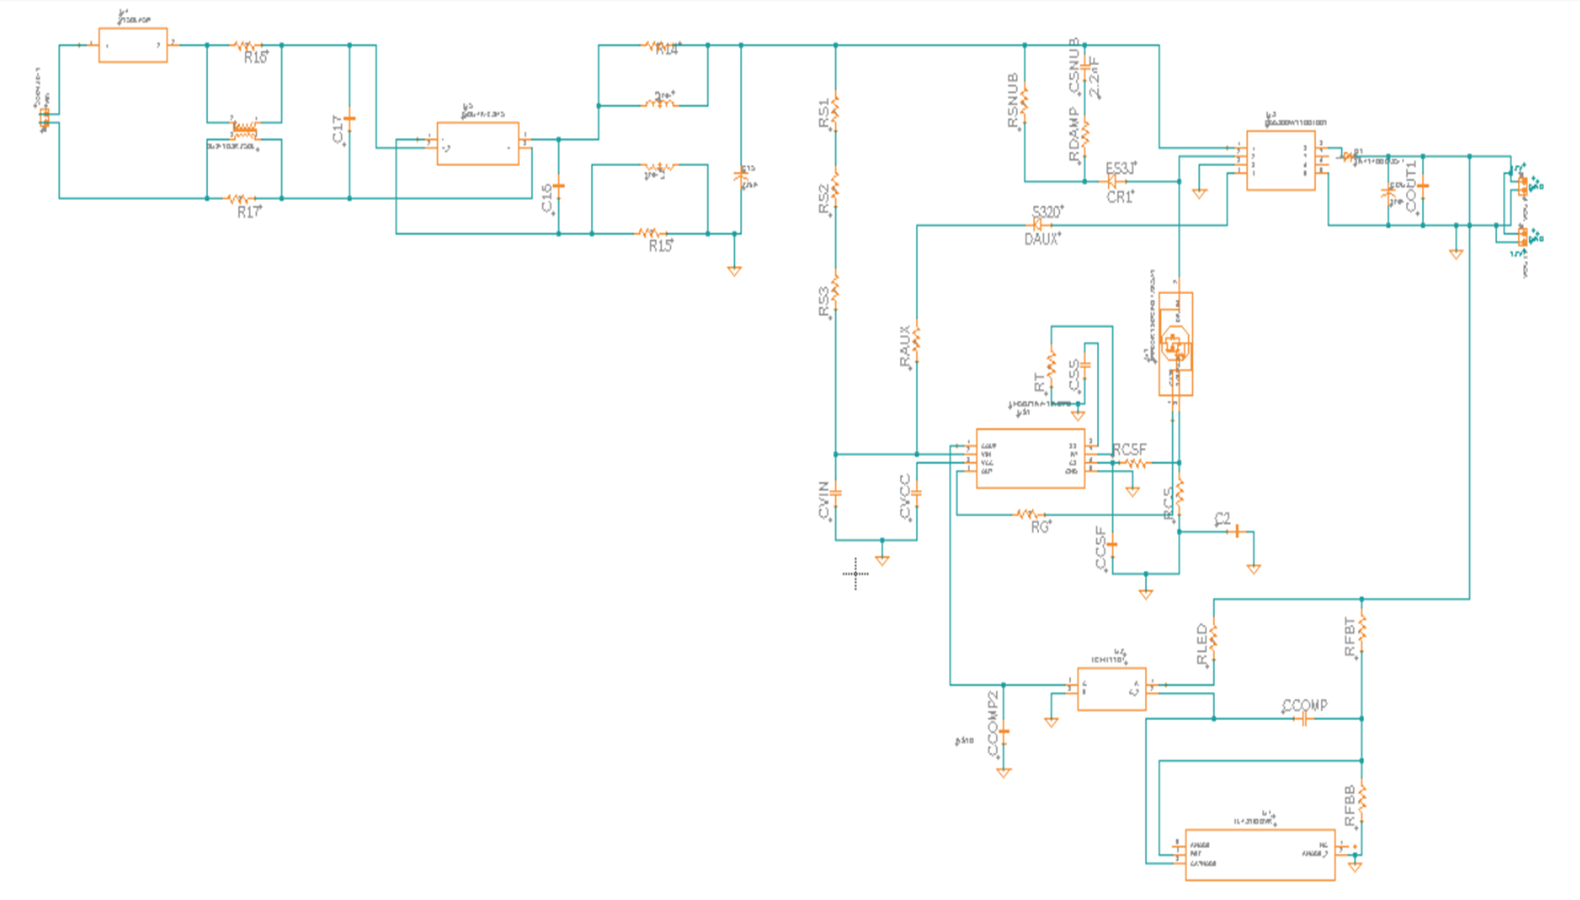
AC/DC Converter
LM5021 From TI
AC input range 100VAC to 240 VAC
DC output of 12V, 4A

Slide 27
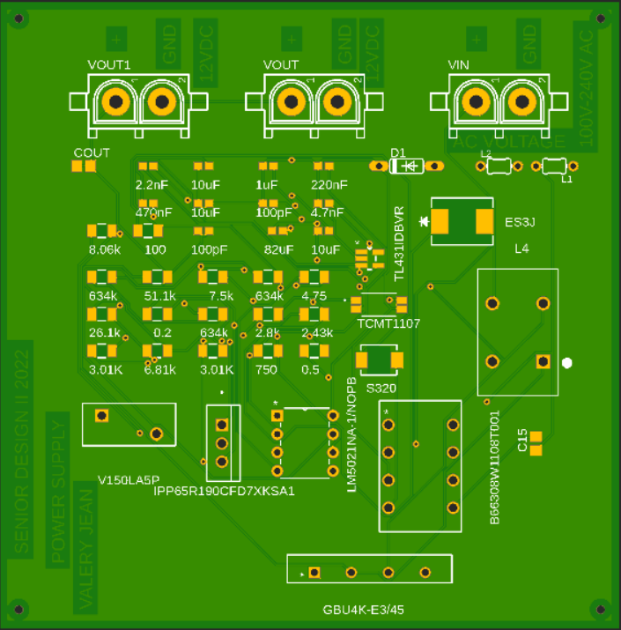
AC-DC POWER SUPPLY PCB

Slide 28
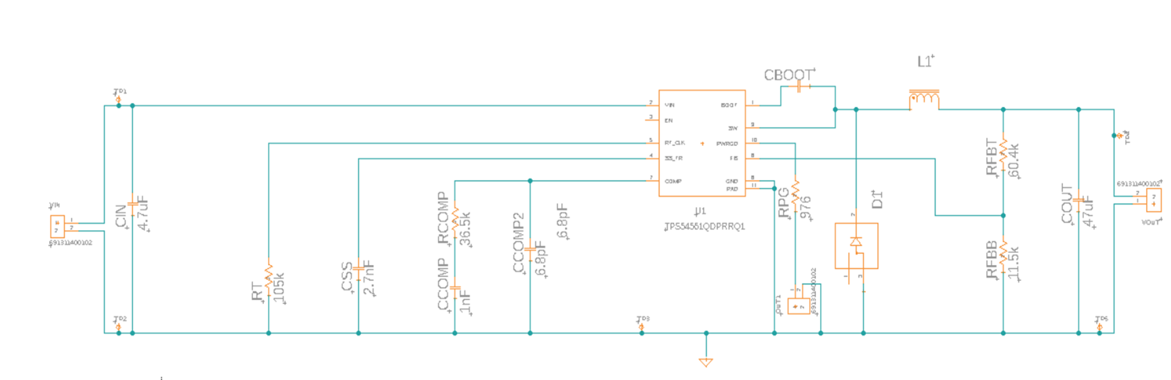
Buck DC/DC Converter
TPS54561-Q1 from TI
Input Voltage range : 7V to 60V
Output Voltage 5V at 5A

Slide 29
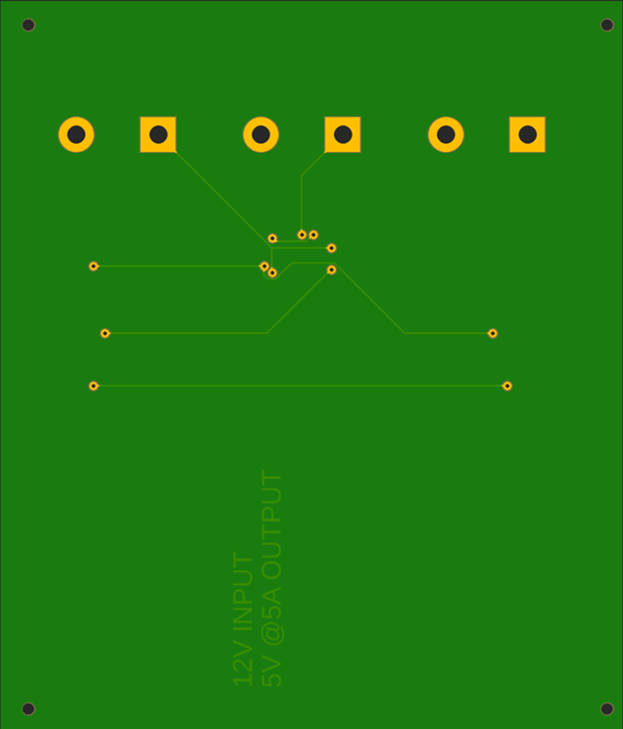
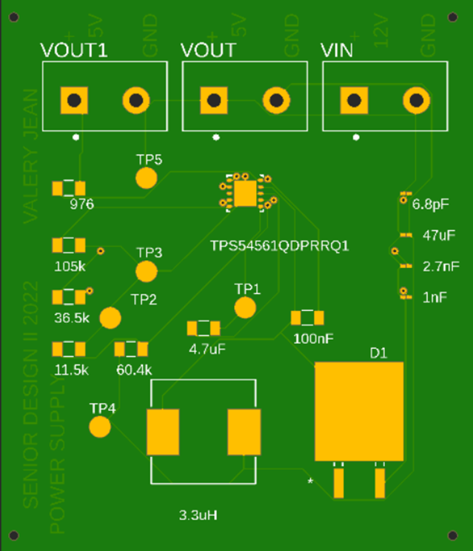
BOTTOM SIDE
TOP SIDE

Slide 30
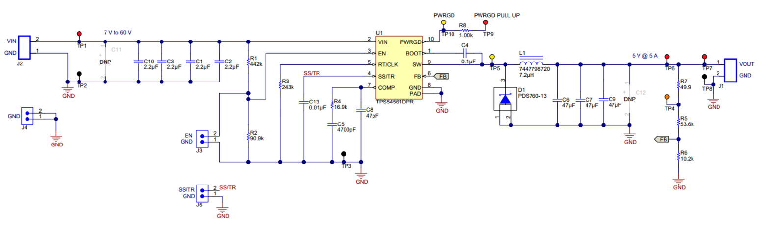

Slide 31
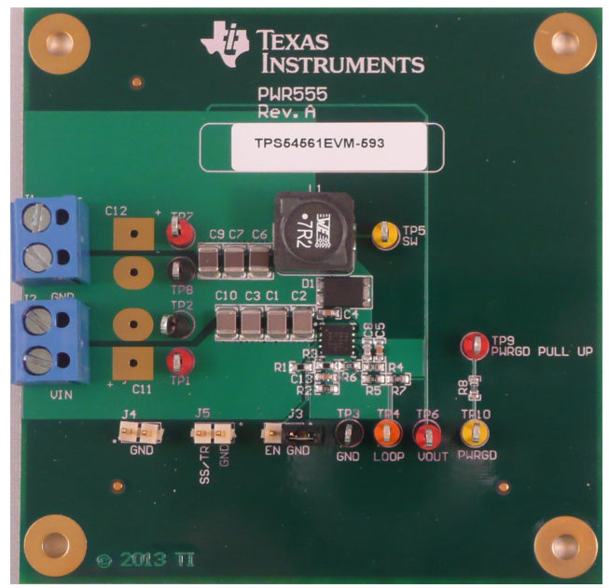

Slide 32
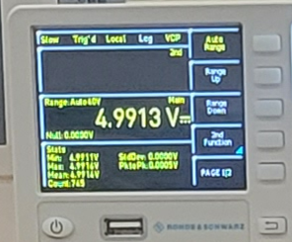
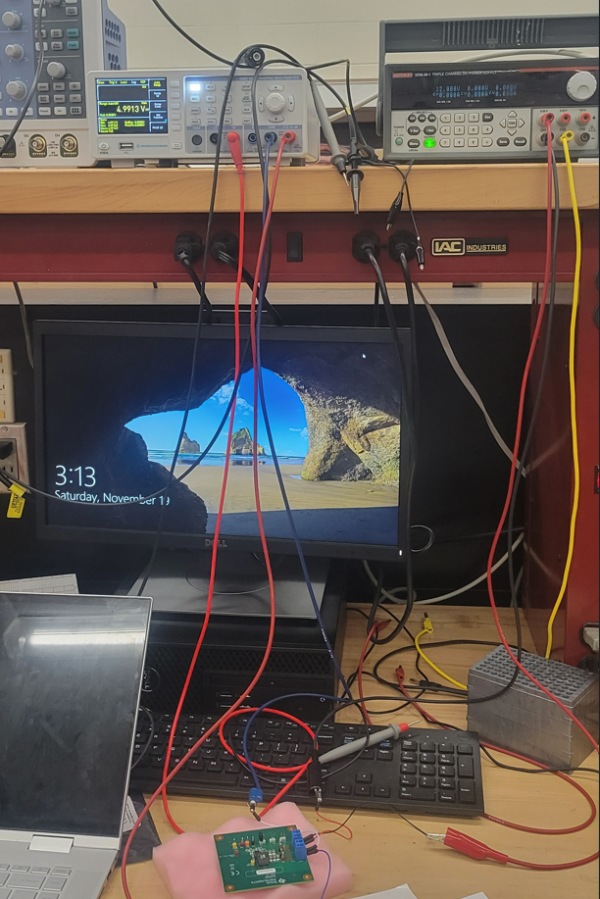


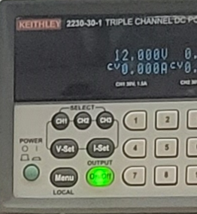

Multimeter
DC Power Supply
OUTPUT VOLTAGE
POWER SUPPLY TESTING
INPUT VOLTAGE
Our Power Supply Board

Slide 33
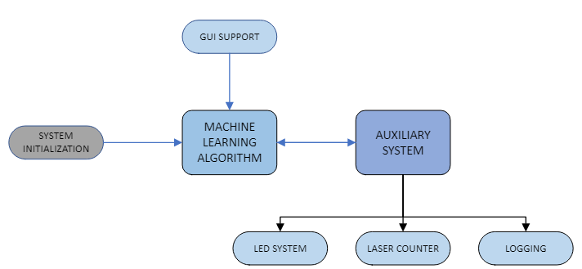
Software Design Overview
Notes:
Software overview
Introduction – Hello my Name is Joseph Sauceda and I will be discussing the software design portion of our senior design project.
let’s start with a general overview of the Software process. Essentially, each module will interact with the next module to accomplish our quality control task. We decide to go with a modular system that is loosely coupled in order to keep any one system from becoming to large and difficult to debug which will be especially relevant during the testing phase.
This diagram provide a general overview of the process that will take place during operation.

Slide 34



Software Tools
PYTHON
VISUAL STUDIO CODE
GITHUB
Notes:
We decided on the following software tools for our project due to the flexibility it offered while still allowing us to not add to the overall budget.
In Python, we found many specialized libraries that facilitated developing our source code. These libraries range from motor control to GUI development and machine learning.
We decided on using VS code for our IDE especially since a version is support for our jetson nano. It also provides linting and debugging services.
And of course, GitHub integrates conveniently with VS code to provide us with version control.
Allowing us to guard against possible loss of code and data version control just to.

Slide 35


Image Capturing USING OpenCV
OPENCV
  Extensive Libraries
  Optimized for Real-time Applications
Python Support
Initial Image Preprocessing
Notes:
To have our project perform the quality control task, we needed a python library that could handle a real-time application. Essentially we will have to capture video in real-time for our machine learning model to evaluate.
To accomplish this, we will relied on OpenCV which provides extensive libraries that are optimized for real-time applications.
With this library, we will mainly use it to capture the images in real-time and perform some image pre-processing before DSP is performed.

Slide 36






Image Pre-processing (DSP)
Notes:
In this stage of the software design, we will preform some digital image processing to produce the best data for out machine learning model to evaluate.
When a image is captured, it will be gray scaled to help in identifying the structures that are most important in classifying our data for the model.
With segmentation, we can further refine the image by concentrating on specific regions of interest that were derived from a thresholding process using an intensity histogram.
Finally, we can then filter noise and apply a smoothing affect for our captured images that are now ready for the final process of classification.

Slide 37

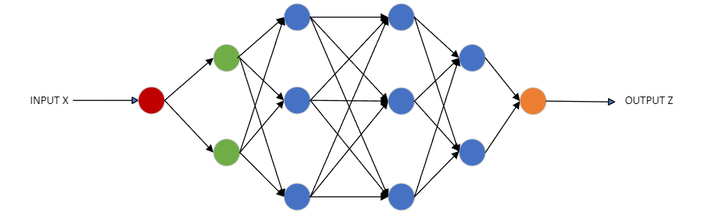
Machine Learning Binary Classification
Deep Neural Network
Notes:
During the machine learning phase, the model will performing binary classification. Something like this is easily performed by human inspection using tools but not with the speed and efficiency that machine learning provides.
This type of process will take this specific and repetitive task and be able to perform this classification in real-time.
We decided on a neural network due to their versatility and excellent classification results.

Slide 38
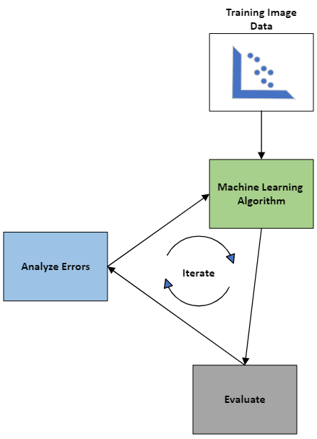
Machine learning Model Training
Train
Test
Evaluate
Optimize
Notes:
We will use training images that the neural network will analyze with multiple iterations to produce an optimum module for classification.
This will involve a training set along with test set to assist in the evaluation phase.
Once we are satisfied with our positive detection rate we will deploy and further refine during more testing.
We will tweak necessary parameter to optimize the model. We are hoping to achieve a positive detection rate of over 80 percent.

Slide 39
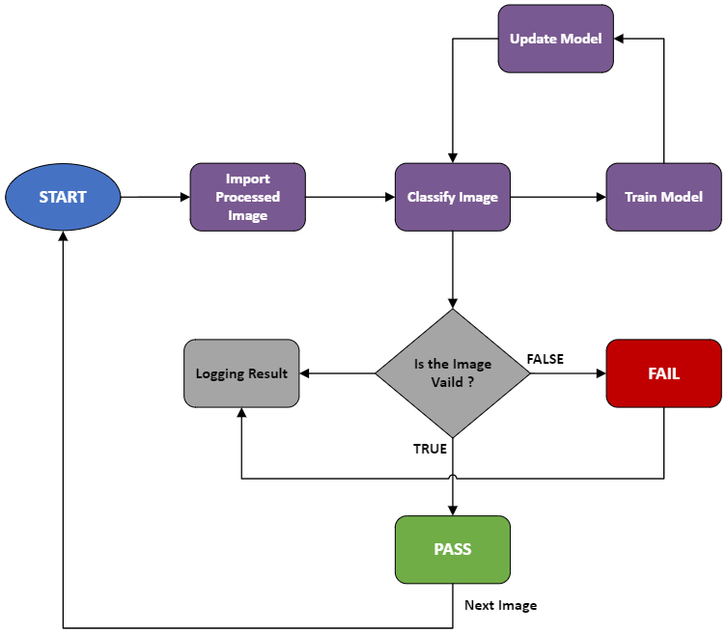
ML Classification Process
Import Image
Classify Result
Improve Model
Log Outcomes
Notes:
Here we have the general working processes where the refined image is fed to the ML algorithm.
The algorithm will then classify the image and the process will start over.
It will also perform other aux features to maintain outcomes and alerts.
We will use the results to further train the model and update as necessary.

Slide 40

Logging, Alerts and Laser Counter
Logging Service
  Historical Data Store
Alerts
  LED System
  GUI Interface
Notes:
The auxiliary system will be taken care of by a MCU so as not to bog down the main process involved in the jetson nano. Although the jetson nano is a solid device selection we need to maintain any overhead service separate so we passed them off to a secondary MCU.
We will perform logging to store results and alerts or warnings.
Any significant errors or issues with be visualized through the GUI or LED status system.
Depending on the severity a corresponding LED will illuminate while as the same time place an event in the log file.
The MCU will also provide motor control allows us to offload any aux functions from the jetson nano.

Slide 41
Budget
Electronics and Power Budget Spending
Optics Budget Estimation
Item | Current Spending
Custom Power Supply | $100
Custom PCB | $3.70
Custom Enclosure (3D print) | $20
Microcontroller | $455
Stepper Motor Driver | $11.45
Circuit Components | $20
Total | $610.15
Item | Cost Estimated
Camera System | $120
Lenses | $280
Laser | $0
Total | $4000

Slide 42
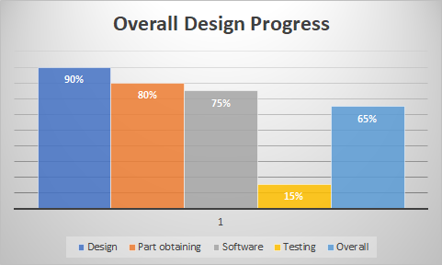
Progress

Slide 43
Issues
Learning curve to applying each Python Library
  OpenCV
  Micropython
  PyTorch
Training is time intensive
Hardware delays
Camera issues
  Resolution
  Framerate
Notes:
The following will describe some of the issue our team encountered:
Some of the issues that we have encountered on the software side are the learning curves associated with some of the python libraries.
OpenCV parameters and syntax can be difficult to program.
Micropython has its own barriers
Every library has its learning curve to deal with.
Training a NN can be very time intensive especially if the wrong parameter are enabled or bad data is hindering the process all together
Hardware delays cause issues for the team but we’ve strived thru as best as possible making due.
Camera selection came with tradeoffs related to achieving the best resolution as the fastest framerates we could achieve.
Many different combinations were tried that we are still in the process of optimizing still

Slide 44
Questions?
Notes:
Thank you for your attention. Do you have any questions?

