Slide 1
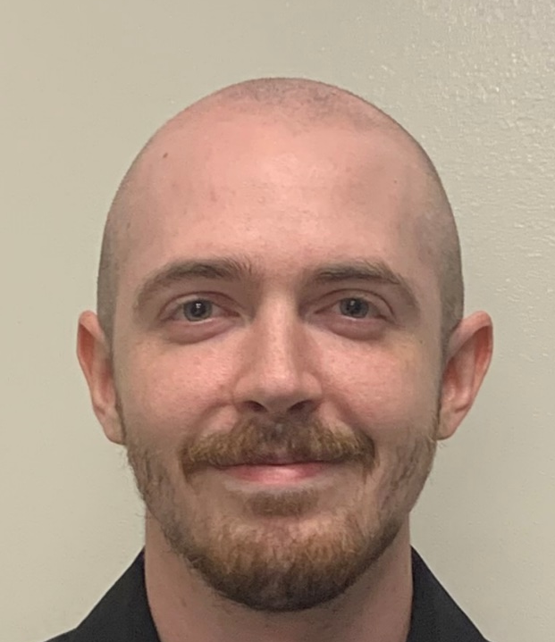
Optical Beacon Tracker for Optical Wireless Communication
Final Presentation
Group 4:
Seth Johnson (PSE)
Raymond Loudis (EE)
Blake Baez (CPE)
Committee Reviewers:
Dr. Kyle Renshaw
Mark Maddox
Justin Phelps
Sponsored by the Knight Vision Lab

Slide 2
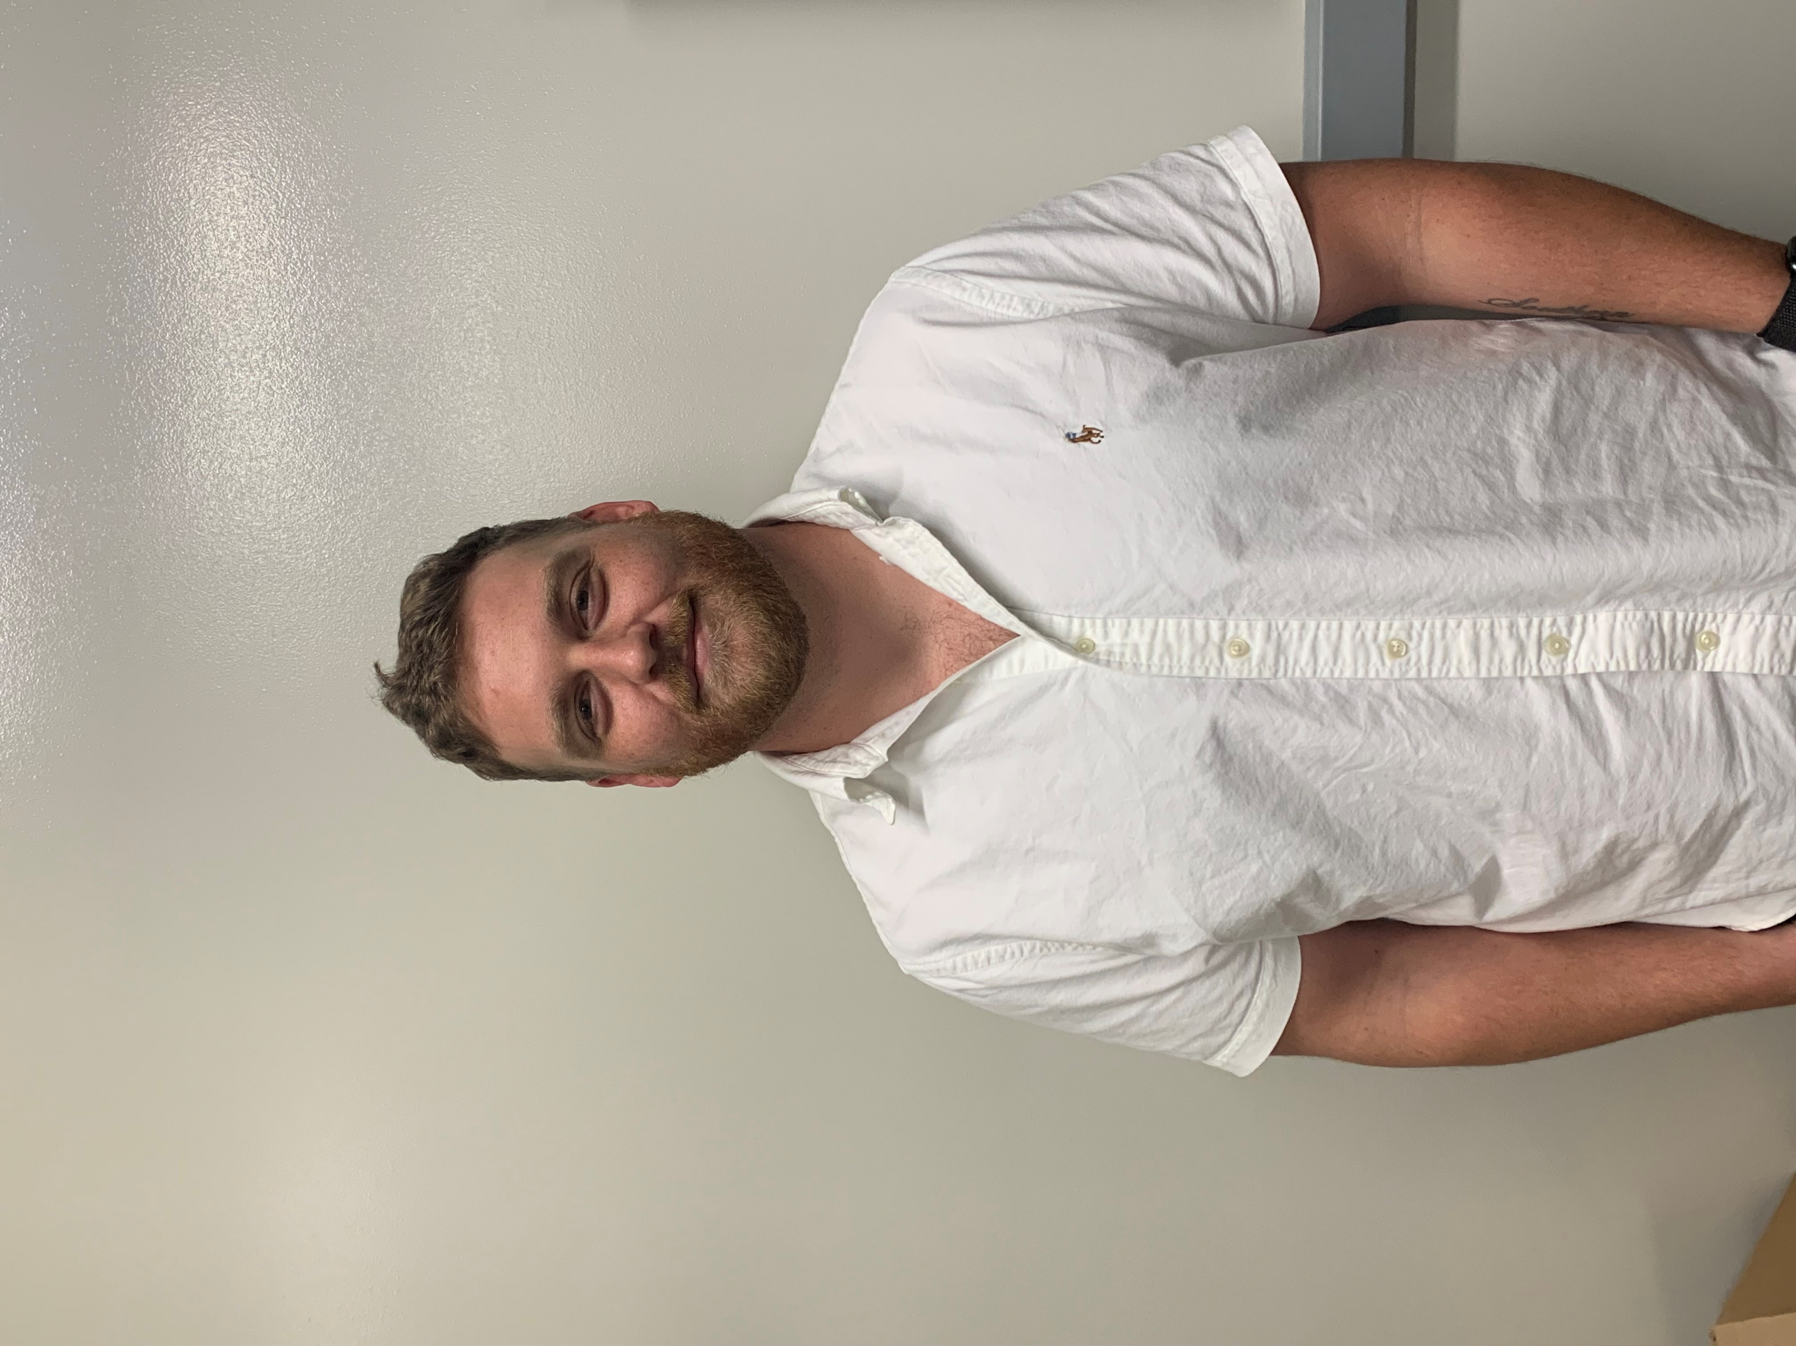


Meet the Team
Seth Johnson
Photonic Science
& Engineering
Blake Baez
Computer Engineering
Raymond Loudis
Electrical Engineering

Slide 3

Meet Our sponsor

Slide 4
Motivation and background
Optical wireless communication (OWC) has existed for decades, however clear communications require precise alignment which is difficult to maintain whilst mobile.
The goal of this project is to build a device that can track an optical beacon while both the receiver and the beacon are mobile.

Slide 5
Project Goals
Basic Goals
Create a beacon with enough power and divergence to be detected up to 3 meters away whilst indoors
Create a receiver that can actively track the beacon whilst mobile, up to 3 meters away when indoors
Advance Goals
Track the beacon up to 1 km away whilst outdoors.
Stretch Goals
Track the beacon up to 10 km away in ideal weather conditions.
Transmit and decode a simple signal (like an SOS) from the beacon.

Slide 6
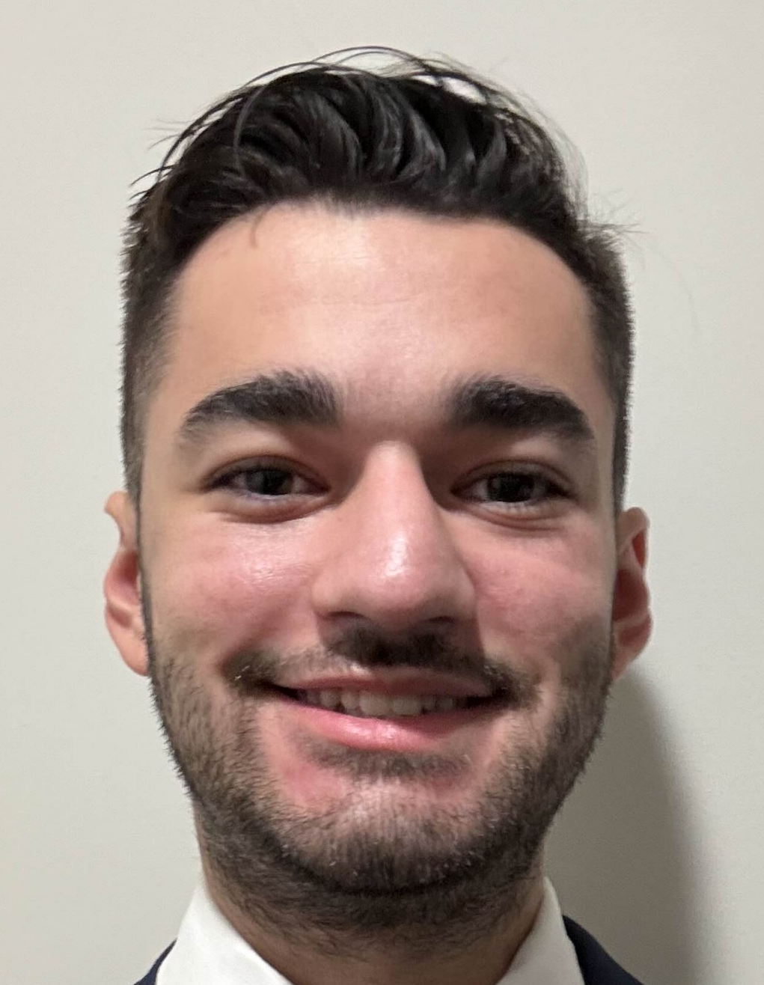
Project Objectives
Calculate the required optical output power for the beacon to be detectable by the receiver at a given distance.
Design the focusing, diverging, and collimating lens systems on the beacon and receiver.
Design PCBs for the beacon and receiver.
Design a power supply for the beacon and receiver respectively, capable of driving the light sources and gimbals/dc motor, as well as biasing the photodiodes.
Create an algorithm that enables the gimbals/dc motor to use outputs from the QPD, GPS, and IMU as inputs for positioning.

Slide 7

Overall Project diagram
Receiver System
Beacon System
Photodetectors
Beacon Illuminators
10˚
45˚
Receiver Motors
Beacon Motors

Slide 8
Project Specifications
Requirement | Specification | Description
Receiver FOV | 5-15 degrees | The viewing angle from the receiver
Beacon FOV | 35-45 degrees | The divergence angle of the beacon
Stationary track accuracy | 10-20 μRad | The accuracy of the system when stationary
Mobile track accuracy | 500-600 μRad | The accuracy of the system when mobile
Track loop without IMU compensation | 10-15 kHz | Signal processing loop without using an IMU
Track loop with IMU compensation | 100-200 Hz | Signal processing loop while using an IMU
Receiver and Beacon weight | Less than 5kg each | The receiver and beacon must weigh less than 5kg respectively
Indoor functional distance | 2-3 meters | Functional distance while indoors
Outdoor functional distance | 100-1000 kilometers | Functional distance while outdoors
Battery life | 30-60 minutes | How long the system will be able to run on battery supply
GPS Accuracy | 2-3 meters | Accuracy of the GPS system without the optical beacon
Reaction time | 300-600 ms | Delay between detecting an optical signal and moving the motors

Slide 9
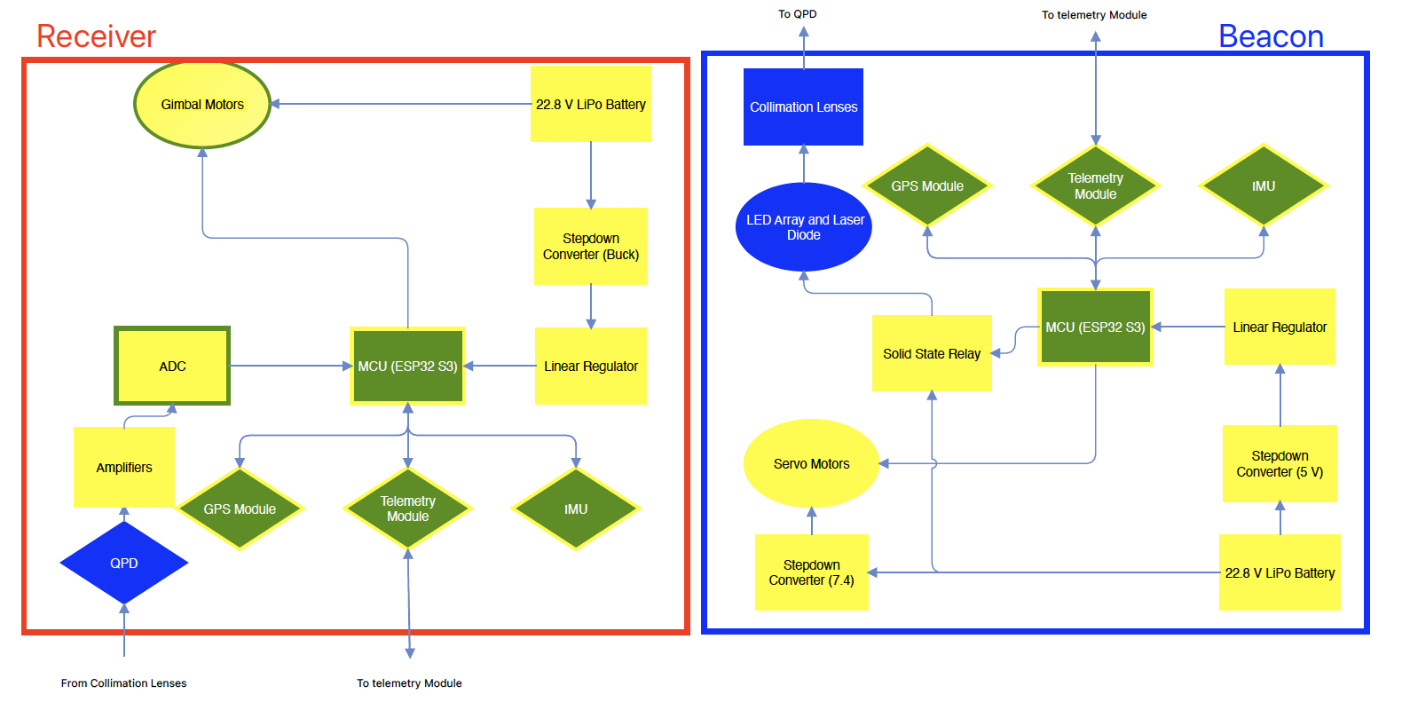
Hardware Block diagram

Slide 10



Power Calculations
$$P_{inc}=P_{o}∙\frac{A_{d}}{A_{B}}$$
$$A_{d}=π{\left(\frac{D_{d}}{2}\right)}^{2}$$
$$A_{B}=π{\left(d∙\tan\left(\frac{θ_{div}}{2}\right)\right)}^{2}$$
Outdoors
$$d = 1 km$$
$$θ_{div}=45°$$
$$D_{d}=1 inch$$
$$A_{d}=π{\left(0.0127 m\right)}^{2}$$
$$A_{B}=π{\left(414.2 m\right)}^{2}$$
$$P_{inc}=P_{o}∙9.4×{10}^{−10}$$
Indoors
$$d =3 m$$
$$θ_{div}=45°$$
$$D_{d}=1 inch$$
$$A_{d}=π{\left(0.0127 m\right)}^{2}$$
$$A_{B}=π{\left(1.24 m\right)}^{2}$$
$$P_{inc}=P_{o}∙0.0001$$

Slide 11
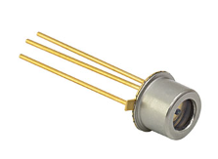
Photodiode selection
Company | Product ID | Responsivity (A/W) | MDP (nW) | Rise Time (ns) | Cost
Thorlabs | FGA015 | 0.95 | 0.44 | 0.3 | $65
Thorlabs | FGA01FC | 1.00 | 0.15 | 0.3 | $174.62
Edmund Optics | #55-754 | 0.95 | 0.15 | 0.3 | $95
Edmund Optics | #62-271 | 0.95 | 0.05 | 10 | $100
Excelitas Technologies | C30645EH | 0.93 | 0.18 | 40 | $318.15
Excelitas Technologies | C30662L -200 | 0.94 | 3 | 0.3 | $203.7
FGA015
InGaAs Photodiode

Slide 12
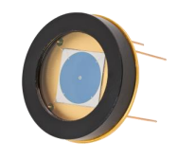
The quadrant photodiode
Quadrant Detector
ϕ200μm laser cut hole on chip
MDP of 0.15nW
SPOT-9D-0
Based on our earlier calculations, the beacon must output a minimum of 164mW at 850nm,
and 450mW at 1550nm

Slide 13
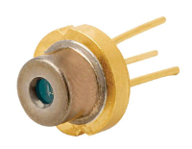
Laser selection
Company | Product ID | Max Output Power (W) | Threshold Current (A) | Fast Divergence Angle (deg) | Unit Cost
Advanced Photonix | CVLL 95-90 | 10 | 1 | 24 | $236
Advanced Photonix | CVLL 350-90 | 25 | 2 | 24 | $254
Thorlabs | FPL1055T | 0.3 | 0.75 | 23 | $424
Thorlabs | L1550G1 | 1.7 | 5 | 28 | $355
CVLL 350-90
1550nm Laser Diode

Slide 14
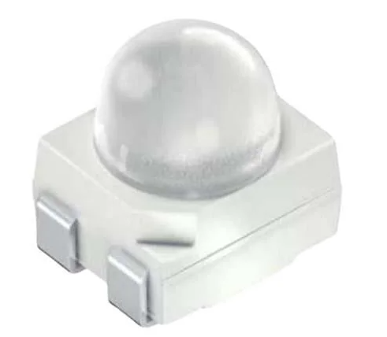
LED selection
Company | Product ID | Output Irradiance (mW/sr) | Driving Current (mA) | Viewing Angle (deg) | Unit Cost
Lumileds | L1I0- 0850060200000 | 1150 | 1000 | 60 | $4.04
ams OSRAM | SFH 4258S | 100 | 100 | 30 | $1.10
Vishay | VSMY98545ADS | 380 | 1000 | 45 | $5.98
Wurth Elektronik | 15427285BA240 | 160 | 1000 | 120 | $2.46
Vishay | VSMY12850 | 16 | 70 | 80 | $0.71
Broadcom | ARE1- 89D0-00000 | 600 | 1000 | 90 | $4.76
SFH 4258S
850nm LED
In a 25 LED array, the
chosen components will
emit 535mW within the
viewing angle.

Slide 15
Mcu selection
Brand/Type | Processor | Flash Memory | SRAM | Communication Protocol Channels
ESP-32 | Dual-core Tensilica LX6 microprocessor, up to 240 MHz | 4 MB | 520 KB | 3 UART, 3 SPI, 2 I2C, 1USB
Arduino Due | Ateml SAM3X8E ARM Cortex-M3, 84 MHz | 512 KB | 96 KB | 4 UART, 2 SPI, 1 CAN, 1 USB
Teensy 4.0 | ARM Cortex-M7, 600 MHz | 2 MB | 1 MB | 7 UART, 3 SPI, 3 I2C, 1 I2S, 1 CAN, 1 USB
Raspberry Pi Pico | Dual-core ARM Cortex-MO+, 133 MHz | 2 MB | 264 KB | 2 UART, 2 SPI, 2 I2C, 1 USB
ESP 32 S3 Mini | Dual-core Xtensa LX7, 240 MHz | 8 MB | 512 KB | 3 UART, 2 I2C, 2 I2S, 4 SPI, 1 USB

Slide 16
Optical Diagram
850 nm filter
with hole in the center
Fiber Output Expander
1550 nm LD
Diverging Lens
Coupler
Condenser Lens
Dichroic
Mirror
Optical Fiber
Quadrant
Photodiode
Fiber Output
Collimator Lens
Optical Fiber
High Grit
Diffusor Plate
1550 nm detector
With 1550 nm filter
850 nm LED array

Slide 17
Lens selection
Each lens was tested both physically and in zemax. And they have the Edmund Optics NIR II AR coating which provides 98%-99% transmission at 850nm and 1550nm wavelengths.
Collecting Lens: 1” diameter, f = 16mm
Diverging Lens: 30mm diameter, f = 30mm
Fiber Output Expander: 6mm diameter, f = -6mm
Array Collimator: 30mm diameter, f = 30mm

Slide 18
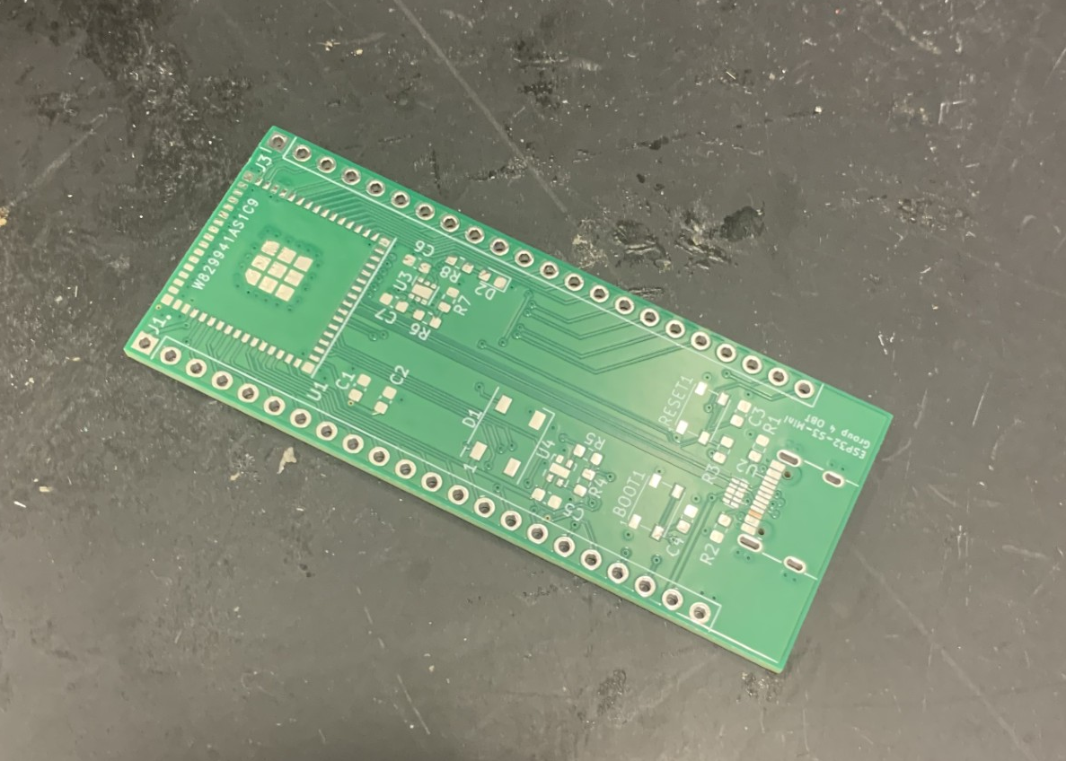
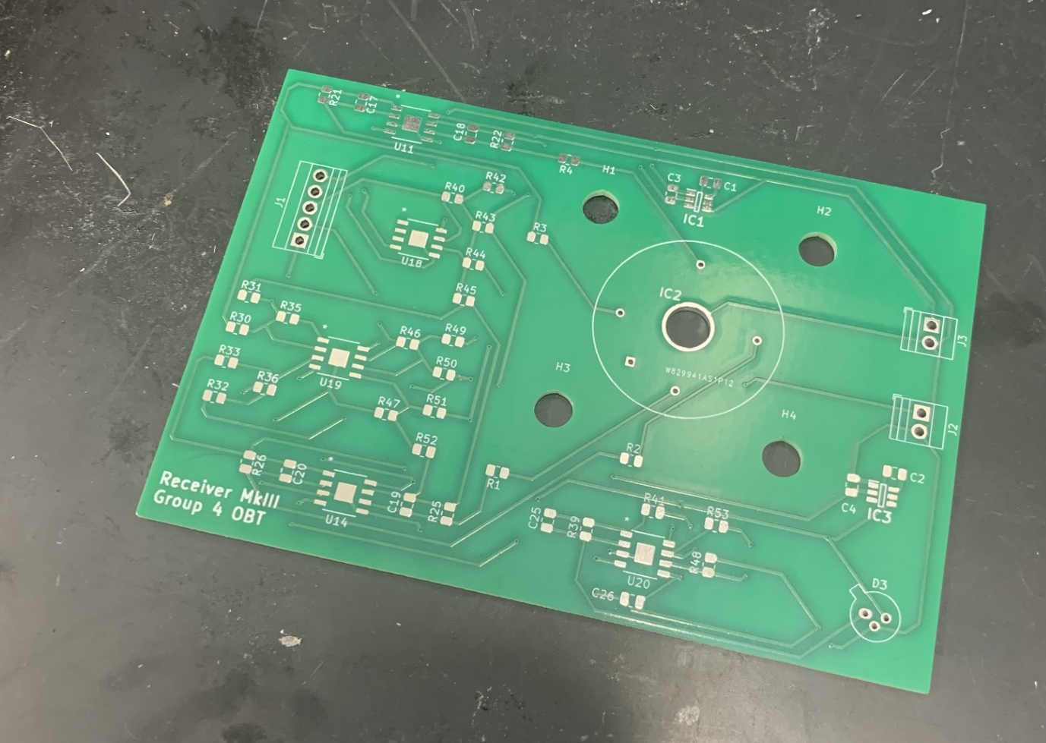
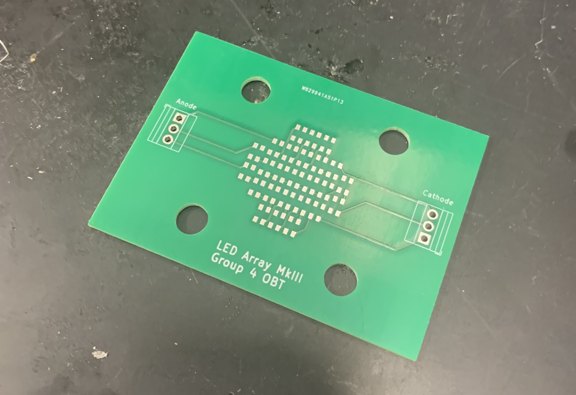
PCB
MCU PCB
Receiver PCB
LED array PCB

Slide 19
Software selection and design

Slide 20
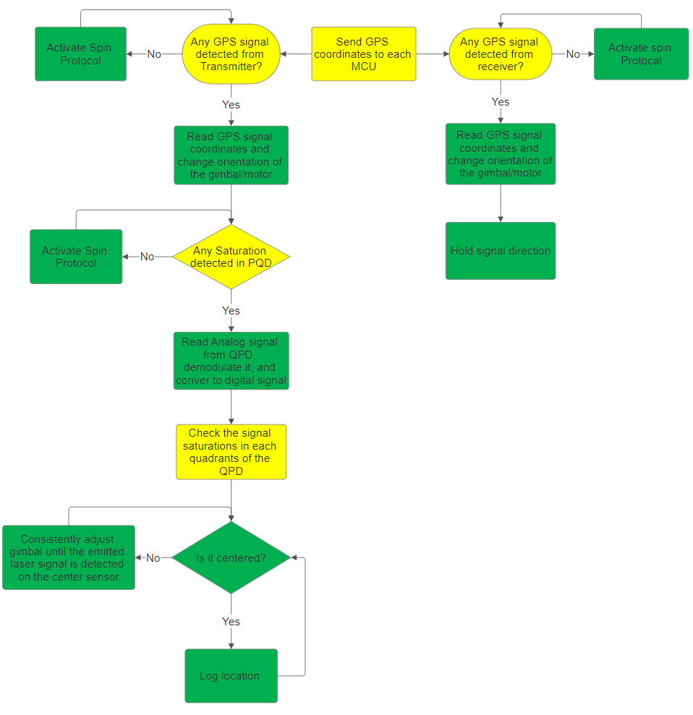
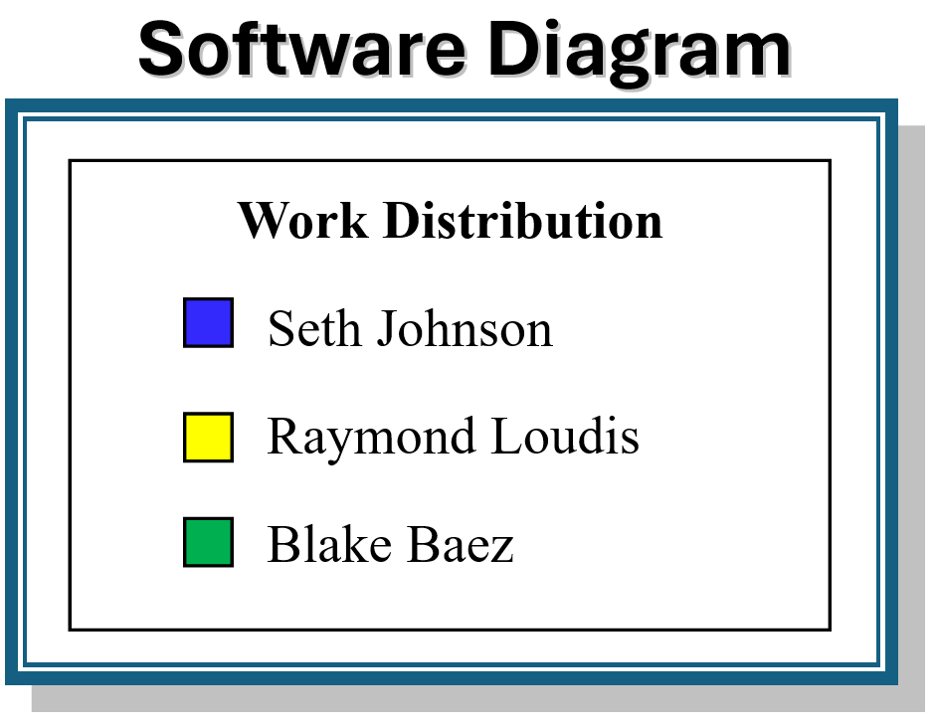
Software Diagram

Slide 21
Programming Language
 | C | Java | Python | C++
Imperative procedural language | Yes | No | No | No
Embedded Systems support | Great support. Nearly all microcontrollers can use c | Second most used language. Needs proper setup to communicate with hardware | Very little outside Raspberry Pi | Very little
Performance | High | Slower than c due to JVM | Slow | High
Memory Control | Low-level | Automated | Automated | Low-level
We chose C for its versatility, great amount of support, low-level memory control, and high performance. All these aspects are very important for a soft RTS system.

Slide 22
Key Concepts in Algorithms and Systems Control
Search Algorithm
For finding any signal
Alignment Algorithm
For establishing a signal from the laser diode
Control Theory
Signal Processing

Slide 23
Alignment Algorithm
Conical Alignment: involves adjusting the alignment of two systems or components by rotating one of them around an axis in a conical pattern until optimal alignment is achieved.
Radial Alignment: involves moving or adjusting the alignment of a system radially outward or inward from a central point, typically along straight lines in different directions
We are using conical alignment for this project because of its efficiency and likelihood of evenly saturating multiple quadrants of the QPD at once is unlikely. Detecting current from one quadrant and narrowing in the tilt and pan motors at the same time.

Slide 24
Alignment Algorithm
 | Conical | Radial
Adjustment | continuous circular motion allows for small, precise adjustments | radial alignment only covers specific directions, potentially missing the best alignment
Complexity | Can be complex depending | Simple
Coverage | Covers a wide area (all angles) | Limited

Slide 25
Search Algorithm
Golden Section Search: Starts with an interval and evaluates the function at two points within the interval, spaced according to the golden ratio; then shrink the interval to discard the suboptimal side.
Spiral Search: Searches for the optimum by moving in an outward or inward spiral pattern from a central point.
 | Golden Section Search | Spiral Search
Efficiency | Very efficient; uses golden ratio to minimize the number of function evaluations | Inefficient for precis searches in a 3D plane; it can require many function evaluations
Convergence Guarantee | guarantees convergence to the minimum for unimodal functions. | no guaranteed convergence to a minimum
Complexity | Not very complex (in a 2D plane) | Can be computationally expensive

Slide 26
Search Algorithm
The golden section search turned out to be less efficient and not accurate enough for this project.
The spiral search is efficient enough while also being more precise and can make up for the inaccuracies of the IMU and GPS we are using. The GPS can be off by 3 meters or sometimes more and the imu azimuth can be off my 20 degrees for various reasons. An efficient and accurate search that’s easy to implement is our choice.

Slide 27
Control Theory
Kalman Filter: a mathematical algorithm used to estimate the state of a dynamic system from noisy measurements.
It was used to combine GPS and IMU data to estimate position better. It specifically allows the tracker and gimbal to track each other without using a search algorithm to search for a signal in a wide range.

Slide 28
Signal Processing
Singal processing was used to make up for the shortcoming in the modules that were purchased as backups in this project.
The IMU needed smoothing signals, a library implemented to allegedly help noise, and refining the data coming in to eliminate IMU drift. Calibration is an important part in this.

Slide 29
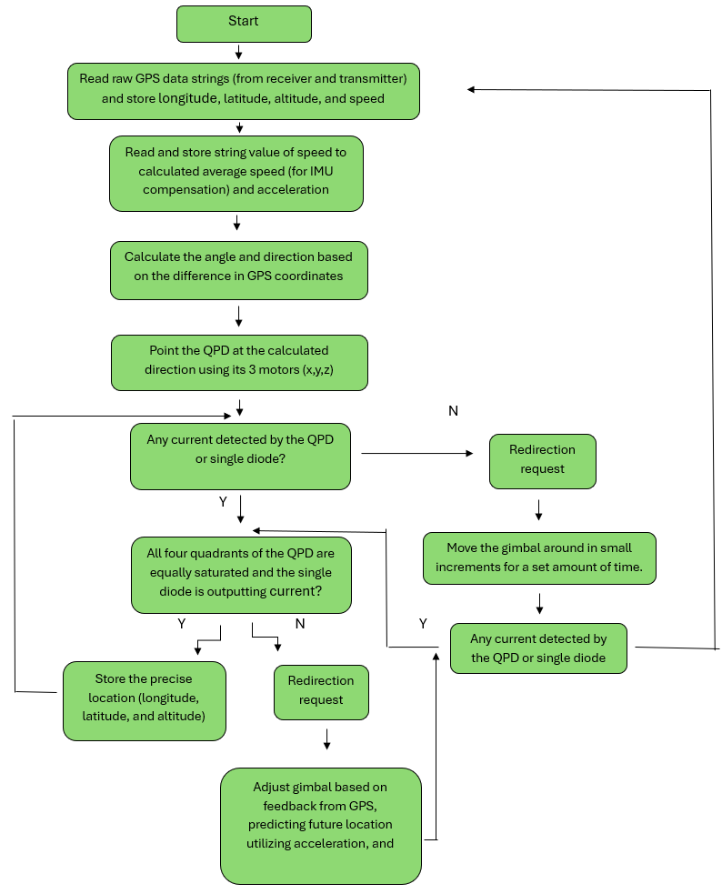
Receiver sequence diagram

Slide 30
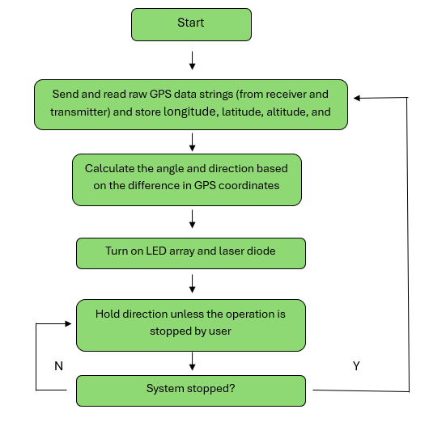
Transmitter sequence diagram

Slide 31
Graphic User Interface
All the necessary data that the user would want to see will be displayed on a GUI.
Such things include the azimuth and gps coordinates of the transmitter and receiver.
The GUI also allows to start and stop the program whenever they please and wherever, if they are connected to the same local internet.

Slide 32
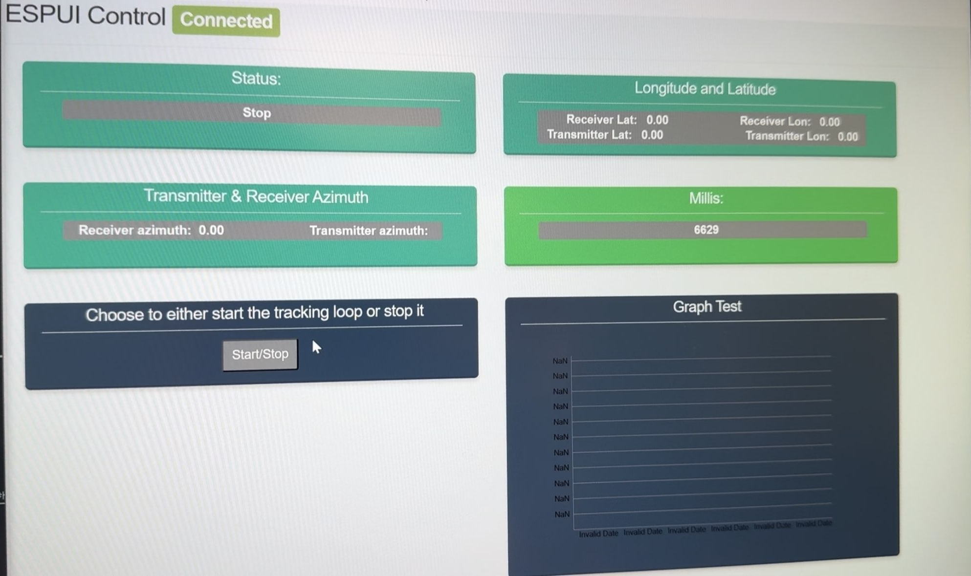
Graphic User Interface

Slide 33
Budget
Our budget is supplied by our sponsor, the KVL group. A few items, such as our motors, were paid for out of pocket

Slide 34
Expenses (as of 11/20/2024)
Item | Quantity | Unit Cost | Total Cost | Acquisition Status
SFH 4258S 850nm LED | 25 | $1.10 | $27.5 | Acquired
CVLL 95-350 1550nm LD | 1 | $254 | $254 | Acquired
SPOT-9D-0 Annular QPD | 1 | $345 | $345 | Acquired
FGA015 InGaAs PD | 1 | $64 | $64 | Acquired
NIR coated Optical Lenses | 5 | $43* | $172 | Acquired
High Grit Optical Diffuser | 1 | $17 | $17 | Acquired
87-040 Dichroic Mirror | 1 | $176 | $176 | Acquired
#84-790 850nm optical filter | 1 | $263 | $263 | Acquired
#65-779 1550nm optical filter | 1 | $89 | $89 | Acquired
Gps-gmv2 | 2 | $6 | $12 | Acquired
LoRa Module | 2 | $7.50 | $15 | Acquired
IMU Module | 2 | $7 | $14 | Acquired
Tattu Batteries | 2 | $405 | $810 | Acquired
All system PCBs | 5 | $60 | $300 | Acquired
PCB components | N/A |  | $270 | Acquired
Cost to Date |  |  | $2768.5
*Average Cost

Slide 35
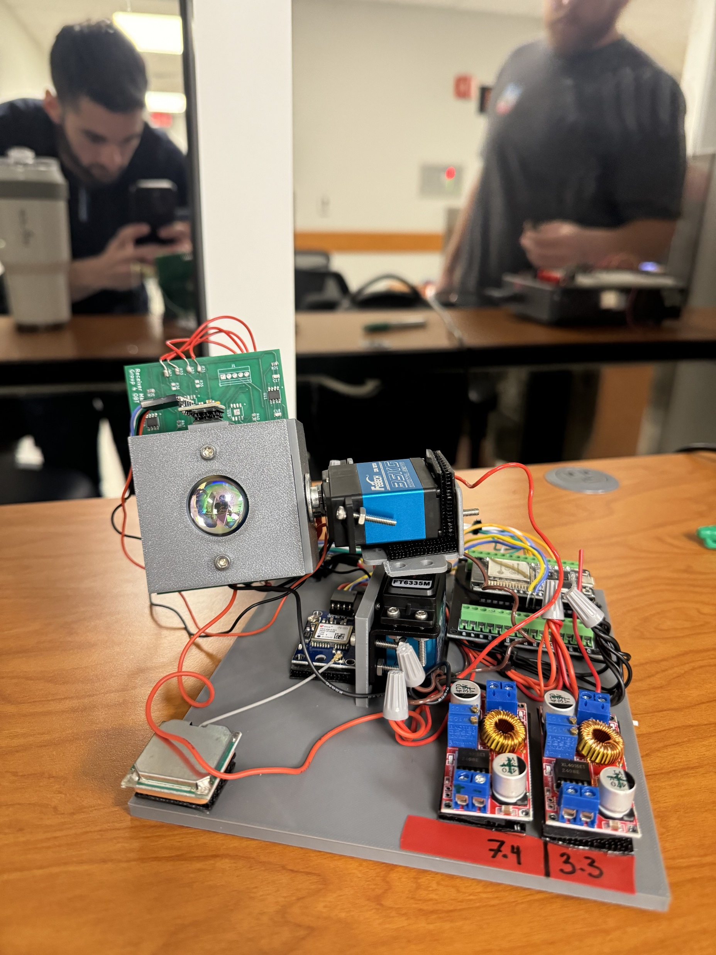
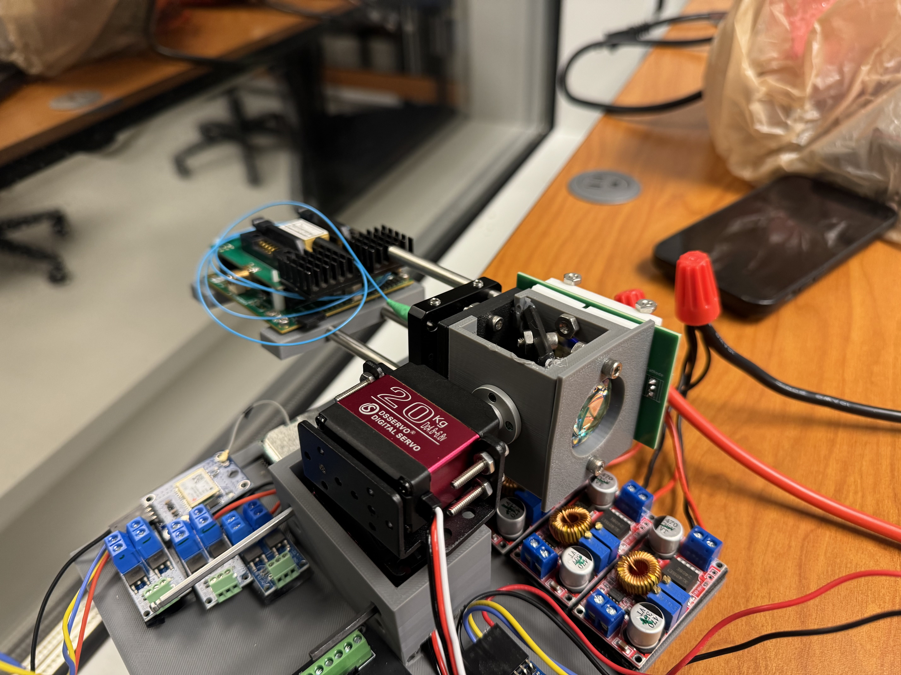
Assembled prototypes
Receiver Prototype
Beacon Prototype

Slide 36
Work distribution
Seth Johnson
Optical design
Optoelectronic hardware selection
Physically assembling the beacon and receiver with Raymond
Blake Baez
Software design
MCU and GPS selection
Designing and maintaining the website
Raymond Loudis
Electrical/PCB design
Electrical hardware selection
Physically assembling the beacon and receiver with Seth

