Slide 1

SmartStride:
Automated Wheelchair Navigation
A Wheelchair with Powerful Self-Guiding and More

Slide 2




The Team Behind the Chair
Matthew Itskovich
CPE
Arturo Lara
CPE
Adam Lilly
EE
Evan Rees
CPE

Slide 3
01
Project Background
What drove us to choose this project

Slide 4
Motivation and Problems
Easier Movement
Safety
Make it far easier to for users to move either wirelessly or autonomously
Can prevent the injury with object detection, auto-braking, navigation
Generic Application
Autonomous Operation
Since we are utilizing a wheelchair’s built in control connectivity, we can apply this to other wheelchairs in the future
With short-staffed medical settings, non-critical patients can be transported autonomously and safely

Slide 5
Basic Goals/Objectives
Recognition
Control
Auto Forward
Install a Kinect V2 and other sensors that will collect data and allow for spacial awareness, then move forward
Implement object detection and automatically brake and prompt the user
Allow for a user or guardian to wirelessly control the chair and interrupt the driving program

Slide 6
Stretch Goals/Objectives
Self Driving
Object Avoidance
Show Mapping
Using mapping and object detection, we can drive the wheelchair to a location in space
Allow for a user to see the 3D map generated on the Display and select a location
Implement object detection and automatically navigate around the object

Slide 7
02
Engineering
Specifications
Electrical, Software, and System Requirements

Slide 8
Requirement Specifications
Component | Parameter | Design Specification
Sensor Unit | Range | 1 - 5m
Motors | Load Capacity | Average American(200lbs)
Main Logic Unit | Response Time | <1 second
Battery | Power On Time | 3 - 4 Hours of Normal Use
Controller | Wireless Connectivity | Bluetooth or BLE/WIFI capable

Slide 9
Electrical Specifications
Component | Parameter | Specification | Name
Power Supply | 24 Volts | Power Components | 2x12v 20AH LA Batteries
Microcontroller | Wired and Wireless Connectivity | Control Chair and Sensors | Raspberry Pi 5
Motor | Torque required to move everything | Strength to move a 200lb person | MP3R Wheelchair (Provided by UCF)
Sensor | Optical, IR, and other detectors | Detect and determine distance | Kinect
DAC | Compatibility with Microcontroller | Controlling motors using digital to analog signal | MCP4728

Slide 10
Sensor Specifications
Sensor | Component | Operation Spec
Infrared | Kinect IR Sensor | 0.5-4.5m operation 70° FOV
Optical | Kinect RGB Camera | 1080p 30fps Camera
Sonar | HC-SRO4 | 2cm-400cm

Slide 11
03
Block Diagrams
Hardware and Software Connections

Slide 12
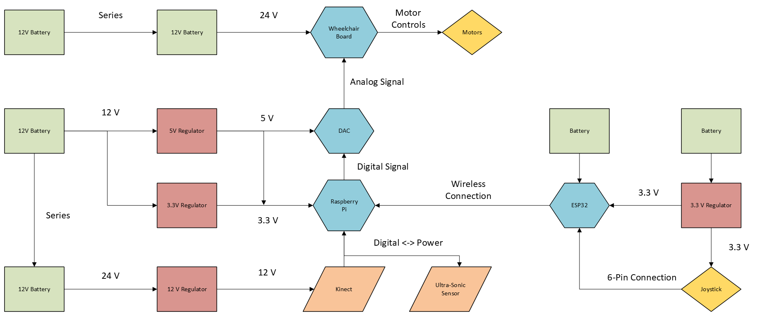
Hardware Block Diagram

Slide 13
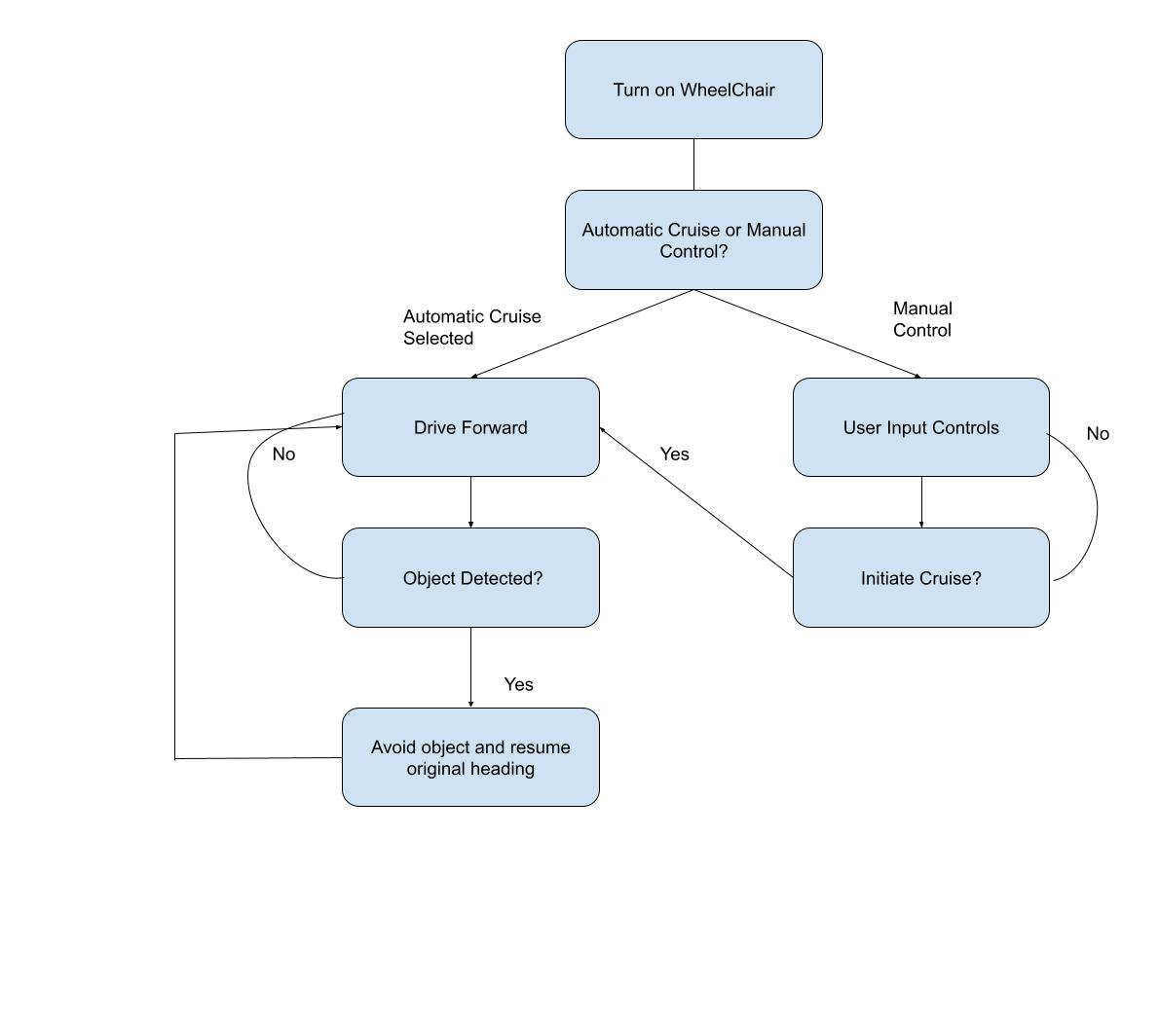
Software Block Diagram

Slide 14
04
Software Selection/Design
Languages and Libraries

Slide 15
Kinect Software
The Kinect is a proprietary Microsoft product but due to a large community of fan developers we have the support to use its many features
PyKinect2 is a public Python library that allows users to retrieve information from the Kinect to run their own programs
It is capable of collecting data from the optical camera, IR sensor and microphone and sending it to anyone’s personal computer
The values from this data will allow the autonomous functions of the chair to make decisions based on what the Kinect sees
Determining the distance from objects will indicate whether the route the chair is currently on is safe enough to continue or if something must be done for the user to reach their destination
The Raspberry Pi is capable of running PyKinect2 without any performance issues

Slide 16
Collaborative Database - Github
One of our objectives is to make sure that the project can help save money for those paying thousands in medical expenses
Github makes sharing the project’s code, including instructions on installations and previous builds, easily accessible to anyone interested in applying the project to their own chairs
Teammates are able to share their work without having to constantly send new versions for every single update
The licenses Github applies to our project allows us to protect the property to ensure that the project is as affordable as possible for other users

Slide 17
Coding Language Overview
The coding being worked on for this project will mainly be using C and Python libraries
Python, being a higher level language, will be used more so for the Pi’s Kinect functions and for running the autonomous mode including any mapping capabilities implemented to keep it running smoothly
C will be used primarily for the ESP32 and other functions that rely more on the hardware and lower level aspects of computing such as the DAC and motor controls
The languages used by each component that requires a computer is mainly determined by the libraries that are most useful

Slide 18
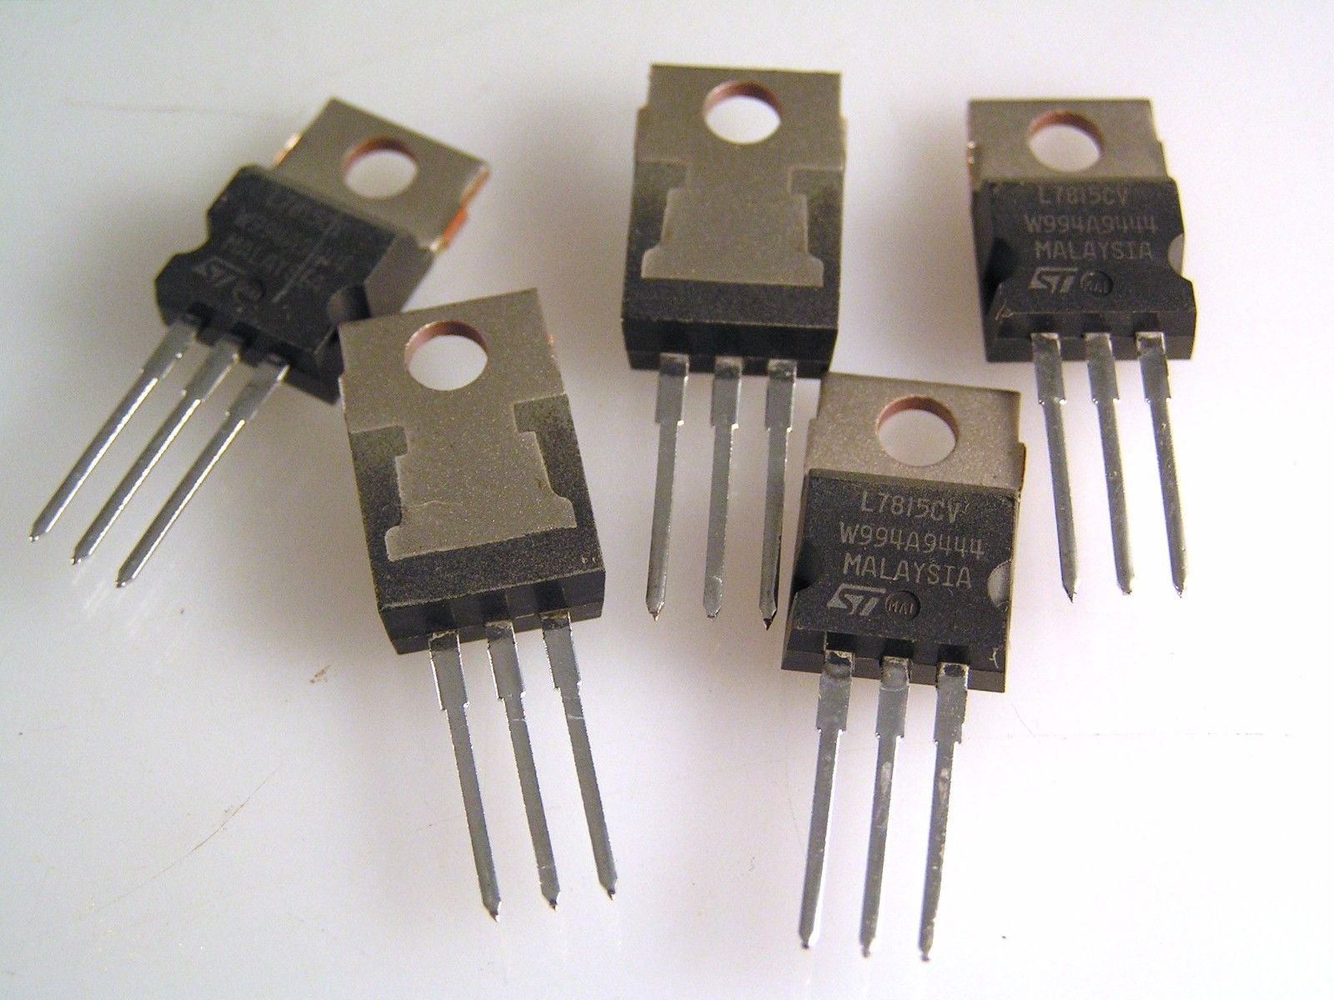
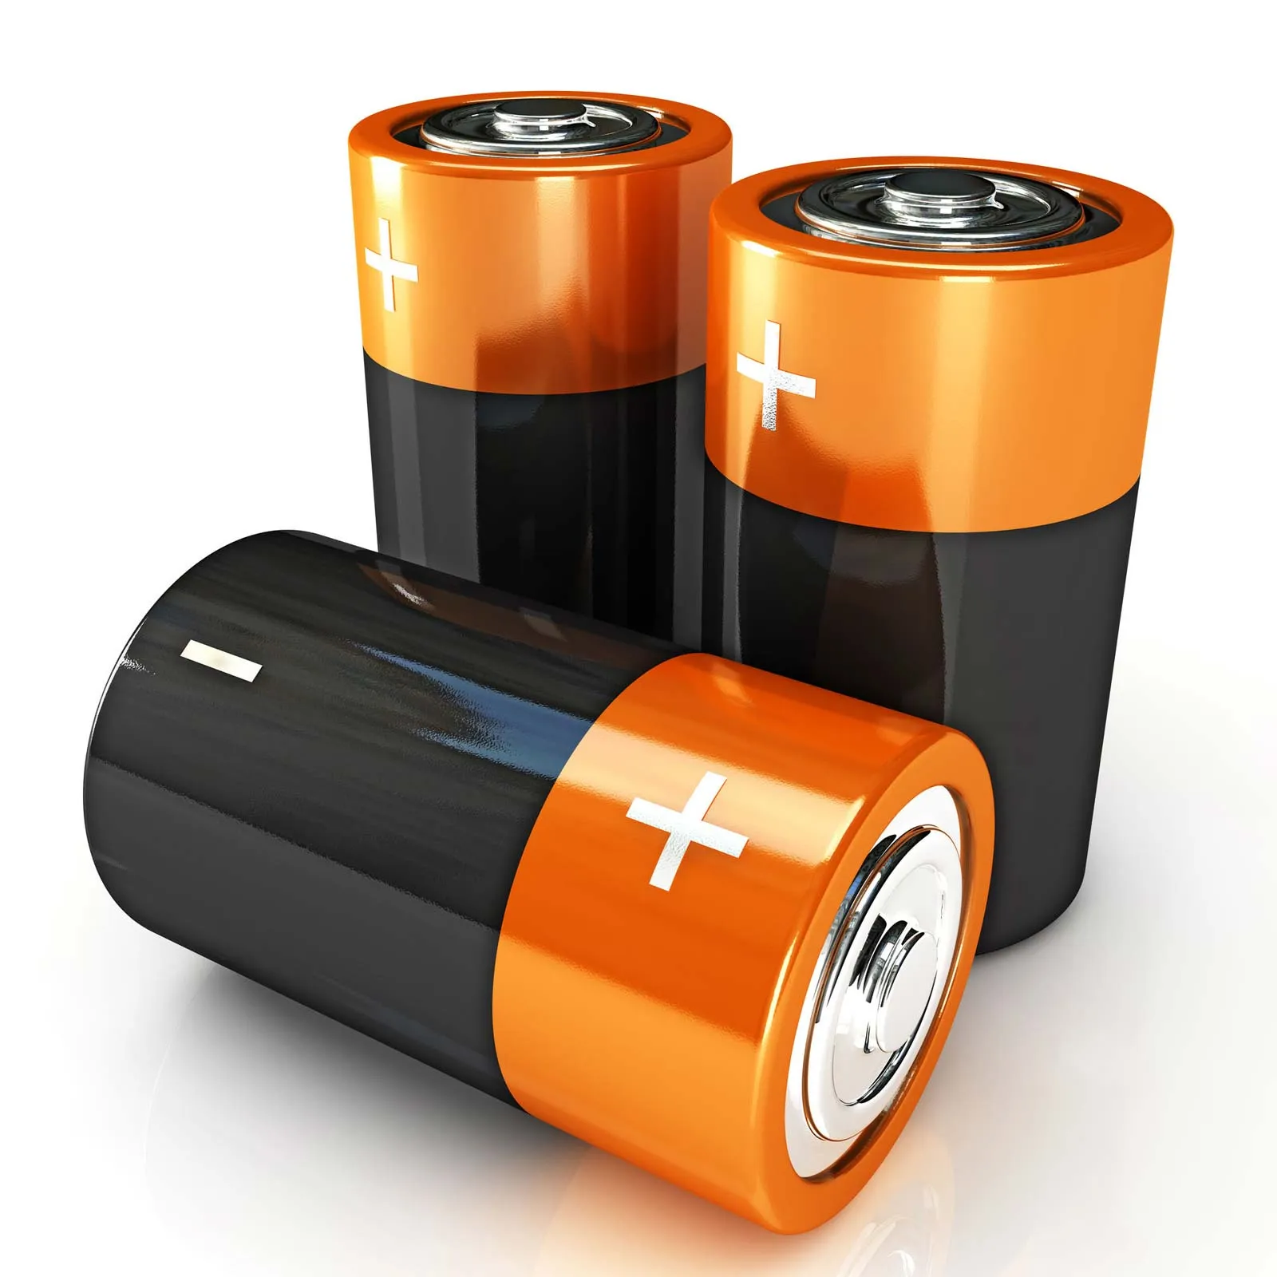
05
Core
Hardware
Hardware Components

Slide 19
Regulator Comparison 5V and 12V
Criteria | Buck Regulator | Boost Regulator | Buck-Boost Regulator
Average Cost | 3$ | 4$ | $5
Durability | High | High | Moderate to High
Operating Range | 3V to 20V | 5V to 30V | 3V to 30V
Type | Step Down Voltage | Step Up Voltage | Step Up-Down Voltage
Lifespan | 5 to 10 years | 5 to 10 years | 3 to 7 years
Maintenance | Minimal | Minimal | Minimal to Moderate
Buck boost provides the most versatility for our needs.
Buck-Boost provides good ranging input voltage.
Buck Boost offers greater flexibility for future design changes or expansions.

Slide 20
Regulator Chosen For 5V and 12V
Model | Price | Input Voltage Range | Operating Output current Range | Supplier
LM7805 | $1.43 | 0V to 35 V | 3A | Digikey
*LM 2679-ADJ* | $5.18 | 8V to 40 V | 5A | Digikey
LM 2940 | $1.94 | 6V to 26 V | 5 mA to 1A | Amazon
LM 2679 has 90% efficiency which is ideal
LM2679 has higher operating current range for bigger loads if needed, ie. single board computer and Kinect.
Much higher input range which makes it more usable for a wider range of batteries.

Slide 21
Battery Comparison
Criteria | Sealed Lead Acid | Gel Cell | Lithium Ion
Cost | $100 - $250+ | $120 - $300+ | $300 - $800
Lifespan | 2-4 years | 4-6 years | 8-15+years
Durability | Least Durable. | Intermediate | Most Durable
Operating Temp Range | -15 to 50 degrees celsius. | -20 to 50 degrees celsius | -20 to 60 degrees celsius.
Size and Weight | 38.6 pounds | 37 pounds | 10.62 - 15.5 pounds
Safety | Intermediate | Intermediate | Safest
Sealed Lead acid is the cheapest of all types.
Original wheelchair batteries were SLA.
SLA is not the most durable but good enough for our use cases and outdoor user operation.

Slide 22
Battery Chosen
Manufacturer | Model | Price | 12 V Battery Capacity | Supplier
*Mighty Max* | ML35-12 | $148.99 (2-pack) | 35 ah | Amazon
Duracell | SLI22NF | $109.99 (each) | 35 Ah | Batteries Plus
AJC | EB1255ONB | $90.19 (each) | 35 Ah | Battery Clerk
Mighty Max was the cheapest available option per battery.
On Amazon for fast shipping
Mighty Max is a Well known manufacturer

Slide 23
Sensor Comparison
Criteria | Kinect v2 | Lidar | Ultrasonic
Cost | ~$20 | ~$80-$150 | $2.50
Range | 0.5m to 4.5m | 0.1m to 8 m | 10cm to 450cm
Resolution | IR 512x424 pixels | 0.8cm | 0.3cm
Power Consumption | 32 Watts | 0.3 Watts | 0.1 Watts
FOV | 30 Degrees | 360 Degrees | 70 Degrees
Frequency | 60 hz | 6 hz | 100000 hz

Slide 24
Main Processor Comparison
Feature | x86 Mini PC (Dell 9020M) | Raspberry Pi 5 | Original Jetson Nano 4GB
Processor (CPU) | Intel Core i7-4785T (4-Core) | 2.4GHz Quad-core ARM Cortex-A76 | 1.43GHz Quad-core ARM A57
Graphics (GPU) | Intel HD Graphics 4600 | VideoCore VII (OpenGL) | 128-core Maxwell (CUDA)
Memory (RAM) | 8GB DDR3 | 8GB LPDDR4X | 4GB LPDDR4
Power Profile | Poor (~40-50W Load) | Excellent (~9.5W Load) | Excellent (5W / 10W Modes)
Cost & Availability | $0 (Owned) | ~$90 (Widely Available) | Discontinued (High used price)
Key Pros | • No upfront cost • Strong CPU | • Low cost & available • Huge ecosystem • Meets all project needs | • Strong GPU for its time • 4x USB 3.0 ports
Key Cons | • Very poor power efficiency • Extremely weak GPU | • Weaker GPU than Jetson • Nonstandard power input | • Outdated & hard to find • Slower CPU

Slide 25
Wireless Processing Unit
Criteria | ESP32 ESP-32S | Raspberry Pi Pico 2 W | Arduino Nano RP2040
Processor | 32-bit LX6 Dual Core microprocessor at 240MHz | Dual Cortex-M33 or Hazard3 processors at up to 150MHz | Raspberry Pi® RP2040 at 133MHz
Flash Memory | 4mb SPI flash memory | 4mb on board flash memory | 16MB Flash IC
ADC Channels | 16 ADC channels | 3 ADC channels | 8 ADC channels
DAC | two dedicated 8-bit DAC channels. | No dedicated DAC converter Can use PWM for rudimentary version | No Dedicated DAC but PWM is possible
Operating Voltage | Operating voltage of 3.0 - 3.6v | Operating voltage 1.0-3.3v | Operating Voltage of 3.3v

Slide 26
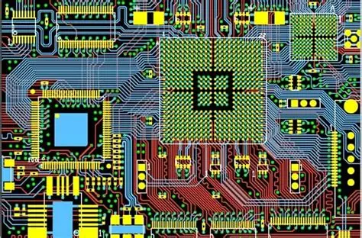
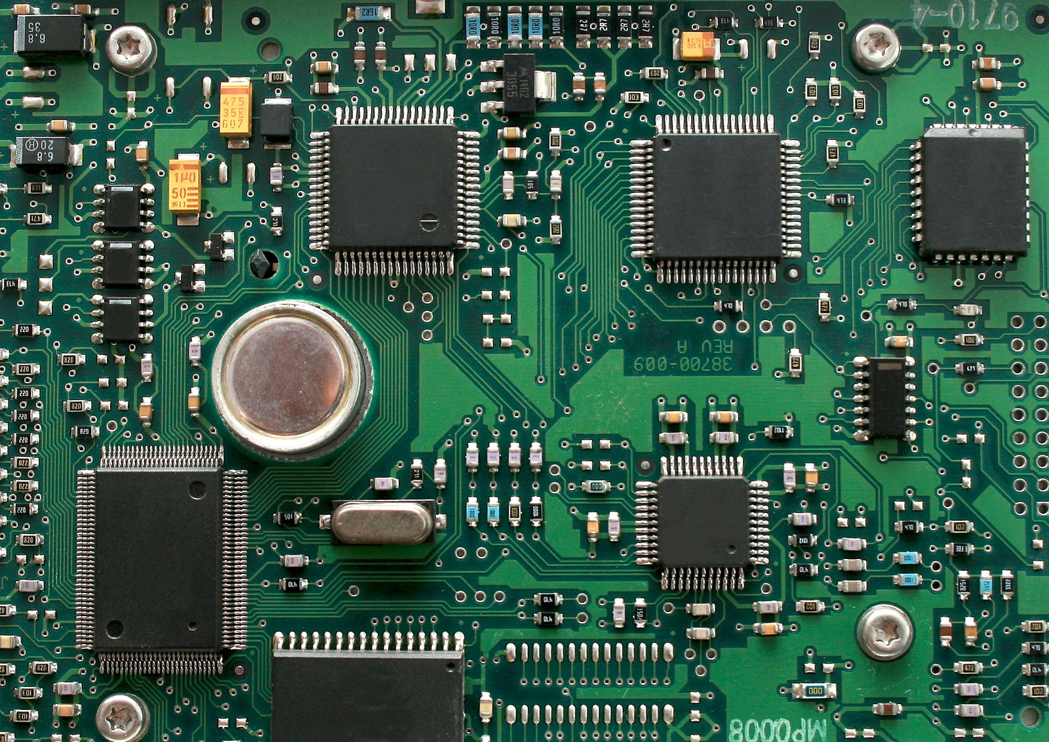
06
PCB
Designs
PCB Design and Explanation

Slide 27
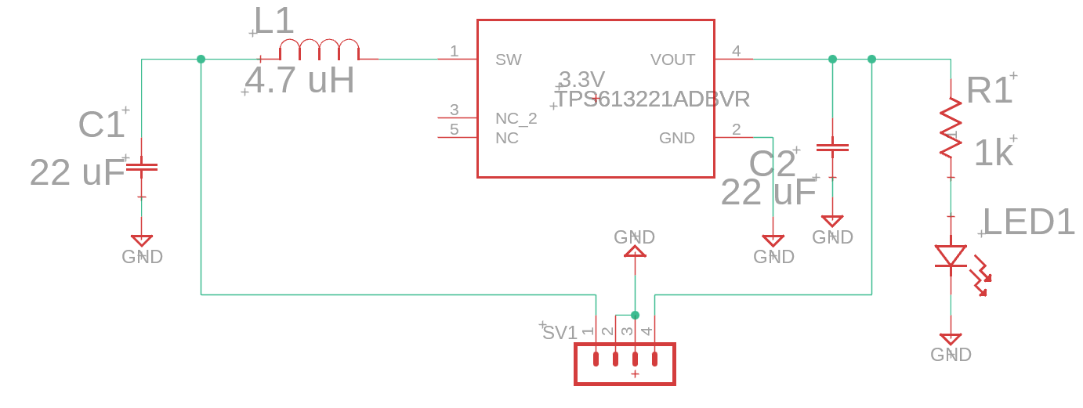
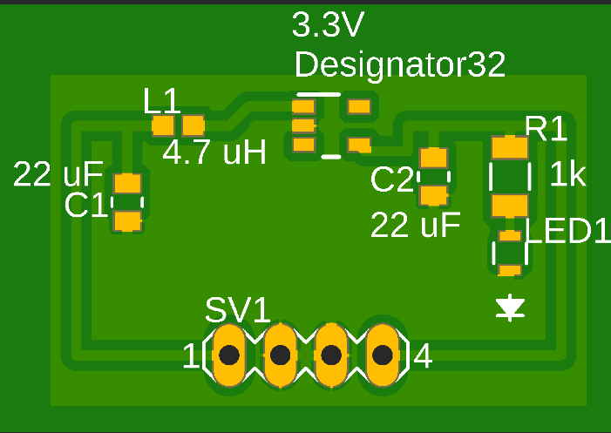
Regulators
3.3V
  TPS613221ADBVR Chip
  LED to verify power flow
  0.9V≤Vin≤5.5V
  Iout is generally 1.2 A

Slide 28
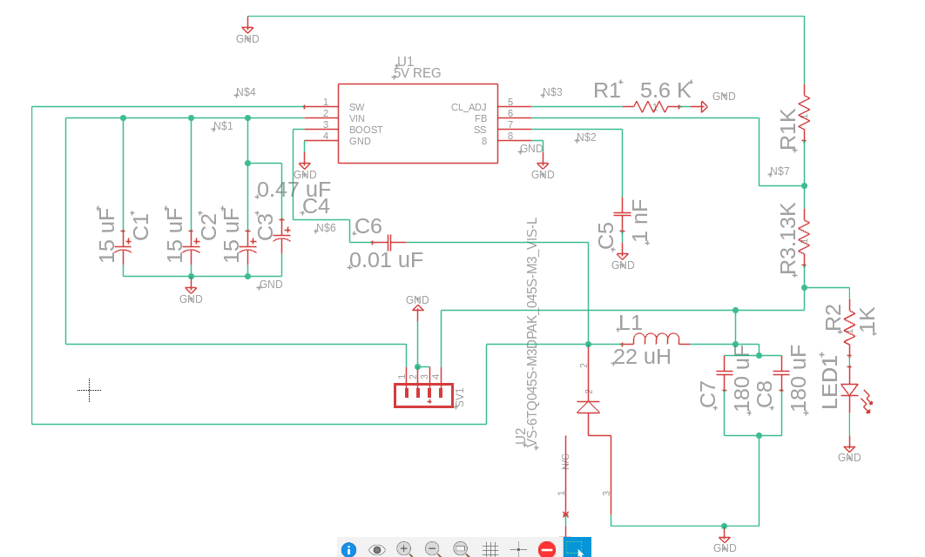
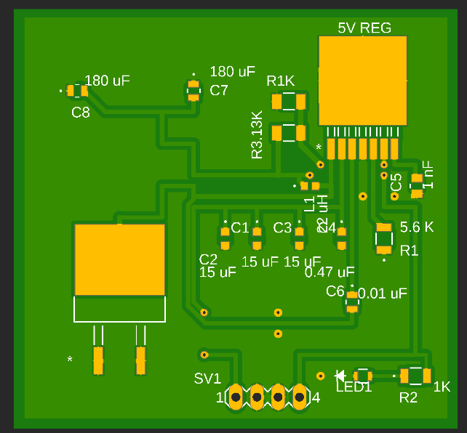
Regulators (Continued)
5V and 12V Regulator Designs
  LM2679ADJ
  8V ≤Vin≤ 40V
  Iout is generally 5A
  Only difference between the 5V and 12V regulator design is the feedback resistor connected to output header.

Slide 29
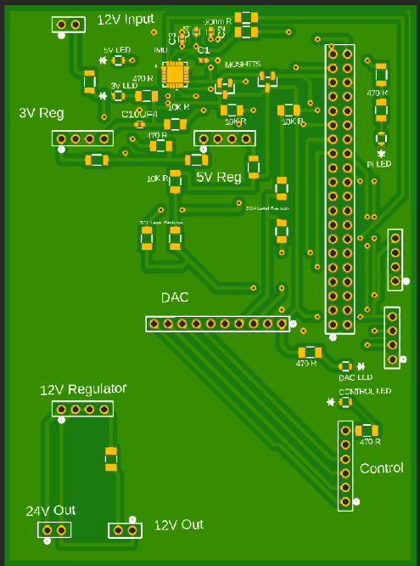
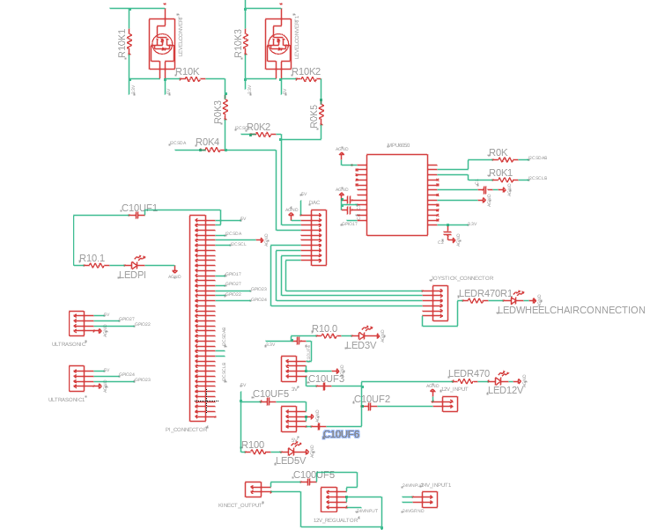
Pi to Wheelchair Schematic
Major Components
  MPU, 2 level converters, DAC, and PI,
  Regulators: 12V to 3.3V/5V regulators
  24V to 12V regulator for Kinect

Slide 30
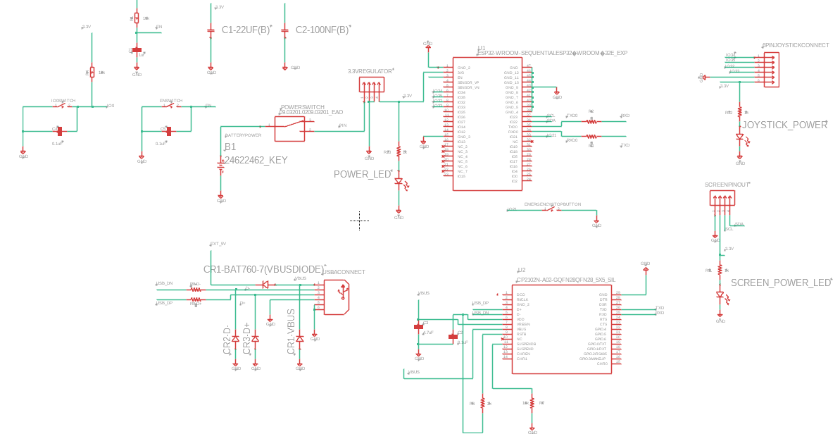
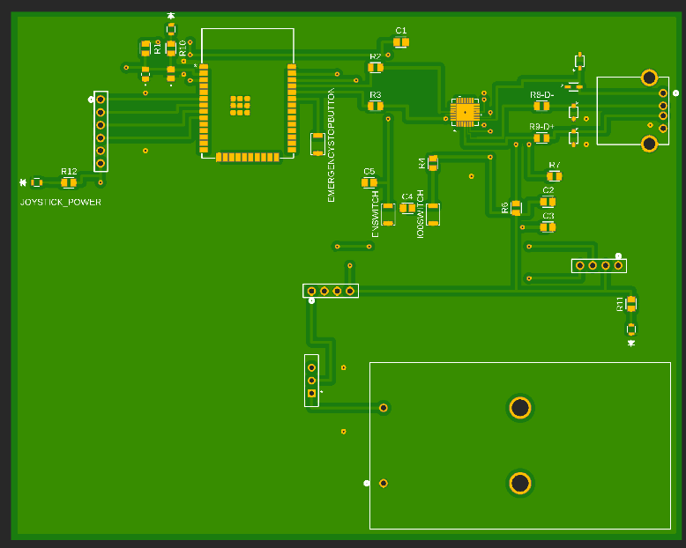
ESP32 Controller Schematic
Major Components
  USB to serial converter
  3.3V reg
  ESP32
  Joystick

Slide 31
07
Prototyping/
Testing
Main Progress of Current Design

Slide 32
Hardware Testing
A lot of the hardware relied on proper communication so testing the individual components compatibility was the first step in our design
The DAC was essential for the chair to be able to move at all and through testing we were able to have the DAC transfer data signals to the motors successfully
The Kinect was fully operation and is capable of determining distances and objects
The joystick and onboard circuitry was made compatible with our newer equipment
All microcontrollers were successful in communication amongst each other and other components on the chair

Slide 33
Kinect Software Testing
Despite being a commercial product the Kinect is pretty advanced and so all of its features need to be accessible for the chair to function properly
The Kinect Python library was fully capable of using the IR and optical cameras installed in the Kinect
Raspberry Pi is able to perform extremely well with the Kinect and store large enough amounts of data useful in autonomous programs
Objects and people are fully recognizable and the device was successful in determining distance
Maps were successfully generated by the Kinects optical sensors allowing the autonomous program to determine coordinates

Slide 34
Autonomous Software Testing
The autonomous program is currently under development and is undergoing testing to fix errors and improve efficiency
Chair can take basic directional commands successfully
The autonomous driving program can identify objects and people and is capable of following them
Program is having issues using coordinates to take complex directions and determine routes to destination
Mapping functions still need development
Wireless communication is also 100% successful

Slide 35
08
Admin
Content
Budgeting, Workload, Challenges, Oh My

Slide 36
Challenges & Problems
Non Typical Batteries
Limited Motor Sensing
Kinect v2 Data Throughput
Since the Wheelchair has the Motors self contained it is difficult to measure motor speed & total distance
This requires external rotation sensing to ensure precision
Despite using a high end SBC, we will encounter limitations on data throughput and processing
We are only sampling as often as required and moving non-real time tasks to a lower priority
Since we are utilizing different batteries than typically expected for our Wheelchair, electrically connecting and mounting needs to be addressed
We are utilizing a wooden base and bolting connectors

Slide 37
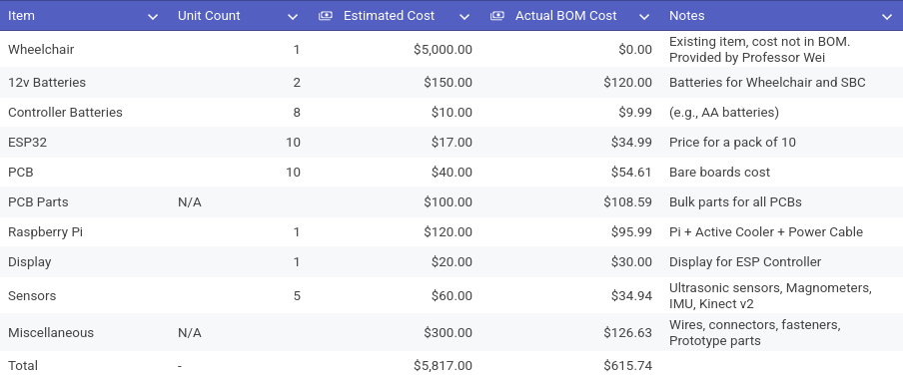
Bill Of Materials

Slide 38
Distribution of Labor
Adam Lilly
Matthew Itskovich
ESP32 Software Programming and Bluetooth Communication
Hardware and Software Debugging
ESP-32 Controller Design
BOM Verification and Ordering
Verify Connections Between Components and Systems
BOM Construction
Regulator PCB Design
Soldering PCBs and Verification
Wheelchair Hardware Modifications
Arturo Lara
Evan Rees
Website Design
3D/CAD Modelling
  Enclosures And Mounts
LCD Programming
Sensor Mounting
Mapping and Self Driving Programming
Pi Hat PCB Design
Pi to Wheelchair Communication Debugging and Prototyping
Coordinates, leads meetings, and Ensures meeting milestones

Slide 39
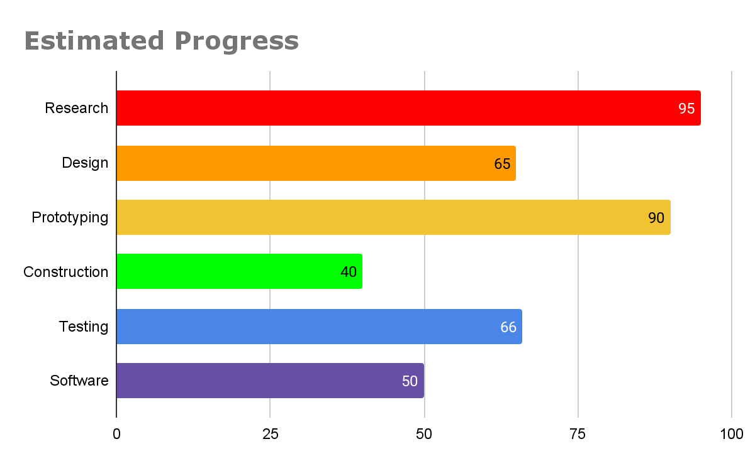
Progress Estimation

Slide 40
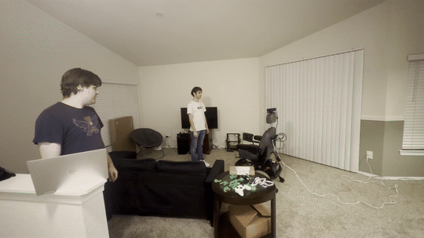
Next Steps
3D Model and Print Enclosures for the Controller and MCU
Unify Software for wireless control and usage
Solder and Assemble PCBs
Make the wheelchair more “smooth” in its operation
Test Hall Effect Magnetometer

